Slide 1



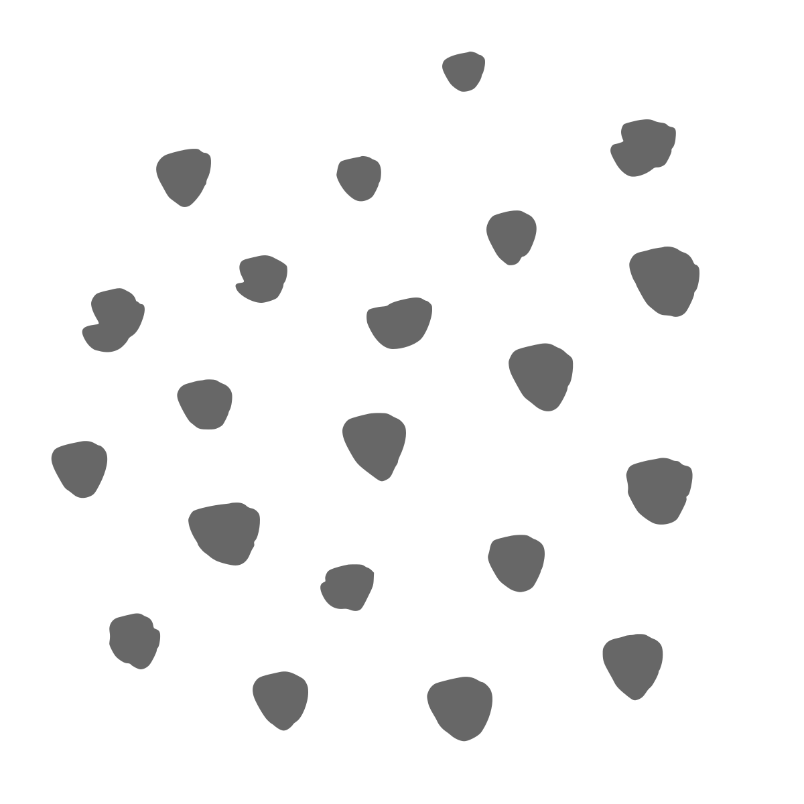



Mental Health and Wildfires f
Booklet D from the Understanding Health Impacts of Wildfires in Urban Areas series
Lead Authors: Savanna Carson, Katherine McNamara. For the complete list of authors, editors, and reviewers, see the website.

Slide 2

Mental health and wildfires
Agenda:
Quick overview
How fires affect mental health and groups most at risk
Potential community emotions after a fire
Fires affect mental health and well-being in many ways
How media can increase stress and recognizing what you need during recovery
How to: During a fire: What can I do to protect my mental health in the short term?
Review of key points
Series Note: This series addresses some of the health concerns from wildfires that reach urban areas. These fires are also called Wildland-Urban Interface (WUI) fires. Since the general public may not use the term WUI, we use “wildfires that reach urban areas” or, more briefly, “fires” to refer to large, catastrophic fires that may also burn buildings, cars, and other non-natural sources.
Key point!
Look for these “Key points” throughout this handout for the most important summaries.
Notes:
• Preview the session: mental health effects, who may need extra support, why recovery is not linear, how media and uncertainty affect stress, and practical coping strategies.
• Clarify that this is education, not group therapy, and participants should use the resource slides for professional or crisis support.
• Invite people to participate at their own comfort level.

Slide 3
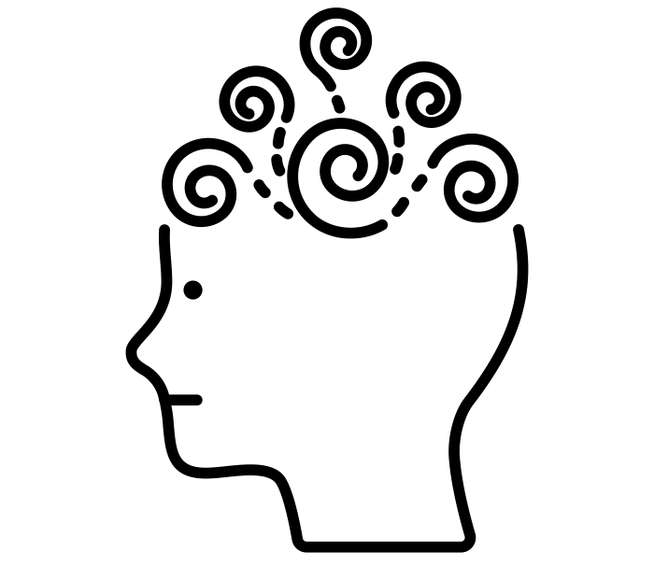
Do fires affect mental health?
Yes. Fire survivors have reported increased mental health-related impacts and/or mental health symptoms (with asterisks*), and more medical visits for these concerns, including:
PTSD, or post-traumatic stress disorder, which can include nightmares*, flashbacks*, irritability/anger*, negative thoughts*, avoidance* Anxiety, worrying*, panic attacks* Depression, sadness*, hopelessness* Insomnia*, poor sleep*, or exhaustion* | Substance Use*: alcohol, smoking, weed Environment- or community-related distress, over-fixating on big unknowns with limited control* Suicidality: self-harm* Other: inability to concentrate*, body tension*, over- or under-eating*
Children or adolescents may also experience: Behavior or adjustment issues, including irritability, anger, or regression Disruption of family support, family stress, or changes Learning issues, trouble learning, concentration, or delayed language development Children may also lack the skills to express or communicate their emotions
Additionally: People can respond to wildfires in many different ways. Some emotions or reactions appear right away, while others appear later. Long-term, repeated exposure to wildfire smoke may also raise the risk of dementia in older adults and other brain conditions.
Key point!
It’s important to recognize that mental health changes may show up in may ways.
1. To P, et al. The impact of wildfires on mental health: a scoping review. Behavioral Sciences. 2021. 2. Jung YS, et al. Fine particulate matter from 2020 California wildfires and mental health–related emergency department visits. JAMA Network Open. 2025. 3. Casey JA, et al. The 2025 Los Angeles Wildfires and Outpatient Acute Healthcare Utilization. medRxiv. 2025 4. Elser H, et al. Wildfire smoke exposure and incident dementia. JAMA Neurology. 2025 5. Adu Mk et al. Children’s psychological reactions to wildfires: a review of recent literature. Current Psychiatry Reports. 2023. 6. Heanoy EZ, et al. Impact of natural disasters on mental health: Evidence and implications. In Healthcare 2024. 7. Li A, et al. Vulnerability and recovery: long-term mental and physical health trajectories following climate-related disasters. Social Science & Medicine. 2023
3
Notes:
• Mental health changes can include symptoms without a formal diagnosis. People may have sleep problems, irritability, sadness, worry, trouble concentrating, or changes in eating.
• Children may show distress through behavior, regression, anger, learning problems, or difficulty expressing feelings.
• Reactions may appear immediately or much later, so continue checking in over time.
Discussion: Have your community felt any symptoms from recent wildfires or large fires?

Slide 4
Who is most at risk for the mental health effects of fires?
Anyone can experience mental health impacts even if they were not directly in the fire zone. Some people may need extra support or face more impacts, especially:
People with direct loss, exposure, or injuries: Lost homes, loved ones, housing changes, or health changes.
People with previous Health Issues: People already sick or dealing with mental health challenges.
People with past traumas (or previous fires)
Racial or ethnic minorities: People facing barriers in access to resources and care, economic barriers, and higher exposures or impacts.
People with fewer resources, including unstable housing, job loss, limited transportation, or less access to services.
Workers, such as firefighters, cleanup crews, caretakers, therapists, or other helpers.
Women, youth (including children and adolescents), or older adults
People in several of these groups may face increased stress and barriers to support.
Discussion: Have you ever felt any mental health changes during smoke events from wildfires or fires? Who in your family or community is more vulnerable to mental health health effects of fire smoke?
1. To P, et al. The impact of wildfires on mental health: a scoping review. Behavioral Sciences. 2021. 2. Jung YS, et al. Fine particulate matter from 2020 California wildfires and mental health–related emergency department visits. JAMA Network Open. 2025. 3. Casey JA, et al. The 2025 Los Angeles Wildfires and Outpatient Acute Healthcare Utilization. medRxiv. 2025 4. Elser H, et al. Wildfire smoke exposure and incident dementia. JAMA Neurology. 2025 5. Adu Mk et al. Children’s psychological reactions to wildfires: a review of recent literature. Current Psychiatry Reports. 2023. 6. Heanoy EZ, et al. Impact of natural disasters on mental health: Evidence and implications. In Healthcare 2024. 7. Li A, et al. Vulnerability and recovery: long-term mental and physical health trajectories following climate-related disasters. Social Science & Medicine. 2023
4
Notes:
• Anyone can be affected, including people outside the burn zone.
• Risk tends to be higher with direct loss, prior trauma or health conditions, fewer resources, repeated stressors, or work that involves supporting others.
• Several risk factors can overlap, increasing both distress and barriers to care.
Discussion: Has your community felt any symptoms from recent wildfires or large fires?

Slide 5
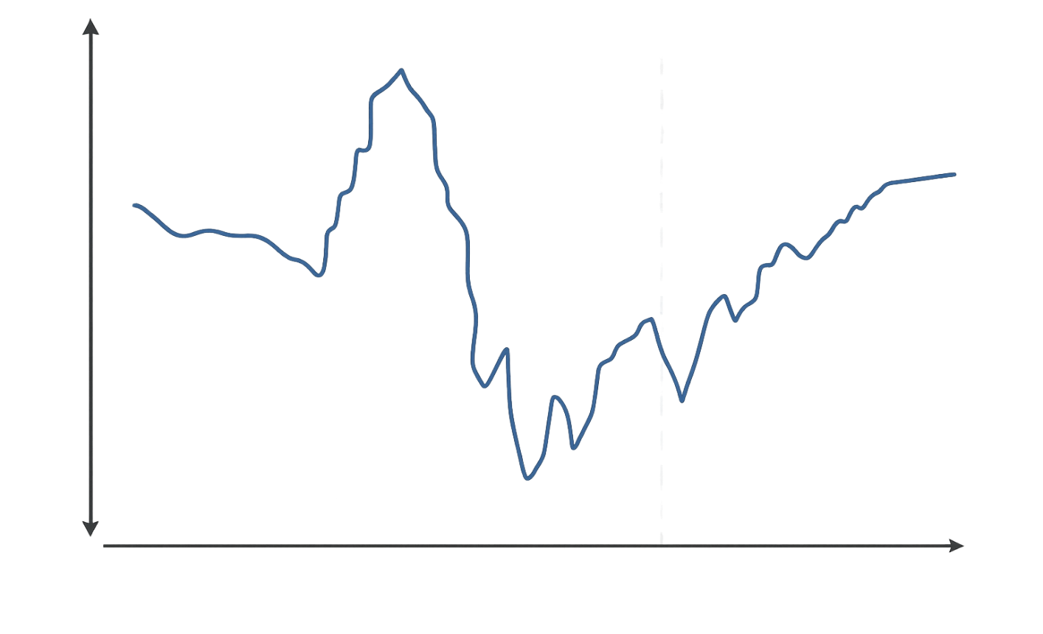
Community emotions after a fire
The figure below illustrates potential emotional highs and lows within the community following a disaster, such as a large fire. This may not exactly match an individual’s emotional journey, but it serves as an example of common community-wide emotional fluctuations.
“We’re in this together”
(Community cohesion)
What may be helpful to understand from this figure:
Recovery is not a straight line. People and communities may feel strong, exhausted, discouraged, and hopeful at different points; expect ups and downs long after the disaster. Emotional recovery is an ongoing, long-term journey.
Emotions and timelines can vary widely across people, losses, and situations.
Secondary stressors (related to living life, such as housing impacts) can create high levels of continuing stress and effort in emotional adjustment.
Fire anniversaries, smoky days, evacuation alerts, insurance deadlines, rebuilding delays, or other triggers can bring feelings back.
Additional stressors and factors can compound. Examples:
  A child losing their home and their school
  A person may be dealing with wildfire damage, housing problems, insurance claims, family illness, and another fire season approaching… plus more.
Emotional Highs
Adrenaline Rush
A New Beginning or New Normal
Pre-Fire
Reality Check (Disillusionment)
Fire Event
(Survival mode)
Setback(s)
One year and anniversary Reactions
Emotional Lows
Warning
Threat
Inventory
Trigger Events
Grief and coping
Time
Key point:
It is normal for emotions to fluctuate, or constantly change, long after the disaster. Mental health recovery is often a long-term process.
Adapted from Zunin & Myers ‘Six stages of psychological response to a disaster’ as cited in Training Manual for Mental Health and Human Service Workers in Major Disasters, U.S. Department of Health and Human Services (2000)
Notes:
• Use this figure as a community-level example, not a fixed path for every survivor.
• Recovery is not linear. Anniversaries, insurance deadlines, rebuilding delays, smoke, and evacuation warnings can reactivate distress.
• Some people never experience a honeymoon period because loss and secondary stressors begin immediately.

Slide 6
Fires affect mental health and well-being in many ways
Wildfires can significantly affect many aspects of life, affecting people’s environment, relationships, finances, sense of normalcy, well-being, and mental health (see figure below).
Additionally, fire smoke may also impact brain health. Exposure to smoke can allow toxic particles to enter the body, resulting in increased toxic stress and inflammation. Some of these small particles may even reach the brain, potentially causing damage with repeated or long-term exposure and affecting brain and mental health.
How fires can affect mental health and well-being in many ways
Ecological (physical, natural surroundings):
Loss of nature and disaster damage. Smoke events and the changing ability to go outside safely.
Living and working conditions:
Evacuation, housing stability, and safety. Changes in school or employment.
Social, health, & community:
Community or family losses, stress, or isolation. Changes in routines, recreation, social dynamics, social networks, and connections. Too much or too little communication including media exposure.
Individual:
Sleeping problems, food insecurity, changes in physical activity, or other lifestyle factors. Dealing with insurance challenges after a fire. Potential health or mental health issues resulting from smoke or trauma.
Key point:
Fires can cause significant losses, constant changes for those affected, and community disruptions that impact mental health. Additionally, smoke exposure may have adverse effects on the brain and mental well-being!
Figure Modified from: Eisenman DP, et al The mental health and well-being effects of wildfire smoke: a scoping review. BMC public health. 2022 Dec 5;22(1):2274. With additions from: To P, et al. The impact of wildfires on mental health: a scoping review. Behavioral Sciences. 2021 Sep 21;11(9):126.
Notes:
• Fires affect mental health through many pathways: the physical environment, housing and work, social connections, finances, routines, and health concerns.
• These stressors can stack. A person may be managing displacement, school changes, insurance, caregiving, and employment at the same time.
• Smoke may also contribute to brain and body inflammation, although long-term effects are still being studied.

Slide 7
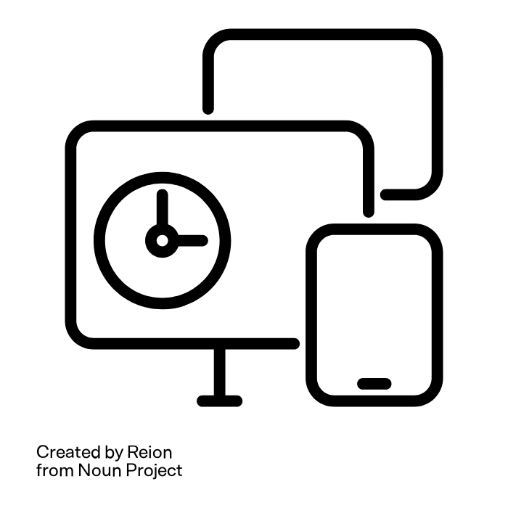

Can news and social media increase stress?
Yes. Too much news, social media, or repeated disaster footage can increase stress after disasters.
Studies have shown that the more hours of media exposure (screens, news, podcasts, radio, social media, etc.), the more stress symptoms people have. Stress is worse when information is conflicting or confusing.
This is particularly true for children.
To minimize confusion, limit media use, rely on trusted sources, and actively discuss with loved ones.
More Media Time Equals More Stress
Media
Stress
Key point:
To minimize stress and confusion, limit media use after obtaining essential information, rely on trusted news sources, and actively discuss, debrief, and decompress with loved ones to build connection. Limit children’s media exposure to reduce their stress.
Holman, et al. Media exposure to collective trauma, mental health, and functioning: does it matter what you see?. Clinical Psychological Science. 2020 Jan;8(1):111-24.
Garfin, et al. The Collective Trauma and Chronic Stress of COVID-19. The Social Science of the COVID-19 Pandemic: A Call to Action for Researchers. 2023 Dec 8:259.
Garfin, et al. It matters what you see: Graphic media images of war and terror may amplify distress. Proceedings of the National Academy of Sciences. 2024 Jul 16;121(29):e2318465121.
Garfin, et al. Media exposure, risk perceptions, and fear: Americans’ behavioral responses to the Ebola public health crisis. International Journal of Disaster Risk Reduction. 2022 Jul 1;77:103059.
Notes:
• Staying informed is necessary, especially for evacuation and safety updates, but repeated disaster footage and conflicting messages can increase distress.
• The goal is not to avoid all media. It is to get essential information from trusted sources, then step away and decompress.
• For children, adults should limit repeated exposure and explain what is known and unknown.

Slide 8
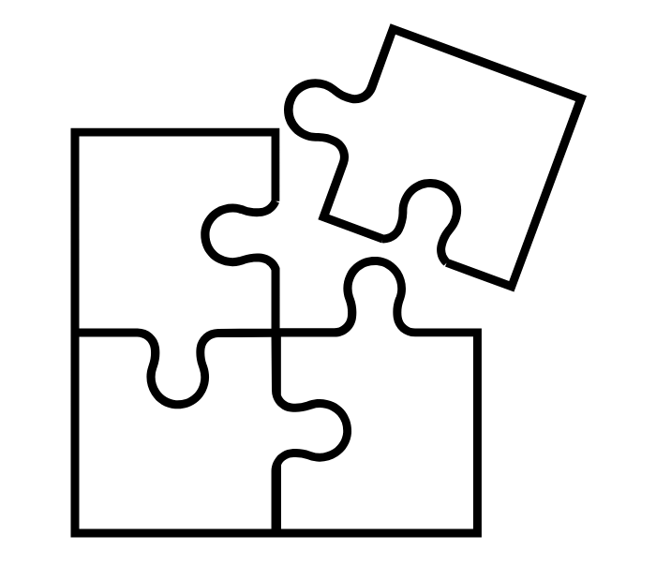
Recognize that your feelings and needs may differ from your surroundings
Many people feel pressure to “carry on” and “move on”
Media and daily life can move quickly
The continuing need to support oneself and family, pay for housing, healthcare, food, etc.
Different cultures, religions, or personalities may have customs that prioritize the needs of others over one's own.
Self-care may seem unimportant, selfish, or time-consuming, but it is critical to reduce burnout and maintain balance.
Affected by the fire
Those unaffected by the fire
Key point:
The media, daily life, and people who weren't affected may move on before you feel ready. Recovery from a disaster can take a long time. Notice what you are feeling, ask for what you need, and stay connected to supportive communities or resources (see page potential resources at the end of this slideshow).
Notes:
• People around you may appear to move on before you are ready, while practical demands continue.
• Self-care can feel selfish or impossible, especially for caregivers and helpers, but it protects against burnout.
• Encourage people to notice what they need and stay connected to communities that understand the experience.

Slide 9
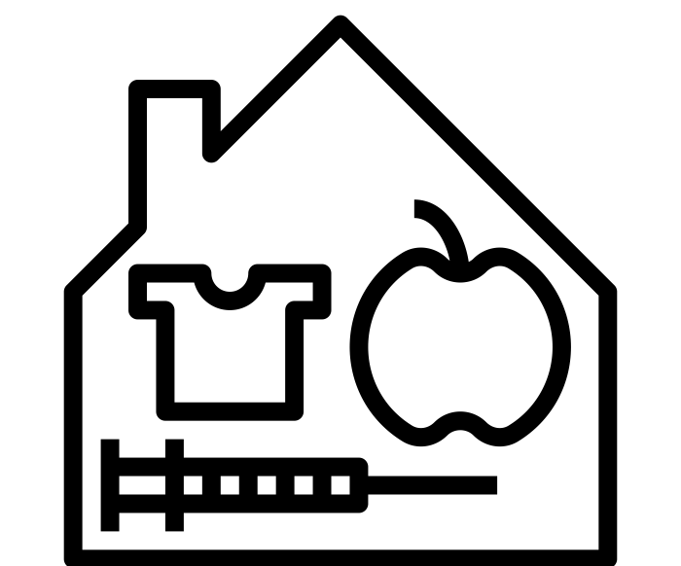
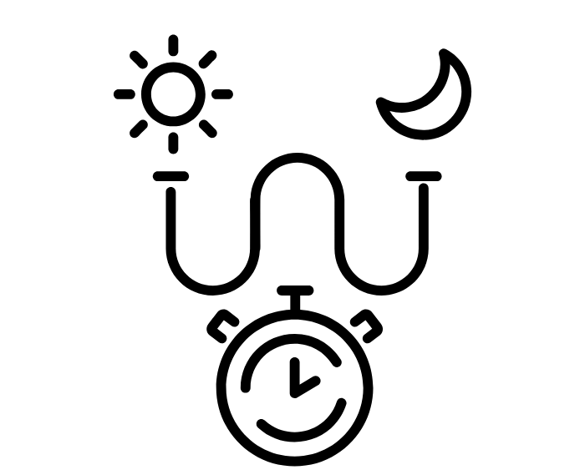

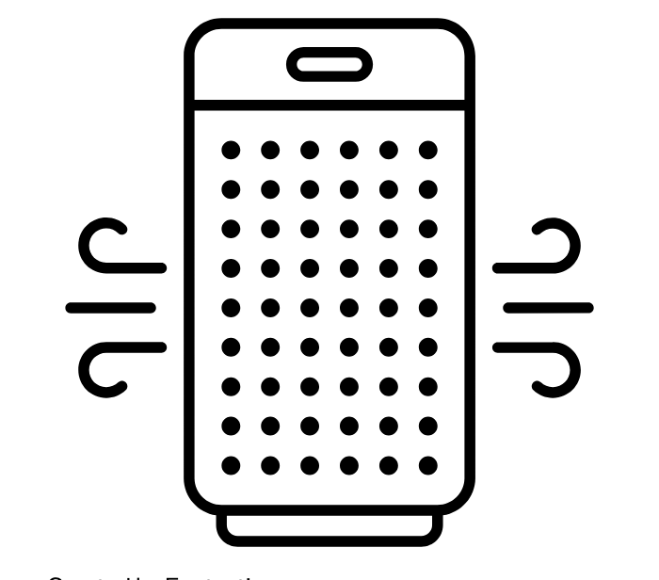
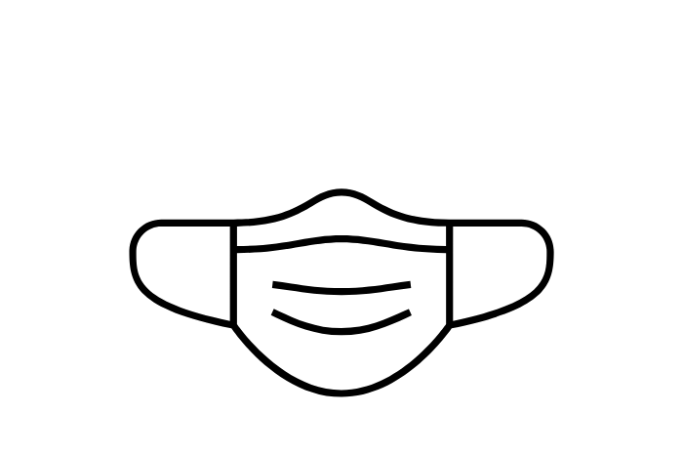
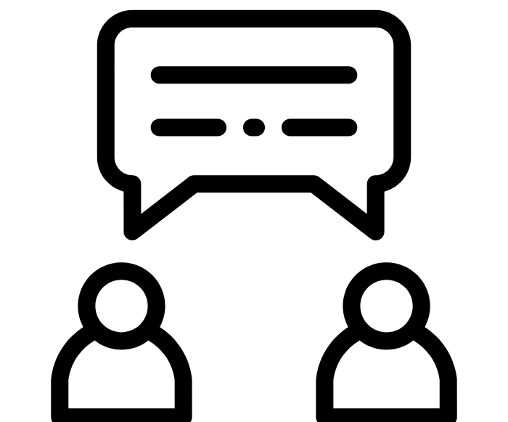
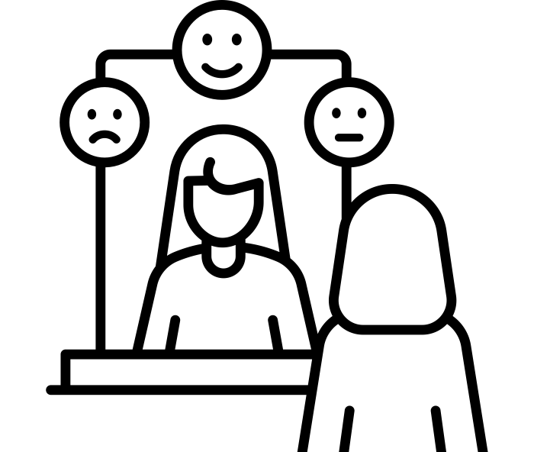
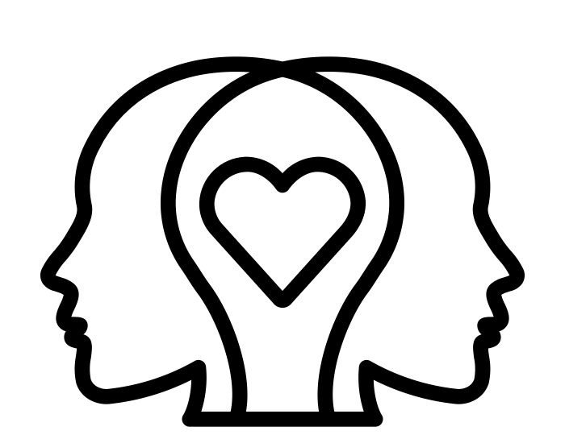
During a fire:
What can I do to protect my mental health in the short term?
Prioritize basic needs:
food, water, shelter, safety, and healthcare
Steady routine
Keep small routines when possible to create stability during uncertainty.
Reduce smoke exposure
or evacuate
Reduces health risks
Limit/reduce endless media
Reduces stress
Talking openly about what is known/unknown with others
Reduce confusion, support understanding
Acknowledge and identify feelings
(even constantly changing, or numb feelings)
Supports processing, self-awareness, relationships, and communicating needs
Recognize that many responses are normal, but know when to seek help (and seek help early).
It’s normal to be okay and
not okay later.
Notes:
• During the fire, safety and basic needs come first: shelter, food, water, medication, and reducing smoke exposure.
• Small routines create stability. Talk openly about uncertainty, identify feelings, and limit endless media after obtaining essential updates.
• Normalize different reactions and seek help early when distress affects daily life or safety.

Slide 10
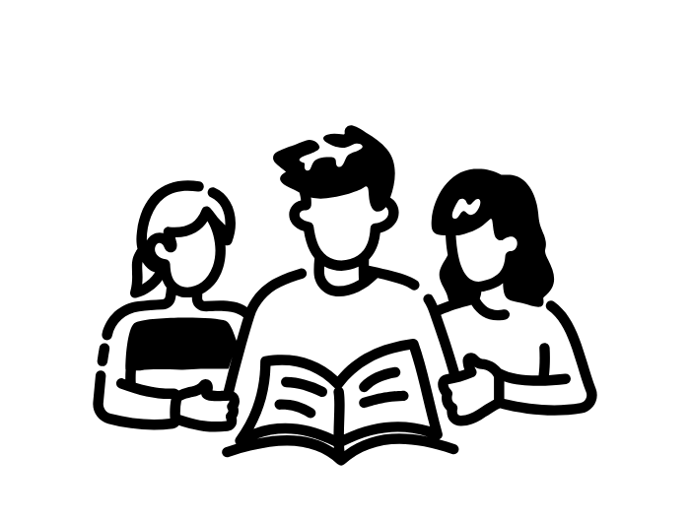
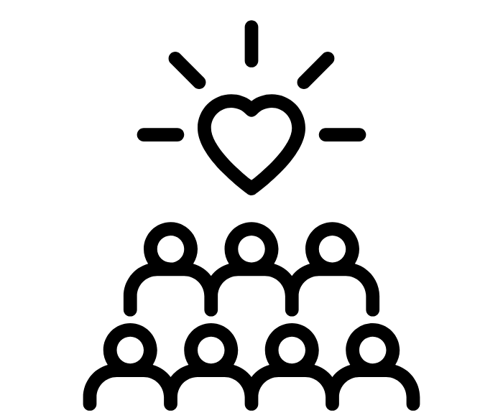

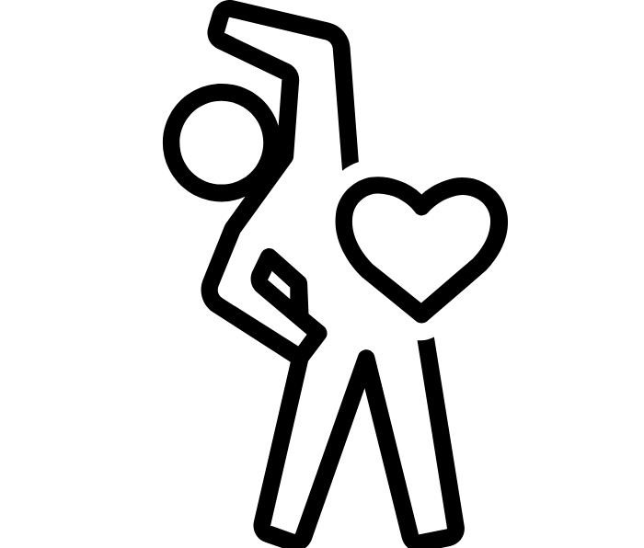

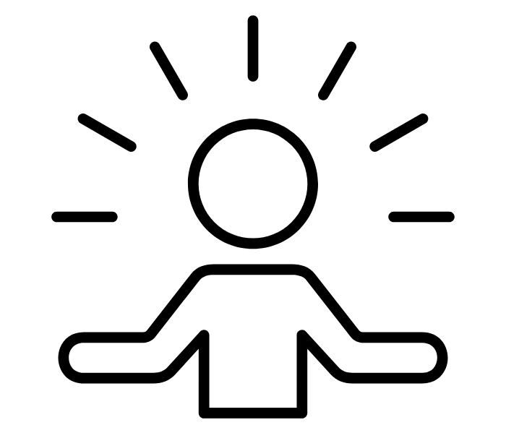
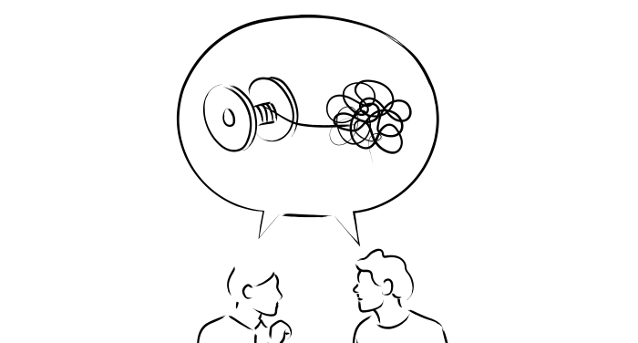

After a fire:
What can I do to protect my mental health in the long term?
All of the strategies on the previous page, PLUS:
Communicating stories and experiences
It helps you process, grow, and understand yourself and your experiences, while grounding you in the present moment to function. Find the ears and groups who will listen and from whom you can also learn.
Community and social support
Receiving and providing support.
Social, family, peer, neighbor, faith, or related connections. Everyone’s recovery path is different, with setbacks and better days.
Look for positives, what you can look forward to, and practice gratitude when it feels possible
“This situation is hard, but I’m grateful for my family, who welcomed me into their home. I look forward to seeing my teachers when school opens again.”
Exercise
Moving your body improves mental health
Nature
(when it’s safe)
Outdoors, gardens, ocean/lakes, trees
Mindfulness &
Spirituality
Being present, instilling peace
Therapy
When you need it or to manage your mental health proactively before you need support.
Using your hands and being creative
Cook, journal, draw, touch, garden, pet animals, play, bounce a basketball, etc.
Notes:
• Long-term recovery benefits from connection, storytelling, movement, creativity, nature when safe, mindfulness, and professional help when needed.
• These are options, not a checklist people must complete. Small, manageable actions are more helpful than adding pressure to recover perfectly.
• Community support can involve both receiving help and contributing in ways that restore meaning and control.

Slide 11

What is resilience?
Resilience IS:
Resilience does NOT mean:
Willpower, adaptability, tenacity, grit, growth, learning… and more…
Ability to withstand, deal with, or persevere through hard things
Dedication to moving forward
Adjusting, learning, asking for help, and building skills and growing after challenges
Things are easy or stress-free. Resilience takes effort, support, and the ability to navigate real challenges. Support is a part of maintaining resilience.
You are done learning, reacting, or feeling! Resilience is an ongoing, active journey through life's ups and downs.
Notes:
• Resilience does not mean a person is unaffected or that recovery is easy.
• It means adapting, continuing, learning, and asking for help while real distress may still be present.
• Support is part of resilience, not evidence that someone has failed to cope.

Slide 12

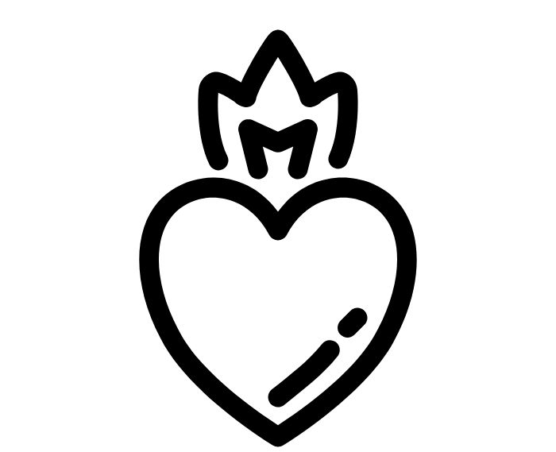
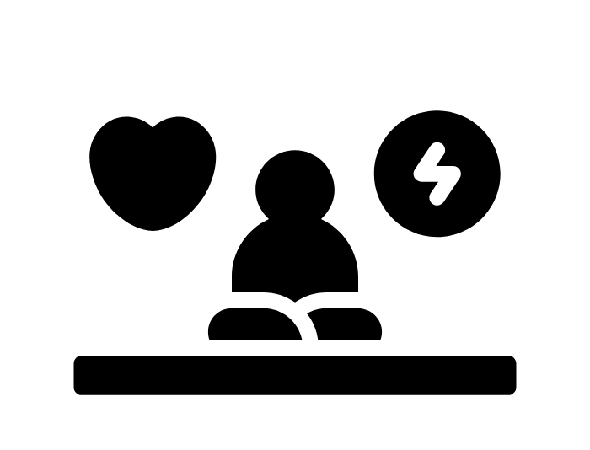
Active Resilience (1/3): Purpose, focus, & balance
What is most important to you?
Valuing your purpose:
Fulfilling the role you play in your family/household, friends, profession, and community
Honoring and understanding yourself:
Recognizing feelings and needs
Accepting your limitations
Being gentle with yourself
Taking care of yourself (Eating, sleeping, etc.)
Paying attention to needs and feelings
Journaling, tell your story, sharing honest reflections
Seeking meaning in your work
Making a contribution
Take action. Figure out what needs to be done, make a plan, and take action.
Do something every day that gives you a sense of accomplishment and purpose. Having something meaningful to focus on can help you share emotions, feel gratitude, and experience an improved sense of well-being. Reduce big tasks into manageable, smaller ones over time, or involve others in helping to manage tasks.
Balance
Relaxation, vacation & avocations (hobbies)
Exercise & recreation
Stress management, therapy, meditation, etc.
Not losing yourself, keeping a routine
Notes:
• Purpose can restore a sense of control, but large tasks should be broken into small, achievable steps.
• Balance contribution with rest, nutrition, sleep, movement, therapy, and hobbies.
• Being gentle with limitations is especially important for people who are supporting others while also recovering themselves.

Slide 13

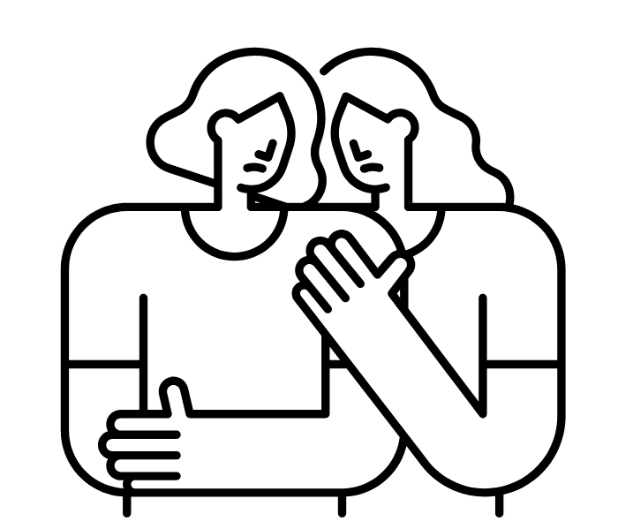
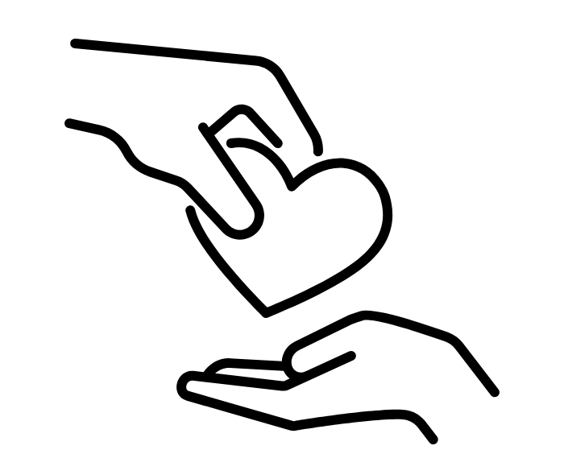
Active Resilience (2/3): Building your community
What community is most supportive?
Look to and seek out your role models, ancestors, guides, teachers…
Be part of communities that support your…
learning, grounding, reflecting, & listening
Inspiration, motivation
Leadership
A reminder of how hard things have been overcome
Reminder of values
Help support your esteem, feelings/emotions,
Social or community groups and gatherings
Religion
Book clubs
Support groups (AA meetings, etc.)
Sports/exercise groups
Seeking and giving support:
Benefits you (rewarding or supportive) and others (receiving support)
Supporting others… volunteering
Finding a cause…
Listening, communication, etc.
Notes:
• Supportive community can come from family, neighbors, faith communities, schools, support groups, clubs, sports, or trusted organizations.
• Giving support may create meaning, while receiving support reduces isolation and practical burdens.
• The best community is the one where the person feels safe, understood, and able to return over time.

Slide 14
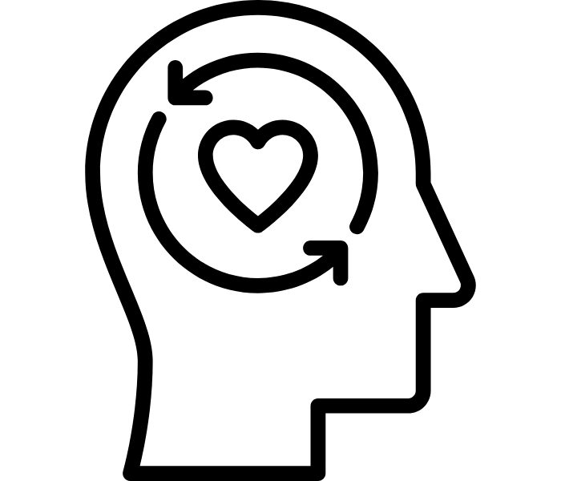
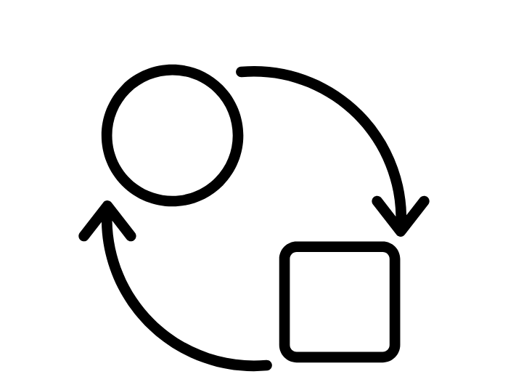
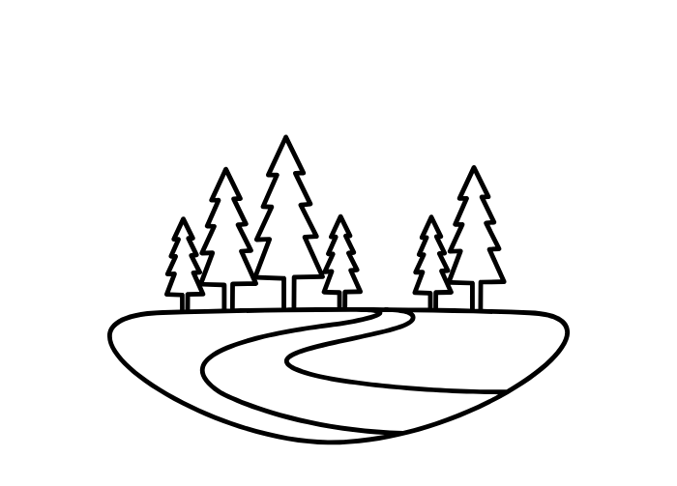

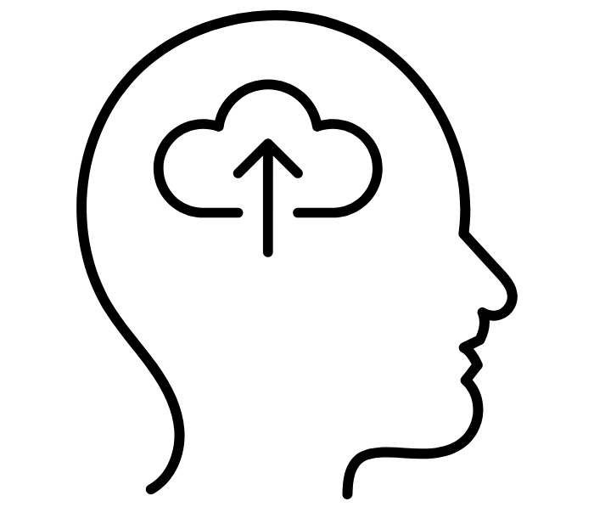
Active Resilience (3/3): Perspective
How can you reflect and learn from this?
Look for positives…
and things to look forward to…
Welcome Change
Expecting change makes it easier to adapt, tolerate, and even welcome it.
Staying flexible reduces anxiety.
Look toward the future and identify what you can look forward to.
Practice gratefulness for what you are learning and how you are growing or changing!
Find something in each day that signals a change.
Take the wide view
What will matter most in 10 years?
A long-term perspective can help you focus on how you can improve your situation if you actively work towards it.
Learn from experiences
Laugh
Remember the skills and strategies that helped you through prior rough times.
Focus on what you can change versus what you do not have control over.
Celebrate what you’ve learned or how you’ve changed.
Finding humor in stressful situations has multiple benefits--supports bonding with others, and has physical and mental health benefits.
Helpful coping mechanism!
Notes:
• Perspective does not mean forced positivity or pretending the loss is acceptable.
• It means noticing what remains meaningful, focusing on what can be changed, and identifying something to look forward to.
• Humor, flexibility, and small milestones can support coping while grief and distress are still real.

Slide 15
Resilience as a scale…
Think of resilience like a balance scale—it tips toward positive outcomes, even when someone has faced many challenges and stressors. This depends on many factors in one’s life, as well as on one’s ability to be resilient.
Negative outcomes Positive outcomes
Individual: Personal history, past trauma, temperament, health, and sense of self
https://developingchild.harvard.edu/resource-guides/guide-resilience/
https://www.frameworksinstitute.org/resources/the-resilience-scale-using-metaphor-to-communicate-a-developmental-perspective-on-resilience/
Notes:
• Introduce the resilience scale: everyone brings a different history, temperament, health status, and prior experience to the disaster.
• Those individual factors affect how stressors and supports are experienced.
• Avoid comparing recovery between people; the same event can tip each person’s scale differently.

Slide 16
Resilience as a scale…
Think of resilience like a balance scale—it tips toward positive outcomes, even when someone has faced many challenges and stressors. This depends on many factors in one’s life, as well as on one’s ability to be resilient.
Negative experiences and stressors
Risk factors
Stressors
Hard Life Experiences
Unsupportive connections
Negative outcomes Positive outcomes
Individual: Personal history, past trauma, temperament, health, and sense of self
https://developingchild.harvard.edu/resource-guides/guide-resilience/
https://www.frameworksinstitute.org/resources/the-resilience-scale-using-metaphor-to-communicate-a-developmental-perspective-on-resilience/
Notes:
• Add the negative side of the scale: loss, triggers, isolation, uncertainty, disrupted work or school, and unsupportive relationships.
• Stressors can be directly related to the fire or part of life that continues alongside recovery.
• Repeated or stacking stressors can keep the scale tipped toward worse outcomes.

Slide 17
Learning Activity:
Resilience as a scale…
Think of resilience like a balance scale—it tips toward positive outcomes, even when someone has faced many challenges and stressors. This depends on many factors in one’s life, as well as on one’s ability to be resilient.
Discussion:
How might a wildfire affect this scale?
What could support positive outcomes during and after a fire?
Consider different groups (youth, older adults, and others in your community). How could these groups be supported through a wildfire?
Negative experiences and stressors
Positive experiences and supports
Risk factors
Stressors
Protective factors
Safety
Hard Life Experiences
Positive experiences
Unsupportive connections
Supportive social connections, mentors, family, and/or therapy
Negative outcomes Positive outcomes
Individual: Personal history, past trauma, temperament, health, and sense of self
https://developingchild.harvard.edu/resource-guides/guide-resilience/
https://www.frameworksinstitute.org/resources/the-resilience-scale-using-metaphor-to-communicate-a-developmental-perspective-on-resilience/
Notes:
• Now add protective factors: safety, stable resources, supportive relationships, mentors, community organizations, and therapy.
• Ask participants what could shift the scale for youth, older adults, workers, or displaced families.
• Focus on concrete supports, not just personal willpower.

Slide 18
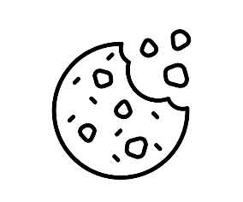
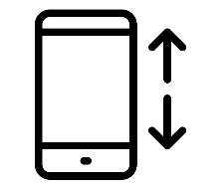
Coping during or after a fire or diaster
SHORT-TERM
STRATEGIES
LONG-TERM
SKILLS or ROUTINE BEHAVIORS
Feel good temporarily but often aren’t helpful long-term or make it worse
Don’t help us build good routines or feel better in the long run
RISKY
Help during stressful times temporarily
Help us build good routines and feel better in the long run
SUPPORTIVE
What are these to you? How might they affect your resilience scale?
Notes:
• Use the grid to separate what helps briefly from what builds longer-term well-being.
• Some behaviors may feel relieving in the moment but increase risk or make functioning harder over time.
• Ask participants to name supportive short-term strategies and routines they can realistically continue.

Slide 19
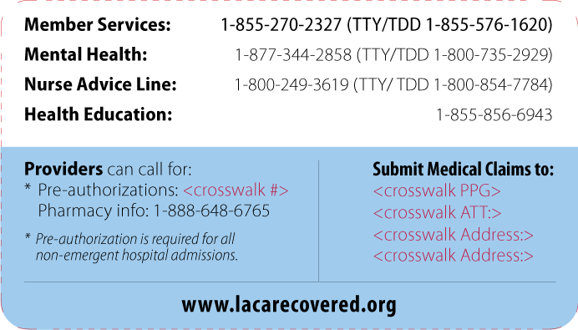
Question: When should I seek mental health support?
Answer: Sooner than you think!
Unsure where to start?
Call 988, nationwide mental health support (which connects to all forms of local support), currently for LA: https://didihirsch.org/
As soon as you recognize a change in yourself or your surroundings that may be affecting your well-being, it is a great time to connect with supportive communities and mental health supports.
Types and levels of Mental Health Supports:
Preventative (after-school programs, social support meant to strengthen protective factors)
Treatment (therapy, support groups, medication)
Urgent/Crisis (ensuring safety)
If you have insurance, the back of your insurance card will typically have a mental health line:
Setting expectations… things that can take time when seeking help:
Recognizing that you might need support, asking for and seeking help can be new, difficult, or uncomfortable.
Figuring out insurance, if you have it, and who is in your network, co-pays
Sharing your basic information with call lines
Finding the right therapist: what is important in a provider for YOU
Notes:
• The best time to seek support is earlier than many people think, when changes begin affecting well-being or daily life.
• Support can be preventive, ongoing treatment, or urgent crisis care.
• If someone is unsure where to begin, 988 connects to local crisis and support services; insurance cards also often list a mental-health access number.

Slide 20
Key Points:
Mental Health Impacts of Wildfires
What you need to know to protect yourself!
1. How do wildfires and smoke affect our mental well-being?
Mental health is affected in many ways. People often experience symptoms like anxiety, stress, depression, trouble sleeping, and mood changes, including not feeling like themselves.
Smoke can play a role in your mental health; tiny, harmful particles in wildfire smoke may reach the brain, potentially causing damage that affects how you feel and think.
20
Notes:
• Wildfires can affect mood, sleep, concentration, stress, anxiety, and sense of self.
• Smoke may also contribute to brain-health effects, but the strongest message is to protect both physical and mental health.
• Different reactions can occur at different times.

Slide 21
Key Points:
Mental Health Impacts of Wildfires
What you need to know to protect yourself!
2. Is it normal to still feel emotional "ups and downs" long after the fire is out?
Yes. Recovery is a long-term process. After a crisis, communities often feel a strong bond, but that can fade as the hard work of rebuilding begins. Stressors like property damage, insurance, job loss, and changes in school or social circles can add to mental pressure long after the fire.
21
Notes:
• Yes, emotional ups and downs can continue long after the flames are out.
• Housing, finances, insurance, rebuilding, employment, school changes, and anniversaries can prolong or reactivate stress.
• Recovery is a long-term process, not a deadline.

Slide 22
Key Points:
Mental Health Impacts of Wildfires
What you need to know to protect yourself!
3. What are the best ways to protect my mental health during and after a fire?
Protect your body: Practical strategies include reducing smoke exposure, maintaining a routine, connecting with others, limiting media, and prioritizing basics like staying hydrated, eating well, sleeping well, and being safe.
Protect your mind: Seek help early. You don’t have to wait for a crisis to talk to someone; reaching out to community support or a therapist early on can help you process your experiences. See resources on page 12.
Protect your connections. Pay attention and notice what you are feeling, ask for what you need, and stay connected to supportive people.
22
Notes:
• Protect the body through safety, sleep, food, hydration, routine, and reduced smoke exposure.
• Protect the mind by seeking support early and limiting overwhelming media.
• Protect connections by naming needs and staying close to people and organizations that can listen and help.

Slide 23
Mental Health Resources

Slide 24


Further Mental Health Resources
Resources to get connected to mental health care:
  Disaster Mental Health Support and Connections https://www.calhope.org/
  Los Angeles County Mental health resources for those affected by the fire (text lines, in-person support, etc) https://dmh.lacounty.gov/our-services/disaster-services/disaster-mh-resources/
Resources for Children and Supportive Conversations:
  Parenting, teaching, and caregiving for children- Wildfire resources:
    "Supporting Children, Strengthening Communities: Professional Skills for Talking About Wildfires Together" with Dr. Melissa Brymer https://www.youtube.com/watch?v=FTwZj5kvbTg
      Communication handout: https://d3kdbh1wduemv1.cloudfront.net/attVnm39LDeYME657.pdf?cache=1736380069
    Addressing the Wildfires: A resource guide for Caregivers and Educators https://ugc.production.linktr.ee/6bfe8bf5-5438-46a2-9db7-5988260d3960_Wildfire-Resources-for-Caregivers-and-Educators.pdf
    Parent Guidelines for Helping Children Impacted by Wildfires: https://www.nctsn.org/sites/default/files/resources/parents_guidelines_for_helping_children_impacted_by_wildfires.pdf
  Service/resources links (some are explicitly for the LA Fires 2025):
    Wildfire resources (more children’s resource links, no-cost therapists, etc.): https://docs.google.com/document/d/1ttP8nT6ueNz_aUFJv2ebVVFljkmecOra/edit?tab=t.0
    Eaton/EFRU Local Mental Health Supports: https://www.efru.la/mental-health
Notes:
• Use these resources as a starting point for caregivers, educators, families, and people seeking local support.
• Encourage facilitators to review links before a crisis and identify which are appropriate for their community.
• For urgent safety concerns, use 988 or emergency services rather than relying only on written resources.

Slide 25
Mental Health and Social Health Data from the 2025 LA fires

Slide 26

2025
LA Fires
2025 Los Angeles fires: Mental Health Data
After the 2025 LA fires:
Adult residents living in wildfire evacuation or warning zones experienced a greater increase in self-reported symptoms of anxiety and depression nearly a year later compared to those unaffected.¹
    Socioeconomic Disparities: The psychological damage was starkly concentrated among low-income households, individuals struggling with housing costs, and those with pre-existing mental health challenges. ¹
Adolescents: 2,839 high school students (10th and 12th graders) three months after the fires revealed massive structural and emotional disruptions due to the fires: ²
  35.8% of adolescents reported chronic worry regarding the health of their family members.
  23.1% feared for their personal safety.
  21.9% directly reported feeling anxious, stressed, or depressed.
  10.4% experienced a family member or loved one losing their home entirely.
Over half (66%) of all fire-affected adults (1,229) described anxiety, stress, or depression related to fire damage to air, soil, water, and nature.³
80% of displaced survivors report a sharp decline in their mental health, ranking emotional strain and trauma as a top post-disaster challenge right behind immediate financial stress and housing loss. ⁴
5-Fold Increase in Crisis Calls: The National Mental Health Lifeline (988) reported a five-fold (500%) increase in calls to its associated Disaster Distress Helpline from the Los Angeles area during the first week of the fires (January 7–15, 2025). ⁵
A majority of fire-affected populations faced financial, physical, mental health and housing challenges after the fires. ⁶
L.A. Wildfires Had Lasting Mental Health Impacts for the Most Vulnerable Residents. Published in JAMA Network Open
Harlow AF, Soto DW, Unger JB, Lee RC, Barrington-Trimis JL. The mental health impact of the 2025 Los Angeles wildfires among adolescents. Environmental Epidemiology. 2026 Jun 1;10(3):e474.
Purdue: The REBUILD Survey: https://docs.lib.purdue.edu/cgi/viewcontent.cgi?article=1001&context=red
Dept of Angels: https://www.deptofangels.org/news/six-months-later-recovery-in-crisis
Time magazine: https://time.com/7207912/los-angeles-california-wildfires-mental-health-support/
Los Angeles County Wildfire Rapid Needs Assessment Report November 2025 http://publichealth.lacounty.gov/media/wildfire/docs/LAC_Wildfire_RNA_Report-Nov2025.pdf
.
Notes:
• Frame these as separate studies and surveys with different samples, questions, and timing; do not combine the percentages.
• Across sources, the consistent message is substantial ongoing distress, especially among displaced, lower-income, housing-insecure, and previously vulnerable groups.
• Remind participants that statistics describe populations, while individual needs still require listening and appropriate support.

Slide 27
2025
LA Fires
2025 Los Angeles fires: Social impacts
…which can also affect mental and physical health
Job and economic loss¹
  Unemployment claims spiked: 11,000 workers filed for unemployment due to the fires.
  Low-wage workers were hit the hardest (50% higher increase in filing for unemployment for those with a high school diploma or less)
Food insecurity²
  Lost access to school-provided meals for youth
  Lost access to kitchens, having to eat prepared foods
  Increasing other living costs, which impacts food budget
Schools and lost learning time³
  Disruption to learning time including school closures, challenges getting to school or new locations, and challenges with online learning.
  Loss of sports and other extracurricular activities
  Disruption to teaching and administration staff
  Longer-term impacts including mental health challenges for students and disruptions to future plans
  Concerns over health risks associated with returning to schools impacted by fire
Housing insecurity^{4,5}
  Homelessness
  Family separations
  Loss of home or material goods
  Having to add new rental or moving costs
  Money lost to evacuation (costs, job loss)
  Time, effort, and stress in dealing with insurance, FEMA, rebuilding, and potential environmental hazards
Changes in safety nets and community services⁶
  Community-based organizations faced new challenges in supporting communities after fires
Lapinski, P., et al. Unemployment Insurance Claims After the LA Wildfires. California Policy Lab. (2025). https://capolicylab.org/unemployment-insurance-claims-after-the-la-wildfires/
https://thelalocal.org/los-angeles-county/a-year-after-the-la-fires-survivors-are-still-going-hungry/
https://insideclimatenews.org/news/14032025/latino-disadvantaged-students-hit-hardest-after-los-angeles-fires/
https://dornsife.usc.edu/news/stories/labarometer-wildfire-survey-of-housing-instability-and-income/#:~:text=Nearly%20a%20quarter%20of%20housing%2Dinsecure%20Angelenos%20said%20they%20lost,of%20those%20with%20stable%20housing.
https://www.latimes.com/environment/story/2026-04-16/how-la-unhoused-population-was-devastated-by-2025-wildfires
https://cnmsocal.org/wp-content/uploads/2025/03/CNM.LAwildfires-SurveyFindings.pdf
.
Notes:
• Mental health is affected by social conditions: job loss, food access, school disruption, housing insecurity, insurance, and weakened community services.
• These are not side issues. Reducing practical burdens can directly support mental and physical health.
• Ask what local organizations can address immediately and what requires longer-term policy or funding.

