Slide 1









After the Fire:
Lead and Fire Contaminants in or around your Home f
Booklet C from the Understanding Health Impacts of Wildfires in Urban Areas series
Lead Authors: Savanna Carson, Katherine McNamara. For the complete list of authors, editors, and reviewers, see the website.

Slide 2

During the Fire: Smoke, Air Quality, and Protecting Yourself
Agenda:
Why the focus on lead?
How do you know if lead got into your body and LA Fires 2025 lead level results
Lead in Interiors after a fire: Is there lead in my house dust? What to do? A brief overview of LA Fires 2025 interior lead dust results
How to: Indoor post-fire cleaning tips
How to: Choosing the right protective gear for post-fire debris
Lead in soil after a fire: Is there lead in my soil? What to do? A brief overview of LA Fires 2025 exterior soil results
Review of key points
Series Note: This series addresses some of the health concerns from wildfires that reach urban areas. These fires are also called Wildland-Urban Interface (WUI) fires. Since the general public may not use the term WUI, we use “wildfires that reach urban areas” or, more briefly, “fires” to refer to large, catastrophic fires that may also burn buildings, cars, and other non-natural sources.
Key point!
Look for these “Key points” throughout this handout for the most important summaries.
Notes:
• Preview the session: why lead is often a go-to test, how blood lead level testing works, an overview of post-fire indoor dust and soil testing, and practical cleaning and PPE.
• Clarify that fire ash and dust may contain many contaminants; lead is emphasized because it is common, well studied, and relatively easy to test.
• The goal is to interpret results practically.

Slide 3
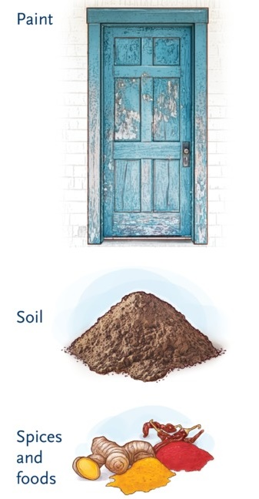
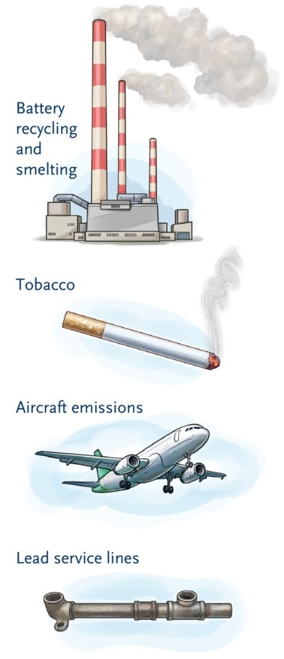
Contaminants after the fire: Why the focus on lead?
After the fire, we often focus on some contaminants, like lead, for a few reasons:
Lead has known health impacts:
  Pregnant people and children: early birth (preterm birth), cognitive impacts (i.e., ADHD), and heart health.
  Adults: Heart disease, high blood pressure, and kidney failure.
  Good to know: Nutrients such as vitamin C, iron, and calcium can help reduce lead uptake in the body. Beneficial foods include green vegetables, sweet potatoes, fruits (like bananas), meat, and dairy products. A diet rich in fruits and vegetables can help lower the risk of lead absorption, especially for children and pregnant people.
2. Lead is one of the most common contaminants found after urban fires. Materials that can contain lead and burn during fires include paint from older homes, building materials, appliances, car batteries, pipe solder, and wiring. These sources have previously contributed to lead levels in indoor dust and outdoor soil. However, when fires consume cars and buildings, they typically release even more lead into the environment.
Common sources of lead include lead paint, battery recycling and smelting, aircraft emissions, cigarette smoking, lead plumbing and soldering, spices and foods, and soil. Historical sources of lead also include leaded gasoline and pesticides.
Key point:
Fire ash, soot, char, and dust likely contain many toxic contaminants. Lead is one of the most common contaminants. It is also often easy (and relatively inexpensive) to test for.
Figures and reference: Lanphear B et al. N Engl J Med 2024;391:1621-1631
Agency for Toxic Substance and Disease Registry (ATSDR) Toxicological Profile for Lead. US Department of Health and Human Services; 2020.
Sample J. Lead exposure in children: failure to protect the most vulnerable. The Journal of Pediatric Pharmacology and Therapeutics. 2024 Jun 1;29(3):212-4
Notes:
• Lead has well-established health effects and can be released when older paint, appliances, wiring, solder, and car batteries burn.
• It is also already present in many older homes and soils, so post-fire testing cannot always tell us what came from the fire.
• Good nutrition helps reduce absorption, but it does not replace reducing the source of exposure.
Other toxins may result from fires, but we won’t cover them today (for example, Arsenic, Asbestos, etc.). These can also be common tests after a fire, but can be tricky as these materials may occur naturally in many WUI fire areas.

Slide 4
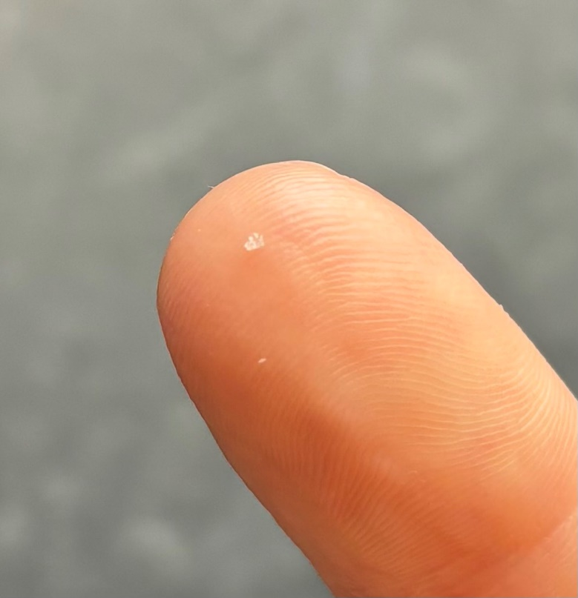
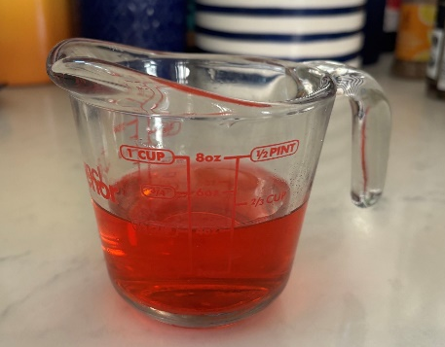
How do you know if lead got into your body?
If you are concerned about fire contaminant exposure, a blood lead level (BLL) test is the most effective way to check if you have been exposed to lead.
This test measures the amount of lead currently present in your blood, but it does not assess lead exposure over your lifetime. Lead levels in the blood typically decrease by half each month once exposure stops, so it is best to test soon after any potential exposure.
Blood lead levels are measured in micrograms (µg) per deciliter (dL) of blood.
You can get a blood lead test through your doctor or a lab without a prescription (for a fee).
Visualizing micrograms (µg) of lead per deciliter (dL)
x1000
One microgram (µg) equals a single grain of sugar cut into about 1,000 pieces
Key point:
Testing blood lead levels is the best way to determine any recent lead exposure. A level higher than 3.5 µg/dL is considered a concern for children and pregnant people, or those who may become pregnant.
One deciliter (dL) equals about a half cup
Binns, H.J., et al, 2007. Interpreting and managing blood lead levels of less than 10 μg/dL in children and reducing childhood exposure to lead: Recommendations of the CDC and Prevention Advisory Committee on Childhood Lead Poisoning Prevention. Pediatrics, 120(5), pp.e1285-e1298.
Los Angeles County Department of Public Health Post-Fire Assessment, Blood Lead Level Testing: https://storymaps.arcgis.com/stories/28efe1b6956b4438a88b2849542bd816?cover=false
Notes:
• A blood lead test is the best measure of recent lead exposure, not lifetime exposure.
• Lead in blood falls after exposure stops, so timing matters, and earlier testing is more informative.
• A result above the reference level of 3 micrograms per deciliter is a signal to look for and reduce exposure; it does not, by itself, identify the source of the lead.

Slide 5

Lead Levels in LA Fire-affected communities
2025
LA Fires
The Los Angeles County Department of Public Health offered free blood lead level testing after the LA fires. Most (1,370) were completed by June 2025, or within 5 months after the fires. As of one year post-fires, none of the 218 children tested had elevated levels, and of the 1,862 adults tested, only 11 had elevated levels, ranging from 3.6 to 14 µg/dL. Follow-up investigations found that the adult elevated levels were unlikely to be linked to fire-related exposure. Overall, the results do not show widespread elevated blood lead levels among those tested. These results reflect only the people who were tested through the program and do not rule out possible exposure in individuals not tested or tested by their own medical provider.
Lead Levels Tested After the Fires
 | Children | Adults
Total Tested | 218 | 1,863
Total Elevated BLLs (more than 3.5 µg/dL) | 0 | 11*
*All adults; all cases found likely not linked to the fires.
Key point:
Blood lead levels are the best measure of lead exposure and indicate no significant lead exposure in those tested following the LA 2025 fires.
Binns, H.J., et al, 2007. Interpreting and managing blood lead levels of less than 10 μg/dL in children and reducing childhood exposure to lead: Recommendations of the CDC and Prevention Advisory Committee on Childhood Lead Poisoning Prevention. Pediatrics, 120(5), pp.e1285-e1298.
Los Angeles County Department of Public Health Post-Fire Assessment, Blood Lead Level Testing: https://storymaps.arcgis.com/stories/28efe1b6956b4438a88b2849542bd816?cover=false
Notes:
• The post-fire testing program did not find elevated results among the children tested and found only a small number among adults. These results are reassuring, as blood lead testing is the best way to measure lead exposure.
• Follow-up suggested the adult elevations were unlikely to be fire-related, which is reassuring for those tested.
• There are some limitations: this does not represent every resident in the fire area or show any blood level tests obtained outside the program, such as through a primary care provider.

Slide 6
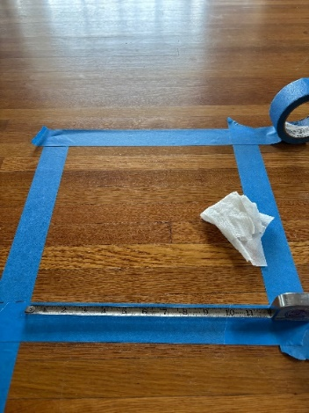
Lead in interiors after a fire: Is there lead in my house dust? What to do?
If your home has been impacted by fire, smoke, ash, soot, char, or dust, it may be important to test the dust for lead or other contaminants. To test dust for lead, a professional will sample the amount of lead present on a surface area (e.g., a square foot of the floor). These methods and standards were developed to prevent lead poisoning from chipping lead-based paint, but are useful for assessing fire-related contamination.
Reducing dust that may have fire contaminants is most important for young children, as they are more likely to put their hands in their mouths after touching windowsills or playing on the ground.
If your home was affected, hiring professional cleaning or remediation services may be the safest option. If you clean yourself after a fire, wear proper PPE and follow best practices for protection (see pages 7 and 8).
Visualizing micrograms (µg) of lead per square foot (ft²)
x1000
One microgram (µg) = a single grain of sugar cut into 1,000 pieces
Regulated levels of Lead (Pb) in dust¹
Agency | Action Level (If at this level or above, it is recommended to clean or take other measures to prevent future lead dust, such as from chipping paint)
U.S. Environmental Protection Agency (EPA) | 5 µg/ft² for floors (micrograms lead/Pb per square foot) 40 µg/ft² for windowsills 100 µg/ft² for window trough
California Department of Public Health | 10 µg/ft² for floors (micrograms lead/Pb per square foot)* 100 µg/ft² for horizontal surfaces* *Effective until July 2027
One square foot (ft²) = 12 x 12 inches for each dust wipe sample
California Department of Public Health Definition of "Lead-Contaminated Dust“ https://www.cdph.ca.gov/Programs/CCDPHP/DEODC/CLPPB/Pages/lead_contaminated_dust.aspx
Notes:
• Dust testing measures the amount of lead on a defined surface area, usually a square foot, rather than the percentage of lead in the dust.
• Windowsills, floors, and window troughs have different action levels because contact patterns and historical paint sources differ.
• Testing and cleaning are especially important where young children play or touch surfaces and then put their hands in their mouths.

Slide 7
Was lead found in homes after the 2025 LA fires?
2025
LA Fires
Yes. After the 2025 LA Fires:
Lead was found in house dust even miles away following the fires.²⁻³
Soap-and-water cleaning and wet wiping often reduced lead levels. However, appropriate PPE and careful work practices (see pages 7 and 8) are recommended for any post-fire cleaning if professional remediation is unavailable to you.
Discussion: Do you remember more dust, ash, or soot in your home after the LA fires, or other fires? Did you conduct any clean up?
California Department of Public Health Definition of "Lead-Contaminated Dust“ https://www.cdph.ca.gov/Programs/CCDPHP/DEODC/CLPPB/Pages/lead_contaminated_dust.aspx
CalTech Science Exchange: How Much Lead and Other Toxic Metals are Present after the Eaton Fire? https://scienceexchange.caltech.edu/topics/sustainability/ask-expert-sustainability/ask-expert-fires/francois-tissot-lead-water-soil-ash-eaton-fire
Eaton Fire Residents United Indoor Dust Post-Fire Lead Testing https://www.efru.la/
Notes:
• Lead was detected in house dust after the fires, including beyond the immediate burn area.
• The encouraging finding is that soap-and-water cleaning and wet wiping often reduced levels.
• If a home had heavy ash or soot, professional remediation is safest; if it is unavailable, use PPE and careful wet methods.

Slide 8


Los Angeles Fires 2025:
CalTech, ~300 indoor dust samples, February 2025: Eaton Area
2025
LA Fires
Distance from the window | At window |  | Less than 3 feet |  | More than 3 feet
Where sample taken | Windowsills |  | Flat surface (table, counter, floor, etc.)
Lead Level (µg/ft²)* | Below EPA Level | Above EPA Level | Below EPA Level | Above EPA Level | Below EPA Level | Above EPA Level
Not Cleaned (# of samples) | 39 | 21 | 10 | 24 | 29 | 18
Cleaned (# of samples) | 24 | 4 | 10 | 5 | 43 | 4
% of uncleaned samples below EPA action level | 65% |  | 29% |  | 62%
% of cleaned samples below EPA action level | 86% |  | 67% |  | 91%
Windowsill EPA Dust Action Level = 40 µg/ft²
Floor EPA Dust Action Level = 5 µg/ft²
Overall, average lead levels were higher near dust entry points (windows), data not shown.
A majority of areas cleaned had lead levels below EPA action level (non-professional cleaning)
However, some areas with elevated lead levels may require professional remediation or repeated cleanings
https://scienceexchange.caltech.edu/topics/sustainability/ask-expert-sustainability/ask-expert-fires/francois-tissot-lead-water-soil-ash-eaton-fire/lead-dust-ash-water-eaton-fire-francois-tissot
Notes:
• The Caltech data show two patterns: levels were often higher near entry points, and cleaned samples were more likely to fall below action levels.
• Basic cleaning was helpful but not perfect. Some locations still required repeated cleaning, retesting, or professional remediation.
• Use this slide to focus routine cleaning attention on windows, doors, and nearby horizontal surfaces.
Professional remediation is the best way to ensure reductions in dust and potential lead levels if accessible to you.

Slide 9
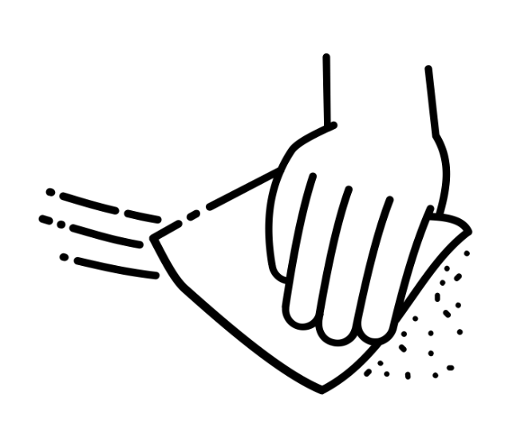
In-Home Cleaning Tips to Reduce Dust Exposure After a Fire
If your home was affected by ash, soot, char, or dust from the fire, it is best to have professionals conduct post-fire cleaning, but if you are not getting professional remediation, follow these practices for safety:
When cleaning, wear personal protective equipment (PPE). See page 11.
If you have central A/C or heat, or an HVAC, wait to turn it on, as it can stir up settled dust/ash.
  Consider turning on your HVAC system and running it for a period while the house is unoccupied, then cleaning the filters, and finally replacing them.
When cleaning, use wet wiping and mopping with soap and water to reduce dust disturbance.
  Avoid dry sweeping (using a broom) and regular vacuuming, as they can release contaminated dust back into the air.
  Regularly clean entry points where dust can enter, such as floors near doors and chimneys and windowsills.
Carpets, rugs, and soft materials are harder to clean.
  Use or rent a HEPA-filtered vacuum. Carpet shampooing and upholstery cleaning may be helpful.
  Alternatively, layer washable rugs or blankets for babies close to the ground until the carpets can be properly cleaned.
  Wash soft materials (bedding, curtains) when possible.
Reduce dust tracked into the home.
  Remove shoes and dirty clothes when entering after gardening.
  Wipe pets' paws before they come inside and limit pet access to contaminated areas.
Clean spaces for children/babies frequently.
  Lay down clean, washable blankets or create clean areas.
  Focus on where babies may engage in hand-to-mouth activities (where they can reach).
If smoke odors persist, you may want to consider an air purifier with a charcoal (activated carbon) filter. Note that these filters become saturated quickly (with dust and particulate matter) and are expensive to replace.
9
After the wildfire: Indoor smoke residues and cleaning considerations By Ryan D. Huff. National Collaborating Centre for Environmental Health https://ncceh.ca/sites/default/files/2026-06/NCCEH%20-%20RHuff%20-%20Wildfire%20Smoke%20Cleaning%20Review%2020260623.pdf
More reading: https://dtsc.ca.gov/emergency-guidance-on-wildfires-1/ and https://dtsc.ca.gov/emergency-guidance-on-wildfires-2-2/
https://scienceexchange.caltech.edu/topics/sustainability/ask-expert-sustainability/wildfire-california-hazards-of-smoke-paul-wennberg
https://cires.colorado.edu/news/how-mitigate-post-fire-smoke-impacts-your-home
Notes:
• Avoid turning settled contamination back into airborne dust. Wet wipe and mop with soap and water instead of dry sweeping or ordinary vacuuming.
• Use a HEPA vacuum for carpets and soft furnishings, and wash removable fabrics when possible.
• Reduce tracking by removing shoes, changing dirty clothing, wiping pets’ paws, and maintaining clean areas for babies and children.

Slide 10

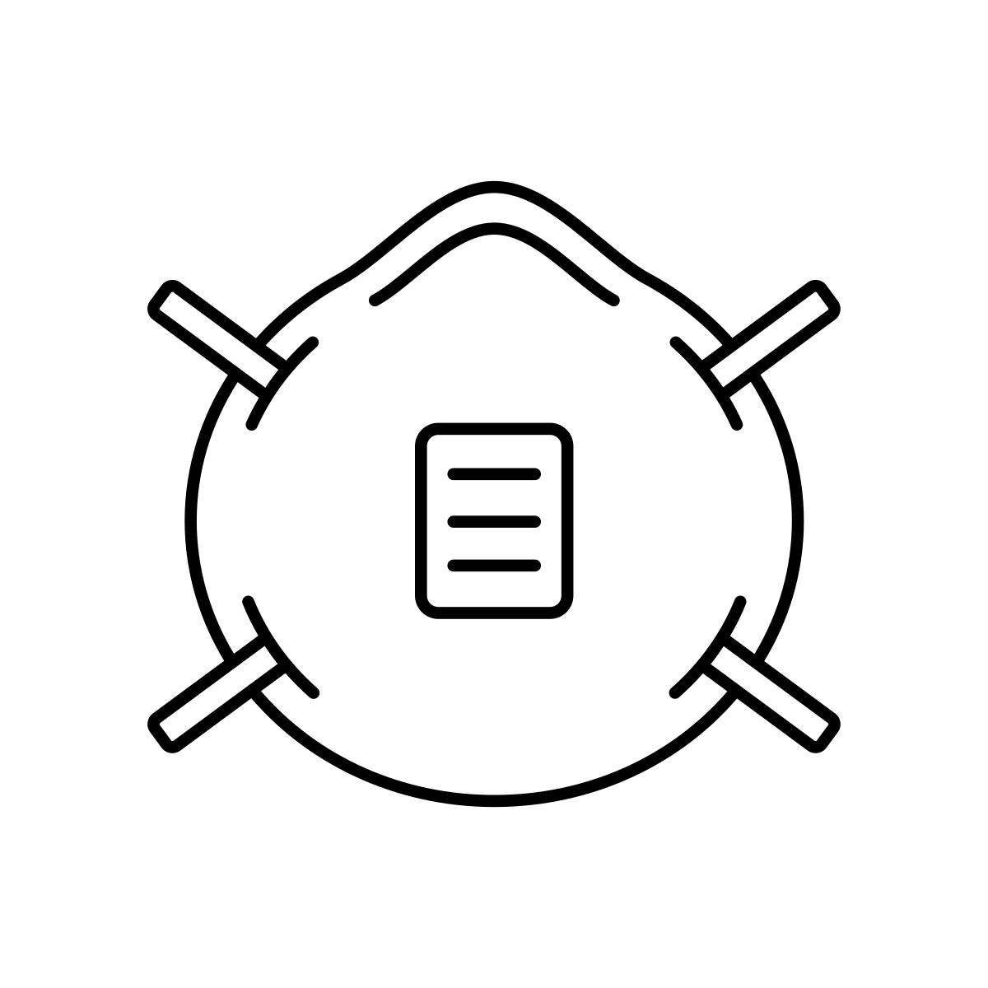

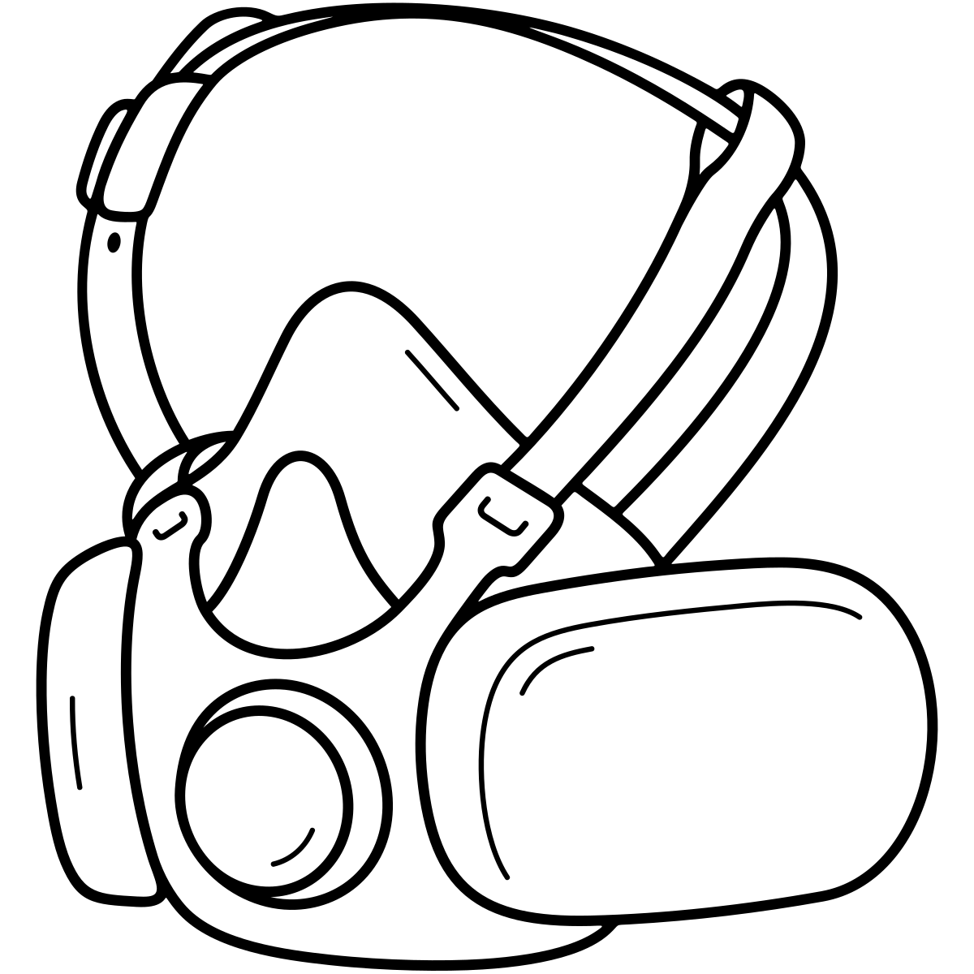

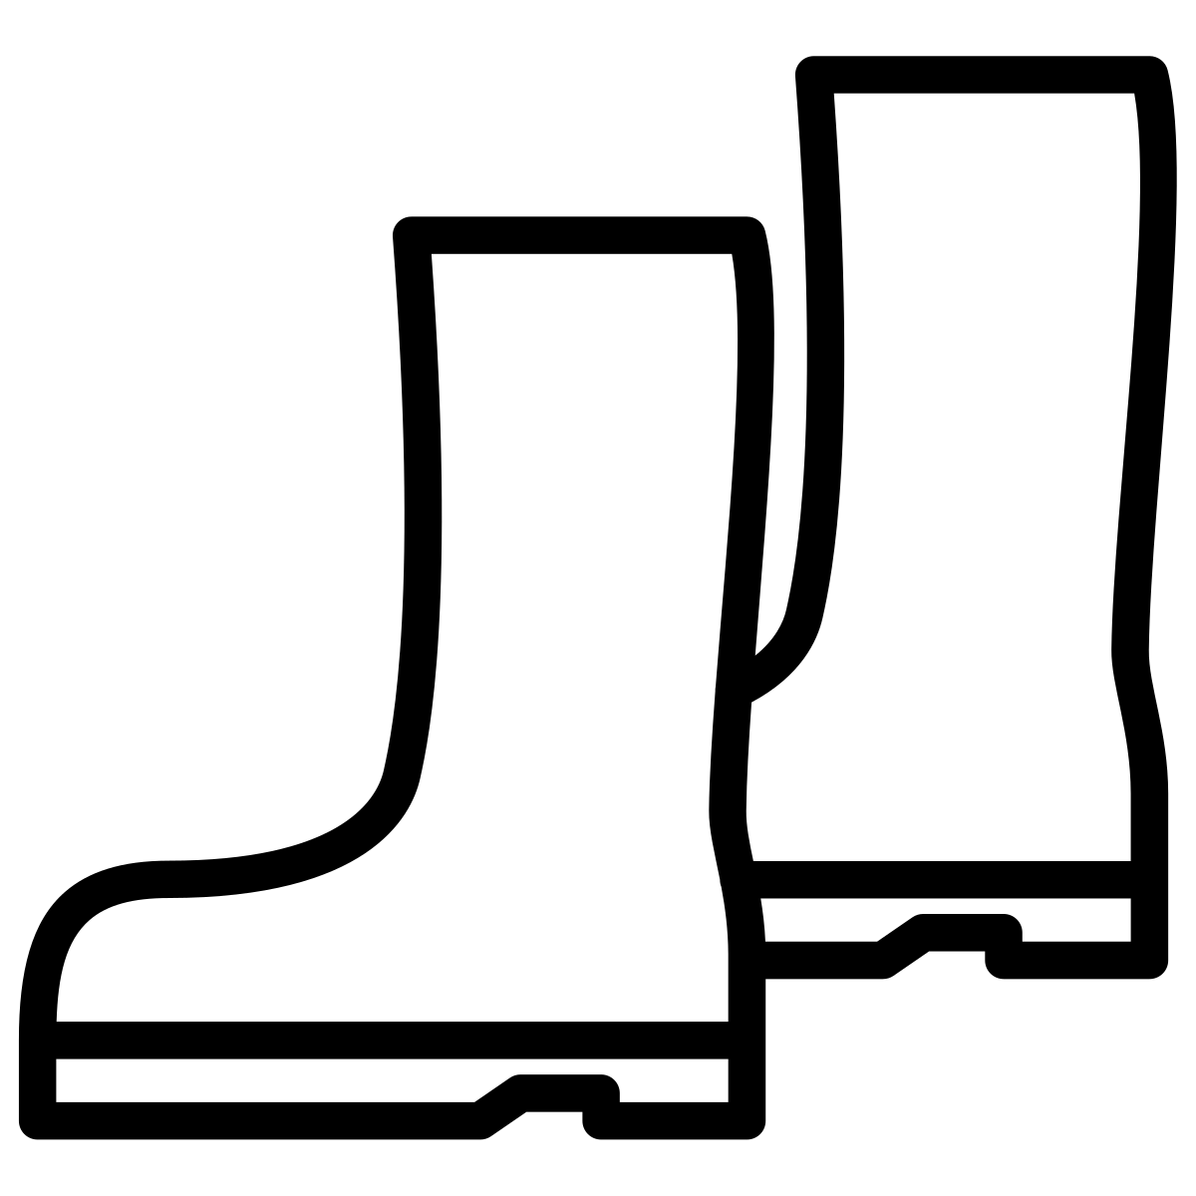
Choosing the right PPE for post-fire debris or clean-up activities
If you need to clean around your home after a fire and professional remediation is not possible, wear protective gear, including the following. If you hire others to clean up your property after a fire, make sure they are provided with proper PPE to protect their health too.
Gloves. For indoor clean-up, use disposable latex and nitrile gloves. For outdoor debris clean up involving sharp or broken materials, consider wearing disposable gloves under leather or heavy-duty work gloves.
Wear a respirator mask. P100 or N95: look for a NIOSH-approved respirator with two straps.
(See Handout B, page 5 for a mask guide).
Wear a disposable coverall suit. Tyvek suits are available at local hardware stores. Remove before getting in your car, entering your home, or entering clean spaces.
Safety goggles. Safety goggles keep dust out of your eyes, but safety glasses do not.
Boots (outdoor) or booties (indoor). Boots you can wash and remove before entering your home. Use disposable booties for indoor cleaning.
10
http://publichealth.lacounty.gov/eh/docs/safety/returning-home-after-fire.pdf
http://publichealth.lacounty.gov/media/wildfire/docs/workershealthsafety/Workers'_Health_and_Safety_Rights_During_Fire_Tip_Sheet-English.pdf
Notes:
• If professional cleanup is not possible, use a respirator, goggles, gloves, disposable coveralls, and removable boots or booties.
• Remove contaminated outer gear before entering vehicles, homes, or clean spaces to prevent cross-contamination.
• If hiring workers, the same protection should be provided to them; worker safety is part of household and community safety.

Slide 11



Lead in soil after a fire: Is there lead in my soil? What to do?
Soil near our homes can be tested to understand if there is any risk to our health. Soil screening levels help us assess if the amount of lead in soil is a health risk. Lead and other contaminants are common in soil in many areas before fires, but fires may add more lead to nearby soils.
Lead poisoning from soil is not likely, but reducing contact with contaminated soil is still a good idea. Exposure to lead in soil may occur while gardening, when children play outside, or when dirt gets carried indoors.
Agency | Lead in Soil Screening Level* *If at this level or above, it can help decide if further investigation or cleanup is needed
 | 80 µg/kg or parts per million (ppm) residential 320 ppm commercial
U.S. EPA | 200 ppm residential 800 ppm commercial
If you have high lead levels in your soil, remediation may include:
Covering contaminated soil: This can be done by placing clean soil on top, planting vegetation (such as grass) to create a natural barrier, or using other barriers like pavers, decks, or sod.
Professional soil clean-up: Professionals remove the top layer(s) of soil (about 6 inches). After removal, retest the remaining soil until it meets background or health screening levels before adding clean soil on top.
If you are concerned about lead levels in soil, or if your household may be more vulnerable to lead exposure (including pregnant people and young children), consider also getting a blood lead test.
Soil screening levels and wildfire sampling guidance: https://dtsc.ca.gov/emergency-wildfire-guidance/
Notes:
• A soil screening level is a point for deciding whether more investigation or cleanup may be needed, not a diagnosis of poisoning.
• Risk depends on both the test result and how people use the area. A child’s play area or garden matters more than inaccessible soil under a structure.
• Options include covering soil, adding barriers or vegetation, or professional removal and retesting.

Slide 12
2025
LA Fires
Was lead found in soils after the 2025 LA fires?
Yes. After the 2025 LA fires:
  Higher levels of lead in soil were found near the Eaton fire than the Palisades fire, likely due to more older homes with lead paint, or more cars being burned.^{1, 2}
  Most soil lead levels were below the CalEPA screening level; however, some homes and areas had higher lead levels. Overall, very few tests were at the “hazardous waste” level which is over 1,000 ppm for residential areas.^{1,2}
  A larger study of over 6,000 soil tests was unable to find a link between fire-related contamination and increased lead levels in soils, likely due to the amount of historical lead in soil.²
Discussion: What are some easy ways to avoid exposures to soil for you, your family and in your home?
1. LAC DPH Post-Fire Lead Soil Testing Results (data dashboard of many soil studies) https://storymaps.arcgis.com/stories/667412ef37ee4392bddb5c90da3480f1?cover=false
2. The USC CLEAN Project: Findings from One Year of Sampling and Analysis. August 2026. https://public-exchange.org/usc/project/soil-testing/clean-issue-brief-aug-26/
Notes:
• Results differed by location, with higher soil lead levels near the Eaton fire than near the Palisades fire.
• Most results were below the California screening level, and very few were at hazardous-waste levels.
• Because historical lead is common in Los Angeles soil, a test may not show how much came from the fire.

Slide 13
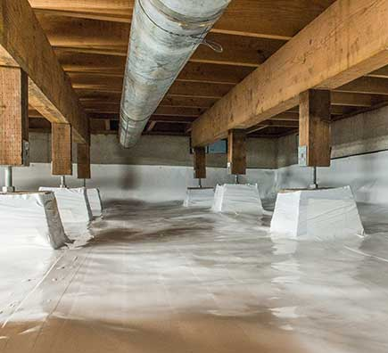
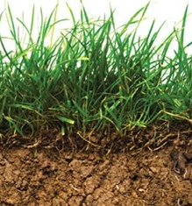

Soil lead results: When to worry, what to do?
Potential actions to consider based on your soil lead test results:
 |  | Lowest risk | Lower risk | Moderate to higher risk | Hazardous waste
Where was the soil tested? Likelihood of human and soil contact: |  | <80 ppm Cal EPA/DTSC screening level | <200 ppm U.S. EPA screening Level | <1,000 ppm | 1,000+ ppm Cal EPA/DTSC: Treat as hazardous waste
 | Infrequent soil contact: Rarely reached, like behind garages or crawlspaces. | Wash hands or body after touching soil. | Exposure is still unlikely. Wash hands or body after touching soil. | Exposure is still unlikely. Wash hands or body after touching soil. | Exposure is still unlikely. Consider the options below if concerned. Wash your hands or body after touching soil.
 | Limited soil contact: Under grass, pavers, or has limited access. | Wash your hands or body after touching soil. | Consider further testing, remediation options, or check blood lead levels. Wash your hands or body after touching soil. | Consider further testing, remediation options, or check blood lead levels. Wash your hands or body after touching soil. | Confirm with additional testing. Consider remediation options; check blood lead levels. Wash your hands or body after touching soil.
 | Frequent soil contact: Walkway, child play area, vegetable garden. | Wash hands or body after touching soil. | Consider further testing, remediation options, or check blood lead levels. Wash your hands or body after touching soil. | Consider further testing; remediation is recommended; check blood lead levels. Wash your hands or body after touching soil. | Remediation is recommended; check blood lead levels. Wash your hands or body after touching soil.
Remediation for soil with higher lead levels may include:
Covering contaminated soil: This can be done by placing clean soil on top, vegetation (such as grass or sod), or using other barriers like pavers or decks.
Professional soil clean-up: Professionals remove the top layer(s) of soil (about 6 inches). After removal, they may retest the remaining soil until it meets health screening levels before adding clean soil on top.
Note: If a single sample exceeds a screening level, it doesn’t necessarily require remediation, as typical practice is to collect multiple samples and average them. If you have concerns, consider where the samples were taken in the yard, consider remediation, or consult an expert.
Created in collaboration with the LAC DPH post-fire soils working group and the USC CLEAN project http://publichealth.lacounty.gov/media/eaton-soil-testing/
LAC DPH http://publichealth.lacounty.gov/media/eaton-soil-testing/
Images: Getty, Posh in progress
Notes:
• Interpret the number together with where the sample was taken and how often people contact that soil.
• For frequently used areas, higher results support additional testing, blood testing when appropriate, and remediation.
• One high sample should be confirmed in context; multiple samples and professional interpretation are more useful than a single isolated number.

Slide 14
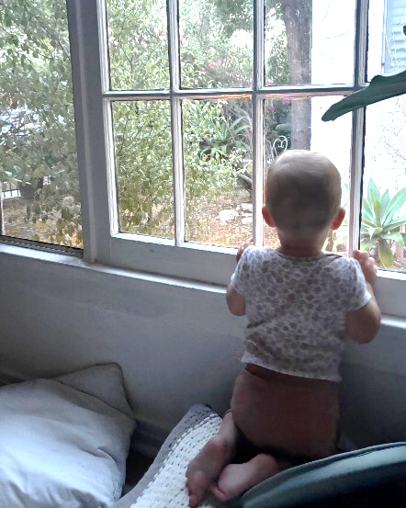


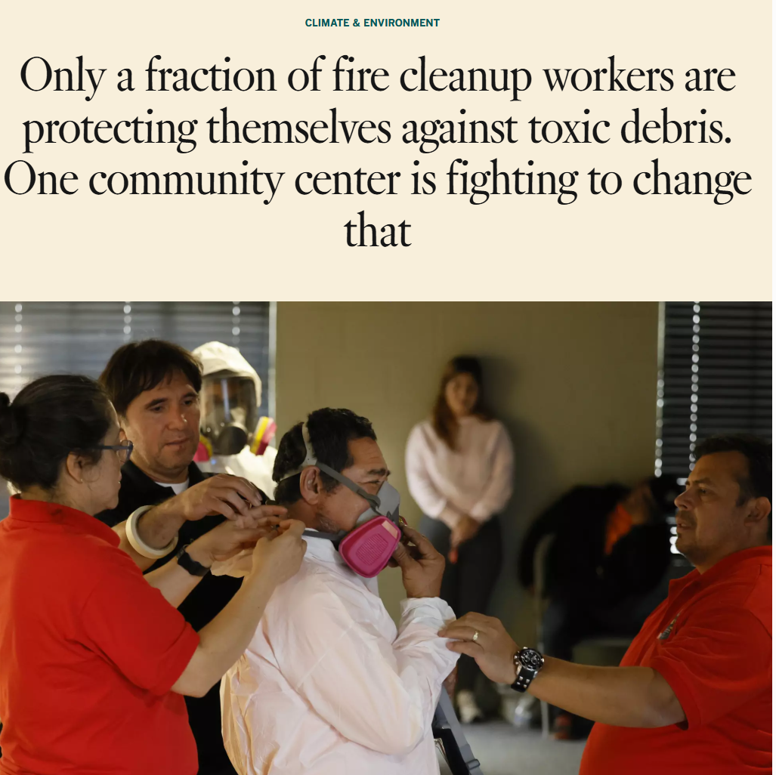

Learning Activity:
Consider each case study. Where might fire contaminants be present? How might each person be exposed? What could reduce exposure?
SCENARIO #1: KIDS AND BABIES
      Grace is 10 years old, has asthma, lives directly across from the fire zone, and walks to school.
She rents a small apartment in an older building built in the 1920s.
Her building has no direct fire damage, but she lives near the burn zone and experienced significant smoke exposure.
Her 1-year-old sister loves looking out the window and always has her hands in her mouth.
Outside is bare soil with plants, but concrete sidewalks lead to and from the house.
What might the family consider to reduce exposures? What areas might be priorities for keeping clean?
SCENARIO #2: CLEANING AND WORKER HEALTH
Clara is 60 years old, has high blood pressure, and works in housekeeping in the fire zones. It’s hard for her to do housekeeping while wearing a mask, and she doesn’t think you need to wear one indoors. Plus, she doesn’t want your clients to believe she is sick.
She cleans homes 8 hours a day using what is available: vacuuming, wiping surfaces, dry sweeping with a broom, etc.
She has young kids at home
What might Clara and her family consider to reduce exposures?
https://www.latimes.com/environment/story/2025-05-22/fire-cleanup-workers-not-protecting-themselves-against-toxic-debris
Notes:
See facilitation guide.
• For Grace, focus on windowsills, floors, entryways, and clean play areas for her younger sibling.
• For Clara, focus on worker protection, wet methods, HEPA vacuuming, changing clothes, and preventing take-home exposure to her family.
• Ask participants to identify both the exposure and the barrier to protection, not just the ideal recommendation.

Slide 15
Tips for gardening if concerned about lead in soil:
Remember that:
It is always ideal to get your soil tested to know if you have issues!
Replacing soil in raised beds can help reduce risk, but remember that soil from hardware stores is also not tested for metals such as lead.
Wash produce!
Wash your hands and your body after gardening activities!
Great links to guides and information for gardeners with potential soil contaminants:
    https://ucanr.edu/site/urban-agriculture/soil-contaminants-and-soil-testing
    http://publichealth.lacounty.gov/eh/docs/ab1990_soilwatertestingguidelines.pdf
    https://extension.oregonstate.edu/catalog/pub/em-9397-5-steps-healthy-produce-during-wildfire-smoke
15
Notes:
• If gardening is a concern, testing provides the clearest starting point.
• Wash produce and wash hands and clothing after gardening; these steps also reduce direct ingestion of soil.
• Raised beds can help, but purchased soil is not automatically tested for metals, so do not assume it is contaminant-free.

Slide 16
Key Points:
Protecting yourself from post-fire contaminants
What you need to know to protect yourself!
1. Why is lead a common contaminant found after fires that reach urban areas?
Lead is a widespread contaminant released from fires burning homes, cars, appliances, and building materials. It has often been found in wildfire smoke, ash, dust, and soil. However, because lead is already common in the environment due to past pollution, it can be hard to determine how much comes from fires.
16
Notes:
• Lead is used as a focus because it is common in urban environments and can be released by burned buildings and vehicles.
• It may be found in smoke, ash, dust, and soil, but historical contamination can make the source difficult to determine.
• Best practice is to reduce contact and interpret results in context.

Slide 17
Key Points:
Protecting yourself from post-fire contaminants
What you need to know to protect yourself!
2. How do you know if you’ve been exposed? Who is at risk?
A blood test measuring the lead levels in blood is the best measure of lead exposure. Babies, children, and pregnant people are most at risk for health impacts from lead.
Lead (or other contaminants) in dust and soil only pose a risk:
  If they are present at high levels AND
  If there is a chance of breathing in, accidentally swallowing, or eating a significant amount of soil or dust.
17
Notes:
• Blood lead testing is the best available measure of recent exposure.
• Risk from dust or soil requires both contamination and a meaningful route into the body, such as breathing disturbed dust or hand-to-mouth contact.
• Children, babies, and pregnant people warrant extra protection because they are more vulnerable.

Slide 18
Key Points:
Protecting yourself from post-fire contaminants
What you need to know to protect yourself!
3. I’m concerned about lead and other contaminants in and around my home. What can I do?
Consider:
Professional testing for interior dust or exterior soil after a fire if your home was affected by smoke, ash, soot, char, or dust.
Professional remediation services for cleaning. If you do not have access to these services, consider PPE and best practices for cleaning.
Getting a blood test for lead for you and your family.
18
Notes:
• Consider testing if the home or yard was affected by smoke, soot, ash, char, or dust. Consider context such as who lives in the home and who would be most vulnerable and reduce exposures.
• Professional cleanup is safest when contamination is substantial; otherwise, use PPE and wet-wiping methods.
• A blood lead test can provide additional reassurance or identify the need to look for an ongoing source.

Slide 19
Additional Lead Information

Slide 20

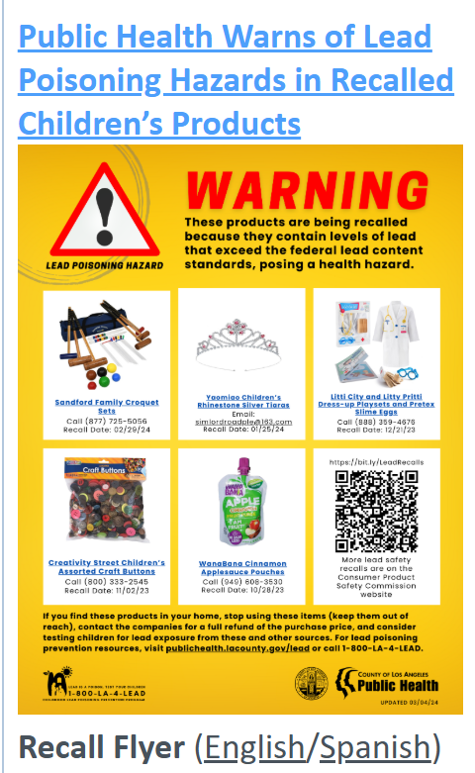

Common sources of lead poisoning
Cases of lead poisoning are often linked to dust in older homes with lead paint and sometimes, commercial products (see right).
Lead poisoning from fire-related contaminants, such as from settled smoke, soot, char, and ash, has not yet been seen, but it’s still good to be cautious.
Soil ingestion is rarer, and it's easy to avoid hand-to-mouth contact with soil, but it can still contribute to lead exposure.
Recent recalled products with high lead levels:
http://publichealth.lacounty.gov/lead/
Notes:
• Most lead-poisoning cases are linked to older housing and lead-containing products, not documented fire residue.
• Soil can contribute, but hand-to-mouth soil exposure is usually easier to prevent than exposure to deteriorating lead paint inside a home.
• This distinction helps target prevention without dismissing post-fire concerns.

Slide 21
Children and Lead
Children's smaller bodies result in higher lead exposure than adults.
Children absorb up to 40-50% of the lead they ingest (eat/drink) while other adults absorb 10-15%. Pregnant women are at increased risk of passing on lead stored in their bodies or from new exposures to their babies.
Minority and low-income children may be at higher risk of lead exposure:
        Live in older, poor-quality housing units (i.e., old, chipping paint).
        More likely to miss out on healthy nutrition. Nutrients like vitamin C, iron, and calcium help reduce lead absorption in the body.
          Good nutrition that reduce lead uptake in the body include vegetables such as broccoli, avocados, leafy greens, and sweet potatoes, as well as fruits like bananas. Iron and calcium can also be found in meat and dairy products.
Key point:
Children and pregnant women are more vulnerable to lead exposure, especially if they live in older homes or do not eat enough healthy foods.
Agency for Toxic Substance and Disease Registry (ATSDR) Toxicological Profile for Lead. US Department of Health and Human Services; 2020.
Sample J. Lead exposure in children: failure to protect the most vulnerable. The Journal of Pediatric Pharmacology and Therapeutics. 2024 Jun 1;29(3):212-4.
Notes:
• Children absorb a larger share of ingested lead and have developing brains and bodies, so prevention matters at lower exposures.
• Pregnancy is also a sensitive period because stored or new lead exposure can affect the fetus.
• Nutrition, housing quality, and environmental conditions can overlap and increase risk.

Slide 22
Lead poisoning is now rare:
Child Blood Lead Levels over time have reduced significantly!
The mean blood lead level (BLL) in today’s children and adults is now under 1 µg/dL (CDC 2020). This is a significant decline in blood lead levels, resulting from the removal of lead from gasoline, paint, and other products that led to higher lead exposures in previous decades.
The new 2025 CDC BLL reference levels are even more protective, at 3.5 µg/dL.
Year | Mean Blood Lead Level for Children 1-5 years of age (µg/dL) | Blood lead level considered to be of concern (µg/dL)
1971 | 150 | 400
1988 | 50 | 250
2011 | 10 | 50
2025 | Less than 1 | 3.5
Key point:
Low levels of lead exposure can still pose health risks, but overall lead exposure and blood lead levels have decreased significantly in the past 30 to 50 years, reducing these health risks.
Lanphear B et al. N Engl J Med 2024;391:1621-1631
Notes:
• Lead exposure has fallen dramatically because lead was removed from gasoline, paint, and many products.
• The reference level has also become more protective as evidence has improved.
• The main message is reassurance plus prevention: modern average levels are much lower, but ongoing sources should still be identified and reduced.

Slide 23
Current Recommended Lead Treatments:
Blood Lead Levels of concern for children
CDC Recommended Treatment for Children’s Blood Lead Levels
BLL Result | Recommended Treatment Action
Less than 3.5 µg/dL | Reduce exposure and educate on common sources and how to prevent exposures.
3.5-19 µg/dL | All of the above, plus: Explore any potential exposures and arrange home investigation (Dept. of Public Health). Check child development. Discuss diet and nutrition, focusing on iron and calcium, which can help reduce lead absorption. Ensure no iron deficiency. Follow-up blood lead level testing.
20-44 µg/dL | All of the above, plus: Arrange for a lead hazard reduction program. Consider an abdominal X-ray to check for lead-based paint chips and other objects, which is especially important for young children who tend to ingest non-food items. Contact a Pediatric Environmental Health Specialty Unit or the Poison Control Center.
Above 45 µg/dL | All of the above, plus: Consider admitting to the hospital if an unknown exposure or further lead exposure (unsafe home). If signs of lead poisoning are present, seek immediate medical attention at a hospital. Signs include confusion, weakness, seizures, coma, nausea, vomiting, and abdominal pain. Consult with a medical toxicologist or specialist to initiate: Gastrointestinal decontamination (removal of lead using laxatives) or Chelation therapy (medication used to remove lead from the body).
Remove and reduce exposure(s)!!
Reduce exposure(s) and consider medical interventions.
Immediate medical attention
Key point:
High blood lead levels (BLLs) are rare, but when they occur, medical treatment typically focuses on identifying and reducing further exposure, followed by re-testing.
CDC: https://www.cdc.gov/lead-prevention/php/news-features/updates-blood-lead-reference-value.html
Notes:
• Treatment is driven by the blood lead result and symptoms, but the first step at most levels is identifying and stopping the source.
• Higher results call for more intensive investigation, follow-up testing, and specialist consultation.
• Very high levels or symptoms such as confusion, seizures, severe weakness, or vomiting require immediate medical attention.

Slide 24

Populations who may have higher exposures or who are more vulnerable to lead (or other fire contaminants) from indoor dust or outdoor soil
Infants, toddlers, young children:
  Everything goes into the mouth (increasing eating dust, dirt)
  On the floor and close to the ground more often
  Especially at risk if already living in older, poor-quality housing
  Especially if nutrition is limited
Cleanup or outdoor workers:
  Workers without PPE (or who incorrectly wear PPE) who are routinely cleaning up dust, ash, or soil
Other specific scenarios with higher lead exposures for self and family:
  Jobs include smelting, battery recycling, and construction, such as renovation of older homes.
  Use of some lead-containing products: jewelry, ceramics, spices, etc.
  Persons who use firearms or have retained bullet fragments in their bodies.
Lanphear B et al. N Engl J Med 2024;391:1621-1631
Notes:
• Higher risk can come from vulnerability, greater contact, or both.
• Children are close to floors and use hand-to-mouth behavior; cleanup and construction workers may repeatedly disturb contaminated material.
• Remember take-home exposure: dust on clothing, shoes, tools, and hands can affect family members.

Slide 25
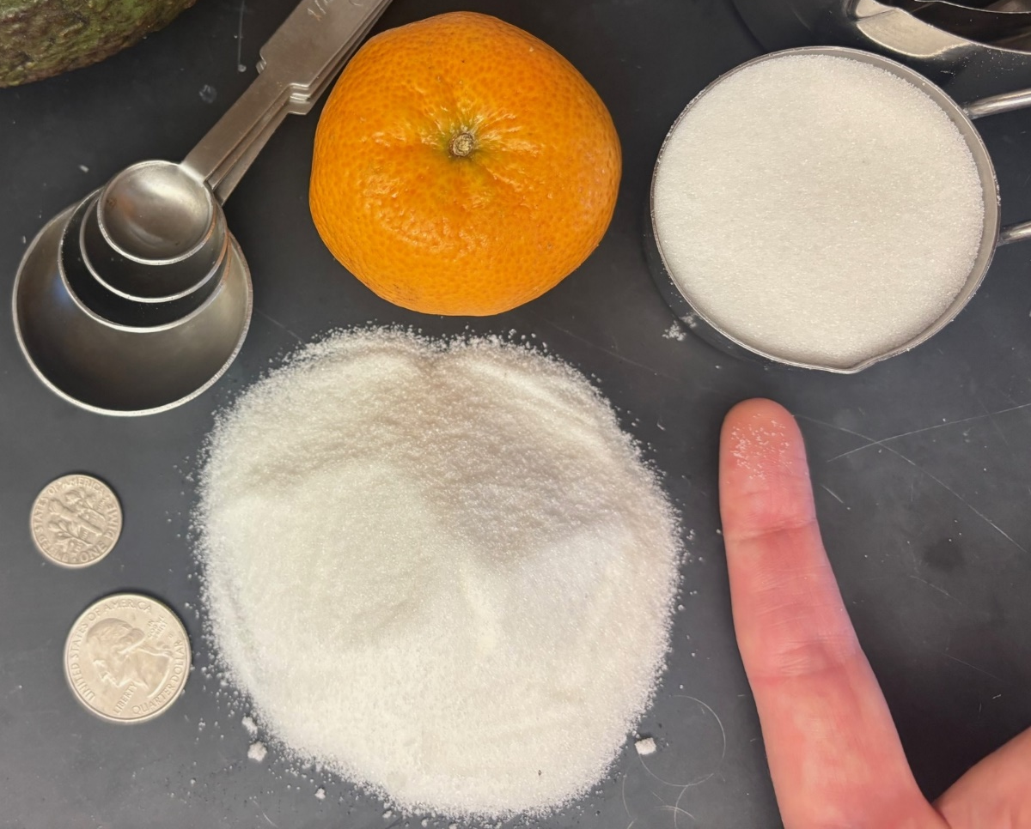
What is a part per million (ppm)?
Using sugar as an example:
80 ppm would be about 80 grains of sugar mixed within 1,000,000 grains of sugar.
This is a very tiny amount, or 0.008% of the big mound of sugar.
1M, or ~1,000,000 grains of white granulated sugar in 1/3 cup of sugar
Key point:
Measurements in ppm are very small and are considered trace amounts. Keep this in mind when interpreting soil test results in ppm, or blood lead levels (which are also measured in ppm, or µg/dL).
~80 grains of white granulated sugar in this circle on a finger
https://dtsc.ca.gov/wp-content/uploads/sites/31/2025/05/LeadSpread-9.1-Information-for-Users-December-2024.pdf
Notes:
• Parts per million can look large on a lab report but represent very small proportions.
• The number still matters, but it should be interpreted with the screening level, sample location, and likelihood of contact.
• Use the sugar example simply to explain the unit, not to imply that all trace amounts are harmless.

Slide 26
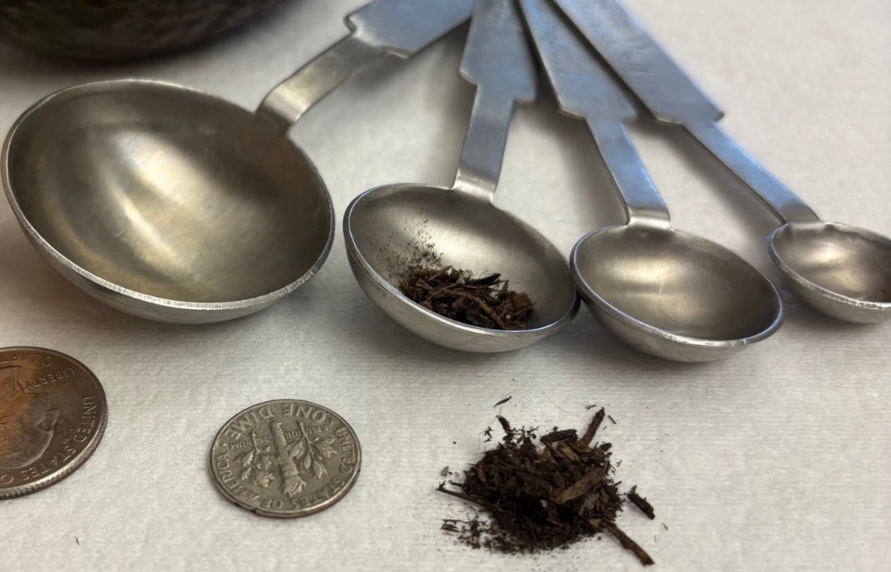
How lead screening levels in soil protect your health
During the LA fires, soil screening levels were questioned, and some residents were left wondering if the California 80 ppm would protect their health. So let’s look at how these soil screening levels protect our health.
Soil screening levels are set to assume daily exposure and are designed to protect people, especially children and pregnant women.
A loss of 1 IQ point in children was attributed to a 1 µg/dL increase in children’s blood lead levels.
To set the 80-ppm screening level, CalEPA estimated a “worst-case” exposure scenario for a child (aged 1-6 years), to occur EVERY DAY for 90 days:
      Incidental ingestion of 80 mg of soil (about 1/4 of a teaspoon), plus small amounts of lead inhaled and absorbed through the skin.
      Assumes a high level (60%) of lead is taken up by the body (the rest typically binds to other soil minerals), with 16% dissolving in the bloodstream.
      From this, 80 ppm had no more than a 2.5% chance of causing any health effect for a child on a daily basis, in this worst-case exposure scenario.
80 mg of dry soil is about 1/4 of a teaspoon, eaten every day!
Key point:
This amount of daily exposure is unlikely to occur for most children, even in homes where the soil contains 80 ppm of lead.
https://www.nature.com/articles/s41370-025-00796-w
https://www.latimes.com/environment/story/2025-08-11/scientists-argue-for-stricter-lead-soil-contamination-standards
https://dtsc.ca.gov/wp-content/uploads/sites/31/2025/05/LeadSpread-9.1-Information-for-Users-December-2024.pdf
Notes:
• The California screening level was built from a health-protective child exposure model using repeated daily soil ingestion.
• The model intentionally uses conservative assumptions to identify when more attention may be warranted.
• Most children will not ingest this amount every day, which helps explain why the screening level is protective rather than a prediction of harm.

