Slide 1

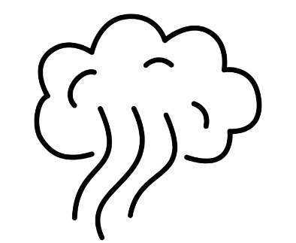
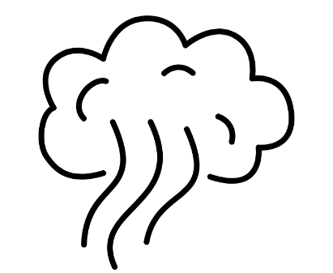
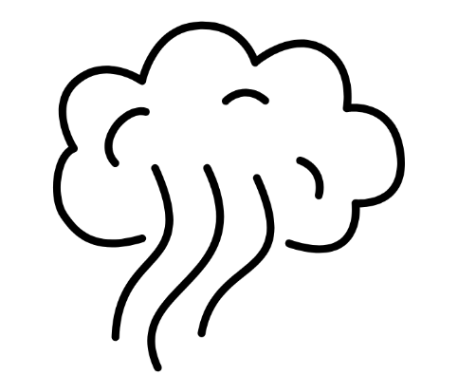




During the Fire:
Smoke, Air Quality, and Protecting Yourself f
Booklet B from the Understanding Health Impacts of Wildfires in Urban Areas series
Lead Authors: Savanna Carson, Katherine McNamara. For the complete list of authors, editors, and reviewers, see the website.

Slide 2

During the Fire: Smoke, Air Quality, and Protecting Yourself
Agenda:
How smoke travels in our bodies and affects our health
How do we measure air quality normally and during smoke events?
LA Fires 2025: How air quality changed quickly and traveled far across Southern California
How to: Choosing the right protective mask for smoke and any debris cleanup
How to: Reduce smoke getting indoors
LEARNING ACTIVITY: Identify the ways to reduce exposure to smoke
Review of key points
Series Note: This series addresses some of the health concerns from wildfires that reach urban areas. These fires are also called Wildland-Urban Interface (WUI) fires. Since the general public may not use the term WUI, we use “wildfires that reach urban areas” or, more briefly, “fires” to refer to large, catastrophic fires that may also burn buildings, cars, and other non-natural sources.
Key point!
Look for these “Key points” throughout this handout for the most important summaries.
Notes:
• Preview the session: how smoke moves through the body, how to monitor it, what happened during the LA fires, and how to protect indoor air and choose masks.
• Tell participants the focus is practical decision-making during rapidly changing smoke conditions.
• Questions about post-fire dust and soil are addressed more fully in Presentation C.

Slide 3
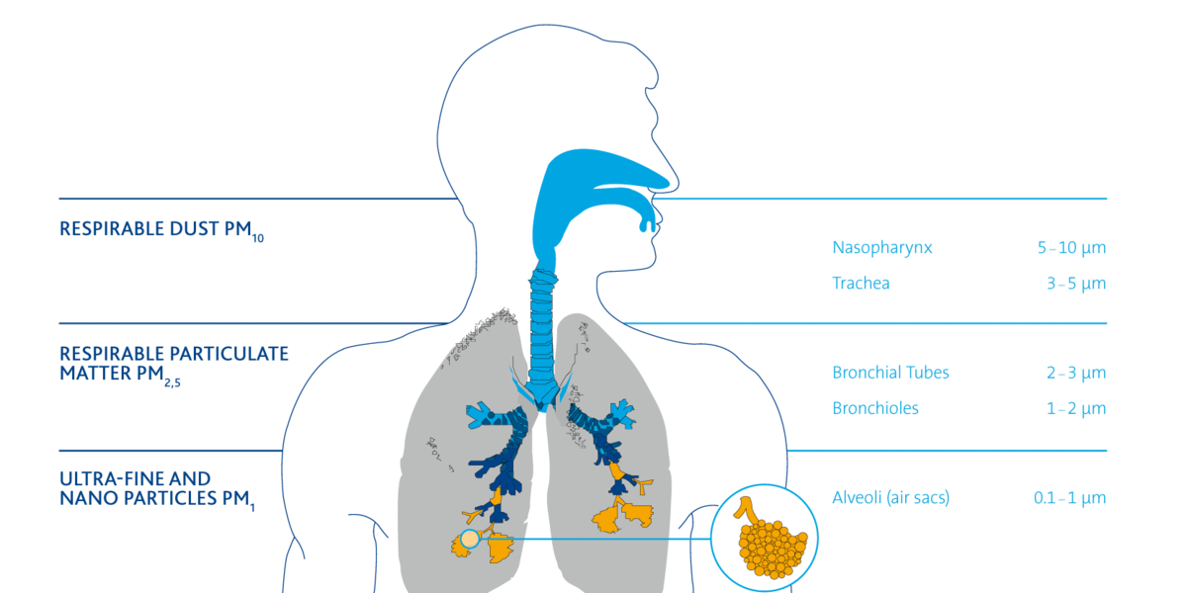
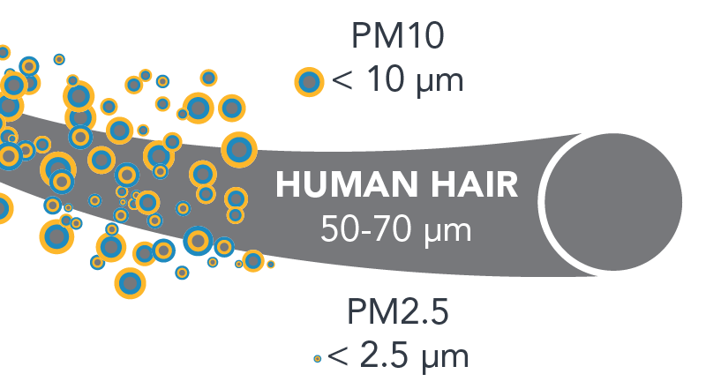


How smoke travels in our bodies and affects our health
Wildfires that reach urban areas create harmful smoke from building materials and cars, making it more harmful than other air pollution. Smoke contains a mix of gases and small particles (particulate matter, or PM). These smaller particles and gases bypass many defense systems, traveling further into our bodies, even past the lungs into our blood, heart, and brain.
Our bodies’ defenses include tiny hairs and mucus (or boogers!), that regularly help trap and clear particles from the air in our respiratory system. But the small particles in smoke are harder for the body to capture and clear.
Particulate matter (PM) is much smaller than a human hair and invisible, but when we breathe it in, it affects our health.
PM₁₀
Upper respiratory tract: nose, mouth, throat
PM_{2.5}
Lower respiratory tract: upper chest and lungs
Key point!
Harmful smoke particles can travel deep into our lungs and body, affecting our health.
3
PM₁
Deep lung air sacs (alveoli)
Image (top): the California Air Resources Board
Image (bottom): https://www.freudenberg-filter.com/en/company/why-filtration/
Notes:
• Smoke includes gases and different-sized solids or particles. The smallest particles can travel deep into the lungs, and some can enter the bloodstream.
• Our defenses capture some material, such as the tiny hairs and mucus that trap some of the bad stuff we breathe in and help get rid of it, but these defenses are less effective against the very small particles in smoke.
• The key point is that small invisible smoke particles can still cause harm, even when the air does not look smoky.

Slide 4
How do we measure air quality normally and during smoke events?
The Air Quality Index (AQI) measures some typical air pollutants giving us a “daily report” of air quality, but it does not capture everything found in wildfire smoke. The AQI tracks daily:
  Gases (ozone, carbon monoxide, sulfur dioxide, & nitrogen dioxide)
  Particulate matter, or the tiny particles in the air, is measured by size (PM2.5 and PM10).
Los Angeles had an average AQI of 43 in 2024. LA’s transportation and smog typically raise the AQI.
One pollutant that AQI measures is PM_{2.5,} which measures the amount, or concentration, of tiny particles in the air, but not what those particles are made of. PM_{2.5} is the best overall indicator of smoke levels, and some agencies use a wildfire-specific PM_{2.5} AQI to communicate smoke-related health risks.
What is a healthy AQI or PM_{2.5} level?
AQI or PM_{2.5} AQI | Health Rating | What to do: Sensitive groups include people with health conditions, pregnant people, older adults, and young children.
0-50 | GOOD |  | Play outside!
51-100 | MODERATE |  | Consider slowing down and spending less time outdoors for sensitive groups.
101-150 | UNHEALTHY FOR SENSITIVE GROUPS |  | Sensitive groups, such as children, should limit or reduce intense outdoor activities. Consider calm indoor activities. If necessary, carry an inhaler.
151-200 | UNHEALTHY |  | Limit all outdoor activity.
201-300 | VERY UNHEALTHY |  | Eliminate outdoor activity. Everyone's health risk is higher.
301-500 | HAZARDOUS |  | Avoid outdoor activity.
AQI or PM_{2.5} AQI scale from: https://www.airnow.gov/publications/air-quality-index/technical-assistance-document-for-reporting-the-daily-aqi/
Notes:
• AQI is a useful daily summary or typical air quality from things like transportation, smoke and pollution, but during fires we pay special attention to PM2.5 because it tracks the concentration of small smoke particles.
• Use the color bands as action levels for the AQI or the PM2.5 AQI: above 100, sensitive groups should reduce activity; at higher levels, everyone should limit or avoid outdoor activity.
• AQI does not tell us exactly which chemicals or metals are in the smoke or smoke particles, so it is not a complete measure of urban-fire smoke but still a helpful tool to gauge air quality during smoke.

Slide 5

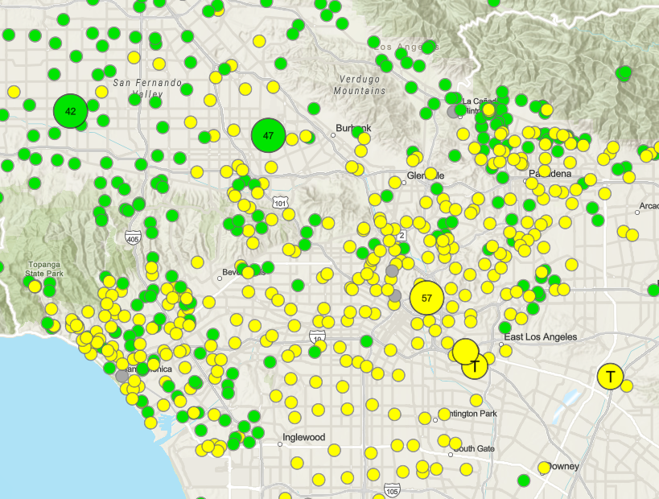
How can I check the smoke levels in my area?
The AQI in weather apps is useful for everyday pollution but may not update quickly for fire smoke. During fires, use sources with rapid PM 2.5 AQI readings, such as EPA’s map.
EPA Air Now - Fire & Smoke Map: https://fire.airnow.gov/
California Air Resource Board Smoke Spotter App: https://ww2.arb.ca.gov/resources/fact-sheets/california-smoke-spotter/
Don’t use your phone’s weather app (AQI only, lacking real time smoke measurements that capture rapid PM 2.5 readings)
Key point!
During fires, check smoke levels using sources above instead of the regular air quality numbers found on weather apps.
Protect yourself from smoke even if the air looks clear, because AQI and PM_{2.5} don’t measure many smoke contaminants.
If you see different numbers, pick the highest one to stay safe!
Discussion: What air quality sources did you use during the fires?
Notes:
During fires, use air quality resources that rapidly changing smoke levels, such as the EPA AirNow Fire and Smoke Map.
• Regular weather apps can lag because the underlying measurements may be averaged over longer periods or come from fewer stations.
• If reliable sources disagree, using the higher reading is a cautious approach, and visible or nearby smoke is still a reason to protect yourself.

Slide 6
Comparing PM 2.5 concentrations and cigarettes
This chart compares health impacts associated with PM2.5 levels to the number of cigarettes smoked per day.
What are normal PM 2.5 levels? In many areas and cities, average outdoor PM 2.5 is often low, such as around 10-20 µg/m³, but during wildfires, levels often reach 90-130 µg/m³ or higher!
BUT! Wildfire smoke is likely even more harmful than cigarette smoke. And urban wildfires are different: Fires that burn buildings and cars can release heavy metals, chemicals, plastics, and asbestos. Most air quality monitors do not measure these toxic contaminants.
PM 2.5 µg/m³ | Cigarette equivalent per day
50 | 2
100 | 4.5
150 | 7
200 | 9
250 | 11
300 | 14
400 | 18
500 | 23
Key point:
If PM2.5 levels are 200 µg/m³, breathing that air for a full day has a similar effect on your body as smoking 9 cigarettes! And yet, fire smoke is likely even more toxic than smoking cigarettes.
Estimate provided as PM2.5 level of 22 µg/m³ = 1 cigarette by research from: https://berkeleyearth.org/air-pollution-and-cigarette-equivalence/
Notes:
• This comparison is a health communication tool, not a claim that wildfire smoke and cigarettes are identical. Both are toxic to your lungs, but may have different ingredients.
• It shows that sustained high PM2.5 can represent a large health burden, and urban-fire smoke may contain additional contaminants from buildings and vehicles.
• This may help make risk understandable, then return to the practical message: reduce exposure as much as possible.

Slide 7

Smoke can change the air quality quickly :
Los Angeles 2025 Fires
2025
LA Fires
Air quality can change drastically during wind and fires.
Checking smoke levels during fires is important, even far away.
Santa Monica: January 9, 2025
Time | EPA AirNow Fire and Smoke Map PM2.5 AQI
2 AM | 47 (Good)
7 AM | 210 (Very Unhealthy)
12 PM | 150 (Unhealthy for sensitive groups)
5 PM | 95 (Moderate)
Typical levels | 12-38 (Good) on average
For example, after the 2025 Palisades fires started on January 7th, Santa Monica’s air quality changed drastically hour by hour on January 9th as the fires spread, reaching unhealthy and hazardous levels. Air quality did not return to typical levels until January 12th (see smoke plume image below).
Notes:
• Look at the case of Santa Monica during the 2025 Palisades fires to show how quickly smoke conditions changed within one day.
• Encourage repeated air quality checks, assume the air outside isn’t healthy when there are local large fires and aim for flexible plans for schools, outdoor work, travel, and exercise to reduce any smoke exposure.

Slide 8
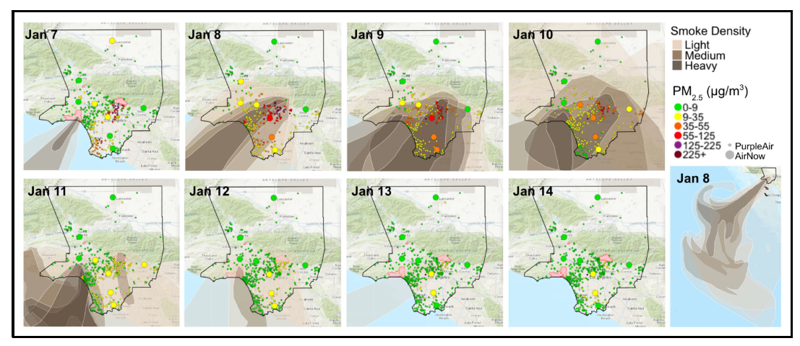
Smoke can travel very far:
Los Angeles 2025 Fires
2025
LA Fires
Wildfire smoke can travel far! The figure below shows Los Angeles County and the smoke plume bringing unhealthy air quality to areas hours away from the fire.
Tuesday
Wednesday
Thursday
Friday
Discussion: Do you think people in far away from the fire (for example, Long Beach) realized they were in heavy smoke?
Saturday
Sunday
Monday
Tuesday
Zoomed-out shot of LA County showing how far the smoke went.
Image (bottom): Schollaert C, Connolly R, Cushing L, Jerrett M, Liu T, Marlier M. Air quality impacts of the January 2025 Los Angeles wildfires: Insights from public data sources.
Notes:
• As you can see from these maps, the smoke plume travels much farther than near the fire, affecting communities across Southern California, including places far from the flames.
• This is why regional schools and organizations may need to act to keep lungs healthy and prevent smoke exposure even when they are not directly threatened by fire.
Dicussion: Do you think distant communities, such as Long Beach (if an LA crowd) understood they were in smoke and what communication channels reached them.

Slide 9
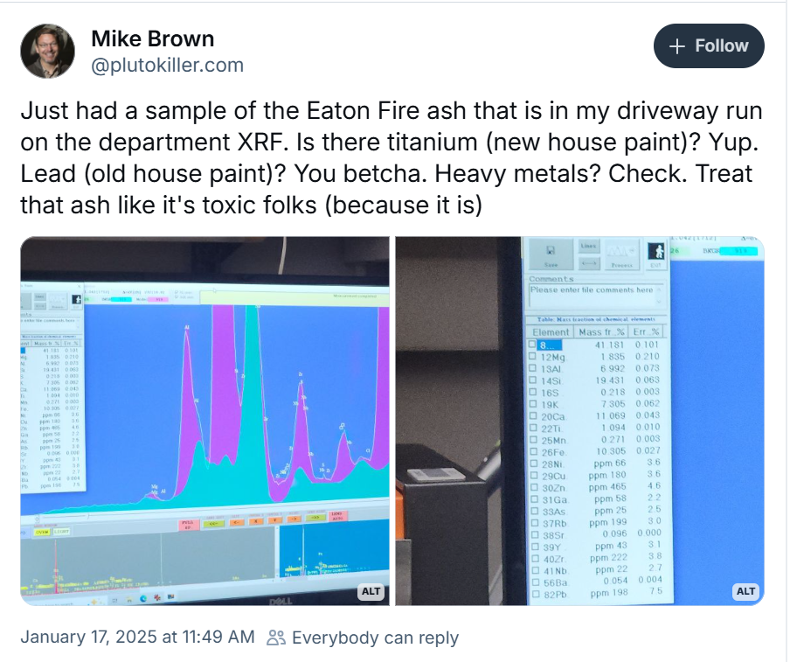
What we were unable to measure through the air quality index…
Los Angeles 2025 Fires
2025
LA Fires
Some common TRACE metals found in air from wildfires:
Arsenic
Cadmium
Chromium
Copper
Lead
Magnesium
Mercury
Nickel
Zirconium
Long-term exposure can cause health issues over time, including lung and heart health problems, brain damage, and increased risk of certain cancers.
Short-term exposures may lead to lung and skin irritation, headaches, nausea, and heart health issues (such as increases in blood pressure).
Notes:
• AQI and PM2.5 tell us how much of certain pollution is present, but not the full chemical mixture.
• Urban-fire smoke may contain trace metals and other contaminants from paint, vehicles, wiring, appliances, and building materials.
• Here’s a great real-life example of a local scientist who tested the ash in their driveway for chemical composition and found many examples of metals in the ash.
Remember that exposure to breathing in these toxic things in smoke depends on concentration of these in the air, duration of smoke exposure, location to the fire, and any protection used.

Slide 10
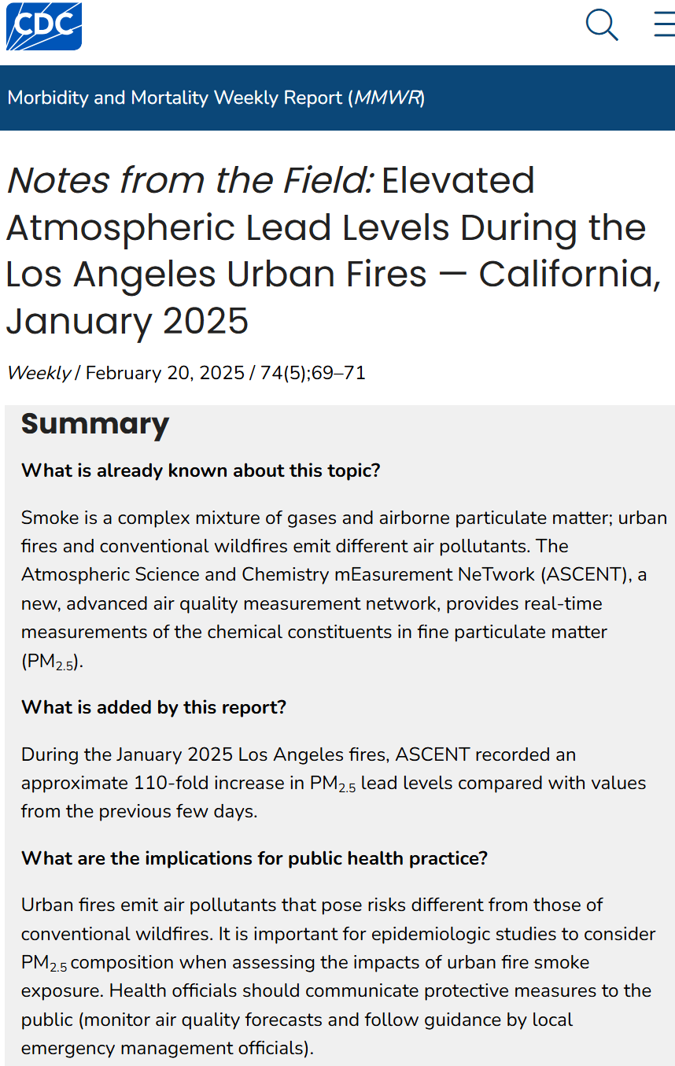
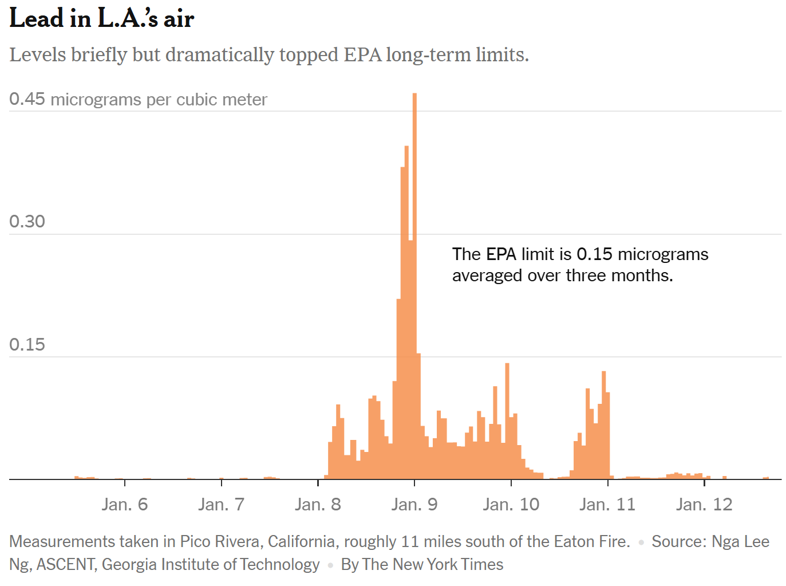
Lead Levels in LA Wildfire Smoke:
Los Angeles 2025 Fires
2025
LA Fires
*Note: EPA and other limits aren’t technically designed for the complex mix of chemicals present in wild/urban fire smoke.
Notes:
https://aqrc.shinyapps.io/ascent_public_socal/
The limited monitoring found elevated airborne lead during the early fire period, followed by a rapid decline.
• These measurements came from only a few locations, so they do not describe every neighborhood.
• The practical takeaway is to be especially cautious during the active fire and first days of heavy smoke, even when routine AQI does not capture every contaminant.

Slide 11
What can we do to reduce our exposure to smoke?

Slide 12
How to reduce smoke getting indoors (1/2)
My home has: | Do: | Don’t:
No central A/C or heat | Do: close windows, doors, or vents. Consider tightly sealing your chimney with a flue stopper or inflatable blocker. Do: use a HEPA air purifier, especially in bedrooms of children, older adults, or people with health conditions. | Don’t: run systems that will pull in smoke, such as window A/C units, attic fans, or swamp coolers
Central air conditioning or heat: Commonly called an HVAC, or heating, ventilation, and air conditioning system | Do: Close windows, doors, or vents. Consider sealing your chimney tightly with a flue stopper or inflatable blocker. Do: Check the HVAC unit for filters and upgrade to MERV-13 if possible. Note: HEPA filters create too much resistance for most central HVAC units. Do: Run the HVAC system in recirculate mode while it is smoky outside, so outside air is not brought in. Do: Replace air filters once the smoke is over. Then run your HVAC system using outside air (not recirculate mode) to vent your home. | Don’t: replace air filters daily. They become more effective as they load with particulate.
You can make an air purifier! See slide 12
12
EPA guide to air cleaners https://www.epa.gov/indoor-air-quality-iaq/guide-air-cleaners-home#:~:text=To%20filter%20particles%2C%20choose%20a,particulate%20air%20(HEPA)%20filter.
LA Fire Health Study Data Brief 5: Levels of VOCs in Indoor and Outdoor Air Before, During, and After Fires: lafirehealth.org/wp-content/uploads/2025/04/040425-LA-Fire-HEALTH-Data-Brief-5-FINAL.pdf
South Coast AQMD. 2025 Wildfire Response. https://www.aqmd.gov/2025-wildfire-response
Goftari E, et al. Post-Wildfire Indoor Pollution in WUI Areas following the 2025 Los Angeles Fires. Part I. Establishing Baseline Contaminant Levels Prior to Home Reoccupation. ACS EST Air. 2025 Dec 19;3(1):142-155.
Notes:
• First identify whether the home brings outdoor air inside. Close openings and avoid systems that pull smoky air directly indoors.
• For central HVAC, use the best compatible filter, ideally MERV-13 when the system can handle it, and use recirculation during smoke.
• After smoke clears, replace filters as appropriate and ventilate when outdoor air is healthy.

Slide 13


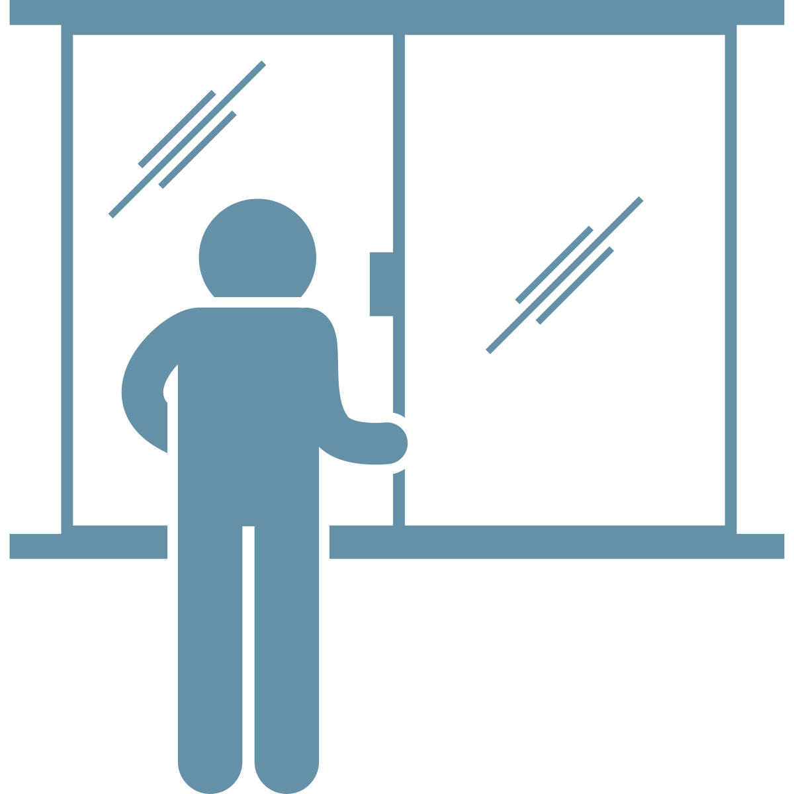

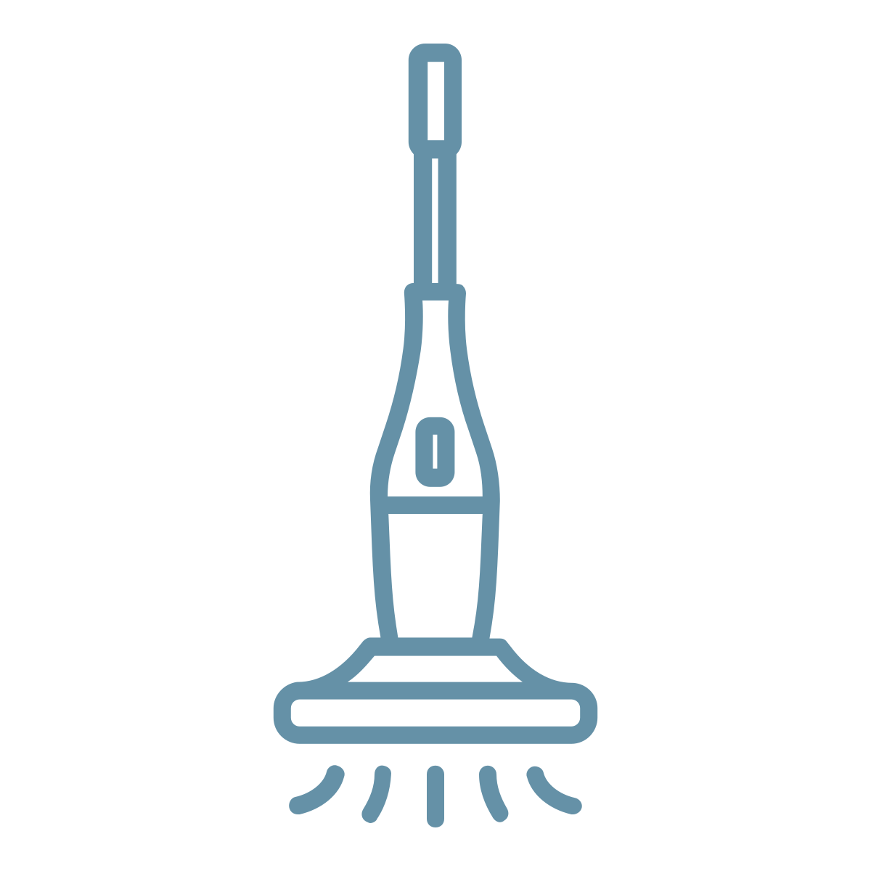
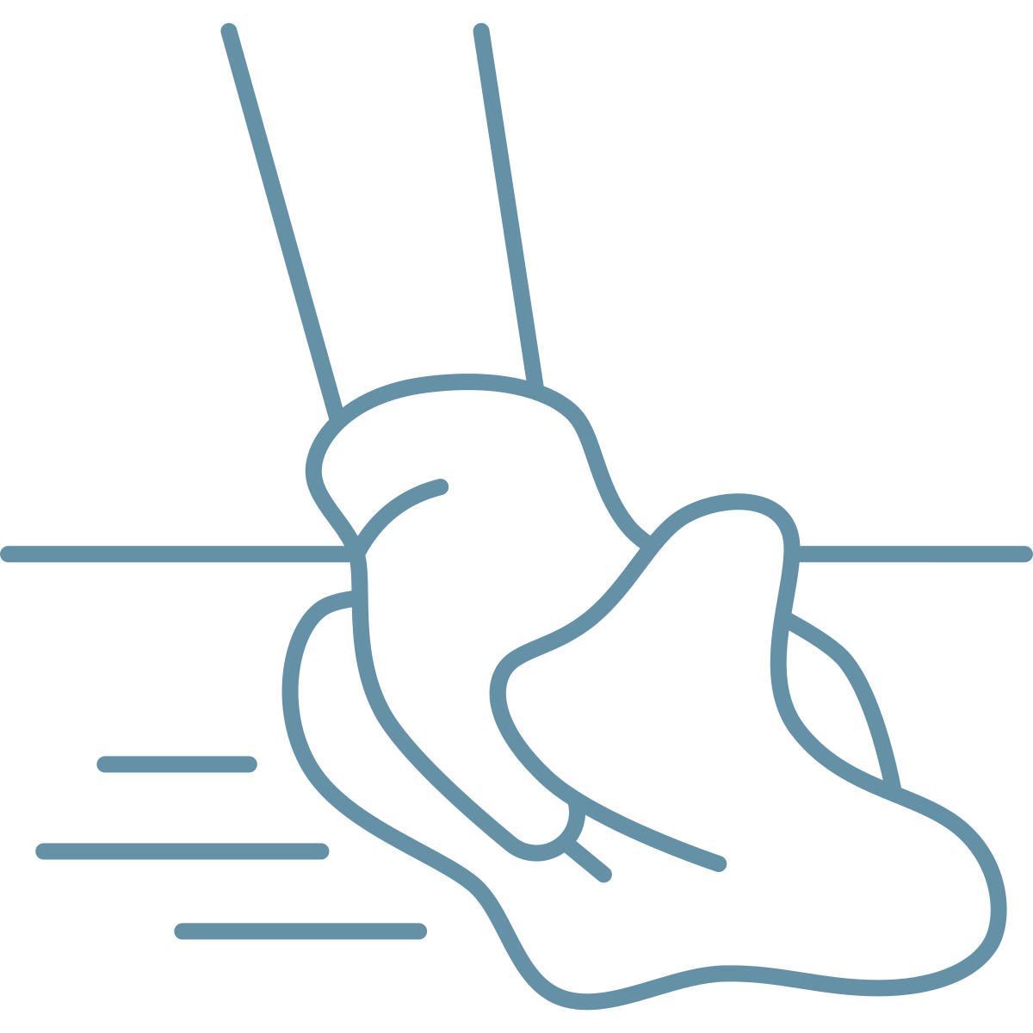

How to reduce smoke getting indoors (2/2)
For all homes:
Reduce indoor air pollution:
  Don’t track dust and dirt into the house or car from outside.
  Clean feet of pets to avoid tracking in contaminants.
  Keep car air filters up to date.
  Eliminate other sources of indoor air pollution by reducing use of gas appliances, candles, air fresheners, fragrances, cleaning products, and other chemicals.
Reduce dust disturbance:
  Don’t kick up any settled dust where smoke contaminants have settled on indoor surfaces.
  Avoid sweeping or dusting.
    Use HEPA-filtered vacuums.
    It is best to have professionals conduct post-fire cleaning, but if you must, use appropriate personal protective equipment (PPE) and wet wipe with soap and water. For cleaning after fires, see Booklet C and masks to wear on slide 9.
13
EPA guide to air cleaners https://www.epa.gov/indoor-air-quality-iaq/guide-air-cleaners-home#:~:text=To%20filter%20particles%2C%20choose%20a,particulate%20air%20(HEPA)%20filter.
LA Fire Health Study Data Brief 5: Levels of VOCs in Indoor and Outdoor Air Before, During, and After Fires: lafirehealth.org/wp-content/uploads/2025/04/040425-LA-Fire-HEALTH-Data-Brief-5-FINAL.pdf
South Coast AQMD. 2025 Wildfire Response. https://www.aqmd.gov/2025-wildfire-response
Goftari E, et al. Post-Wildfire Indoor Pollution in WUI Areas following the 2025 Los Angeles Fires. Part I. Establishing Baseline Contaminant Levels Prior to Home Reoccupation. ACS EST Air. 2025 Dec 19;3(1):142-155.
Notes:
• Reduce indoor sources of pollution because smoke is already adding to the air quality burden inside the home.
• Avoid stirring settled material. Use wet cleaning and a HEPA-filtered vacuum rather than sweeping or dusting.
• Leave shoes outside, clean pets’ paws, and keep vehicle cabin filters maintained to reduce tracked-in dust.

Slide 14
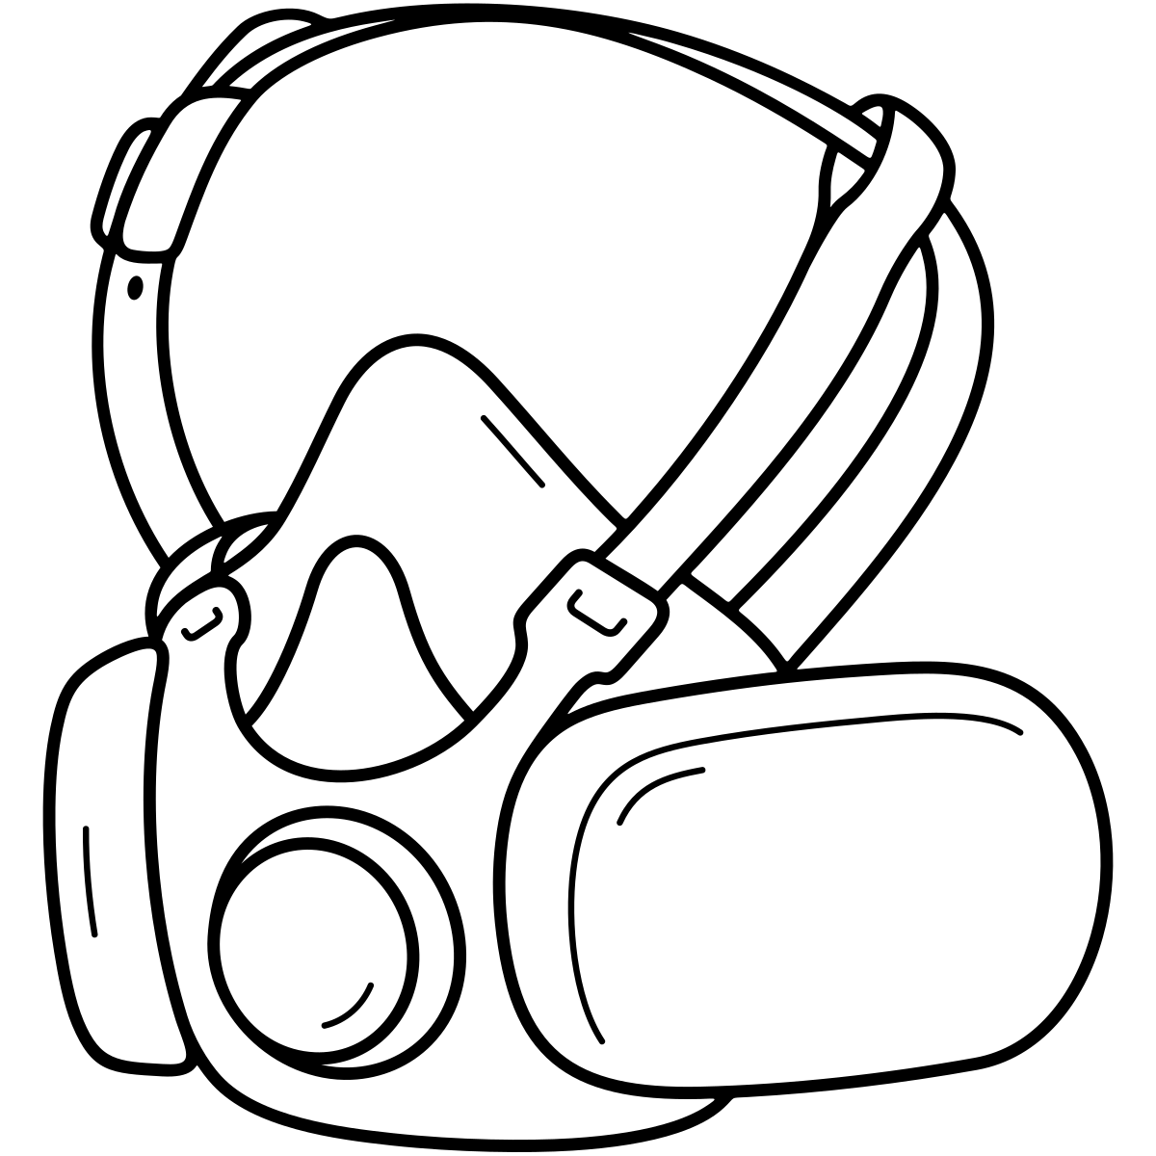
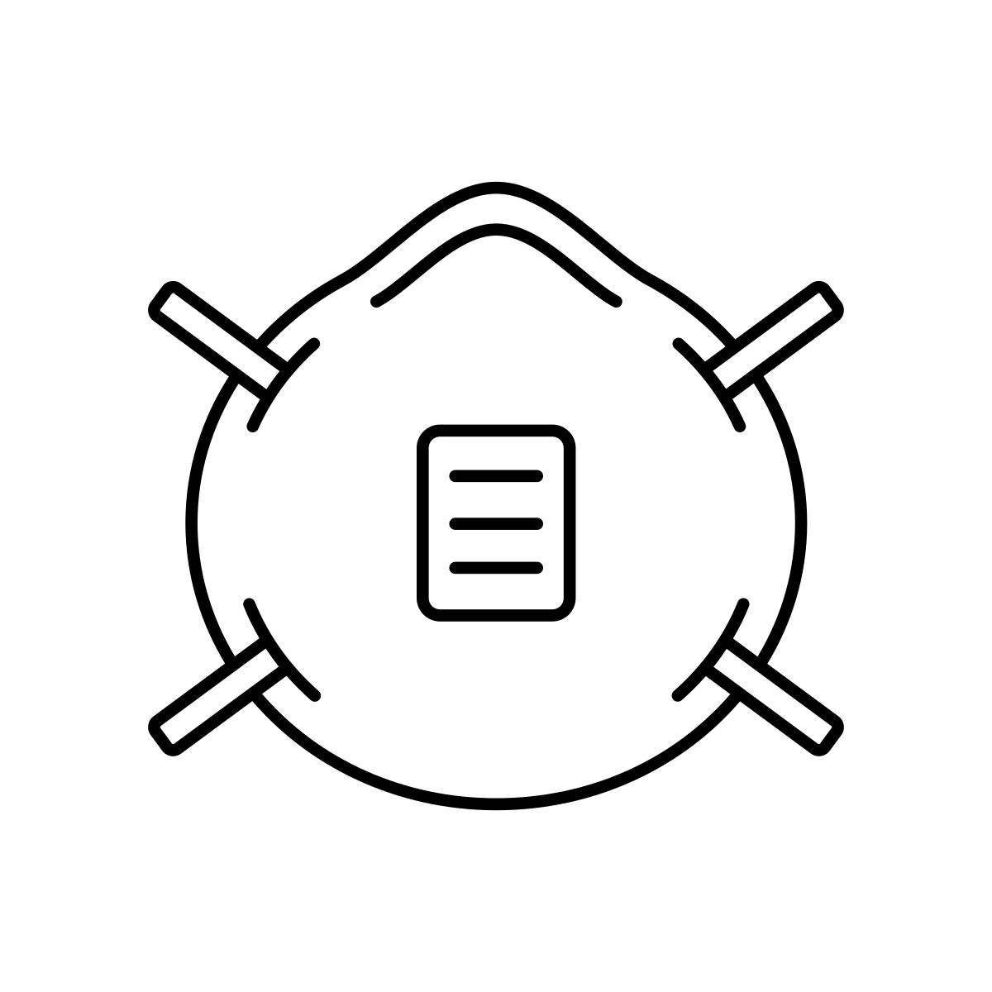



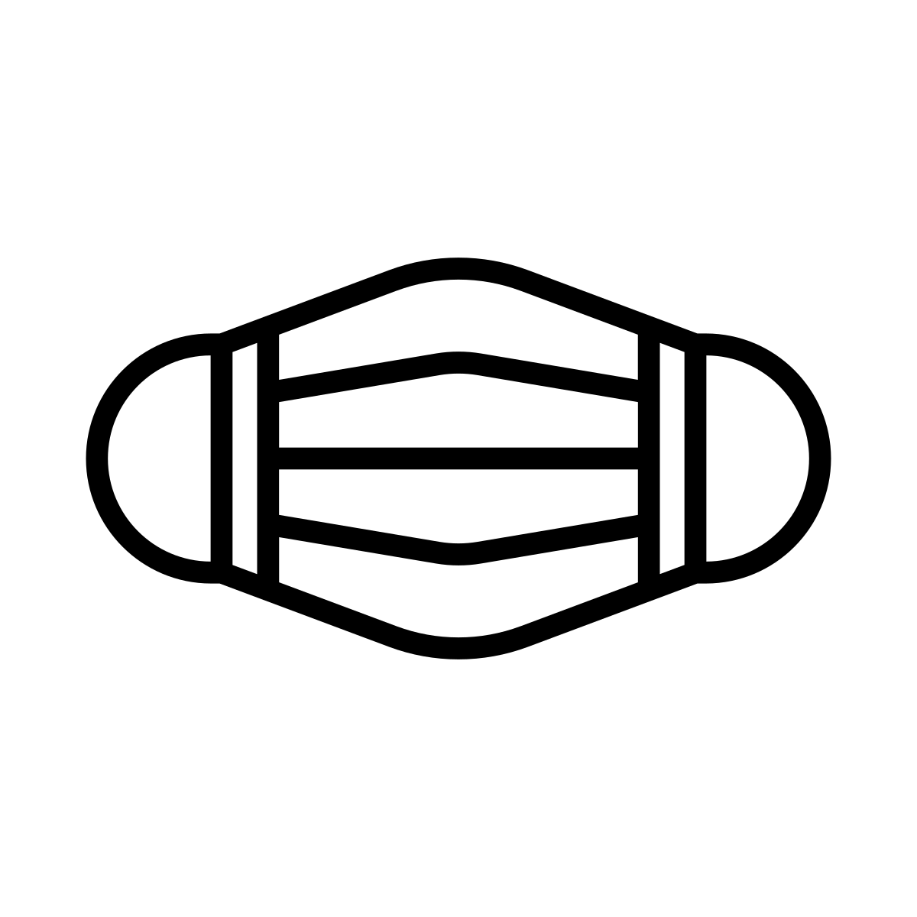
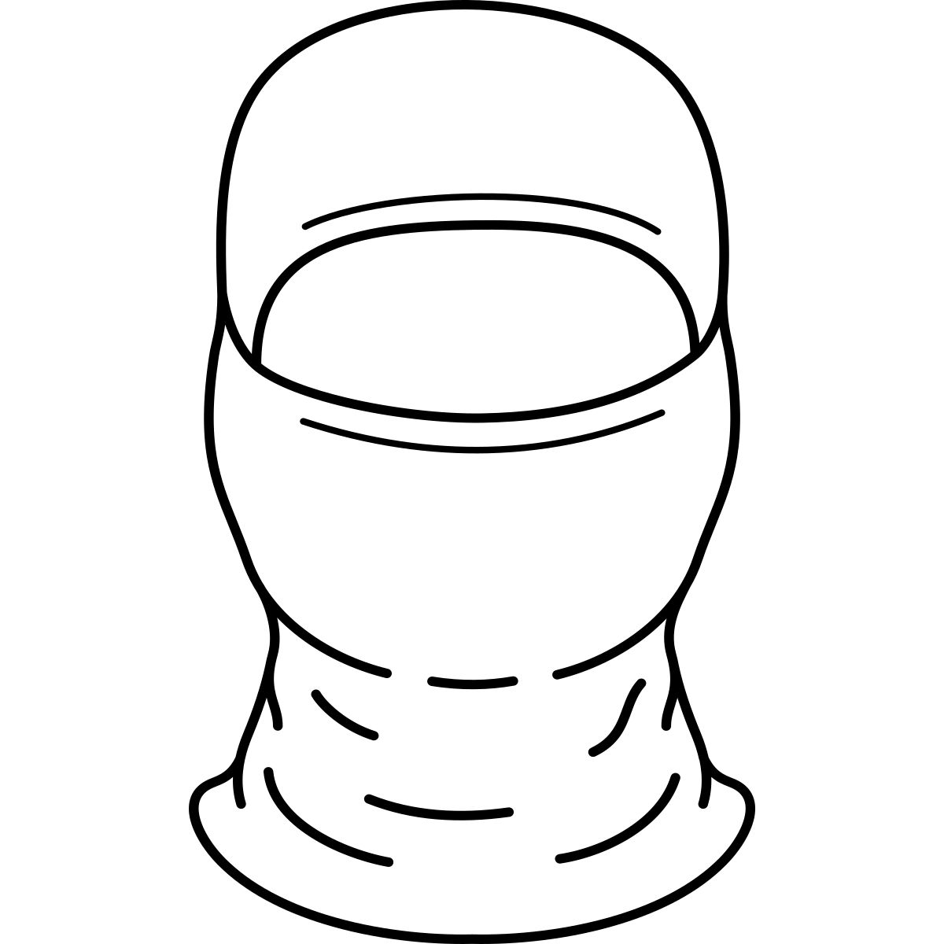
Choosing the right mask for wildfire smoke and clean-up activities
MOST PROTECTION | GOOD PROTECTION | OK | NOT RECOMMENDED
P100 Elastomeric/reusable | N95 | KN95 | Medical mask, cloth covering, bandana, or no mask
Reusable, but expensive and heavy to wear. | Affordable, more comfortable (especially with an exhale valve), and disposable. Requires an airtight face seal to work well. Replace with new mask after multiple wears. | Affordable, comfortable, and disposable. Requires an airtight face seal to work well. Available in children’s sizes. | Not enough protection.
Use these options for spending time outdoors during smoke or when handling fire debris. See handout C for PPE to wear on the rest of your body for fire debris. |  | In general, these masks have not been shown to be effective against small smoke particles, dust, and toxic fire contaminants, and may create a false sense of safety.
14
Discussion: Do you have masks handy for a smoke event? In your emergency kits?
EPA Mask Information: https://www.epa.gov/sites/default/files/2018-11/documents/respiratory_protection-no-niosh-5081.pdf
Notes:
• For smoke and fire debris, the best protection comes from a NIOSH-approved respirator with a tight face seal.
• A P100 offers more filtration but is heavier and more difficult to wear; an N95 is often more practical if it fits well.
• Cloth and surgical masks do not provide adequate protection from fine smoke particles, and facial hair interferes with the seal.

Slide 15
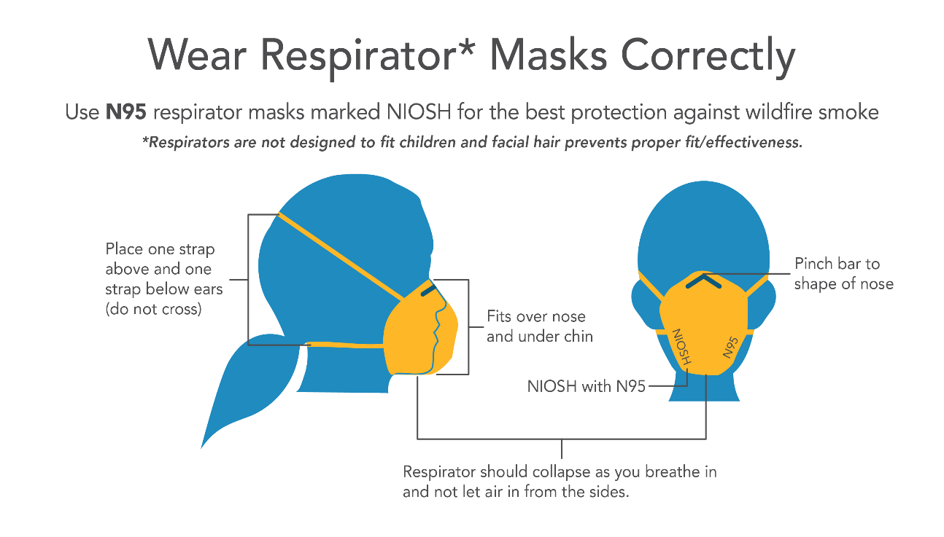
How to wear masks correctly
How to wear respirator masks correctly for your safety:
Use *NIOSH-approved P100 or N95 masks for the best protection against wildfire smoke. Respirators are not designed for children or for those with facial hair.
Pinch bar over the bridge of your nose
Place one strap above your ears and one strap below your ears. Do not cross the straps.
Fit over the nose and under the chin
Look for the NIOSH (*National Institute for Occupational Safety and Health)-approved label for certified protection
The respirator mask should collapse against your face as you breathe in and should not leak air in from the sides
Note: No masks work effectively with facial hair (like beards), as it prevents a proper seal on the face and allows smoky air to enter.
Bottom figure: https://ww2.arb.ca.gov/news/california-battles-wildfires-officials-outline-how-protect-yourself-and-your-family-damaging
Notes:
• Demonstrate the two straps, nose clip, and coverage under the chin.
• Ask users to check for air leaking at the sides; the respirator should draw inward slightly when they inhale.
• A respirator that is uncomfortable, damaged, dirty, or repeatedly reused may not protect as intended.

Slide 16

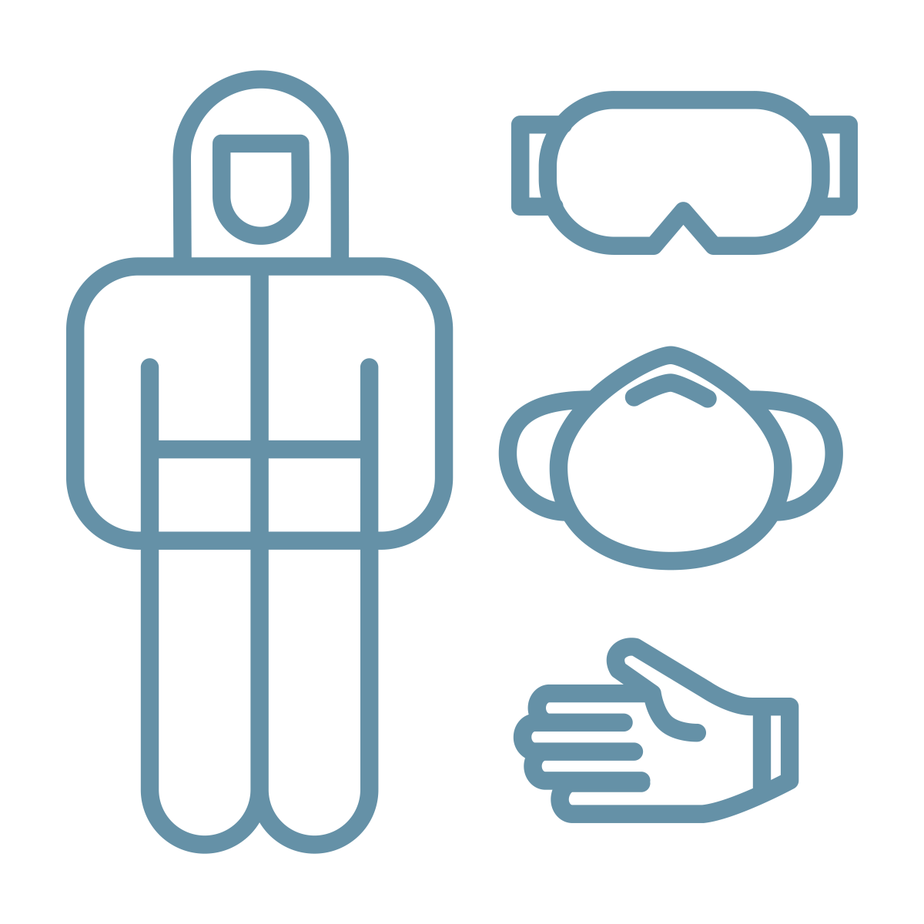

Learning Activity:
Match each activity on the left (A-E) to the best types of smoke protection on the right (1-6). Discuss what may not work for some people, or strategies that may not be an option in your situation.
You can choose more than one way to protect yourself!
ACTIVITY
WAYS TO PROTECT YOURSELF AND OTHERS
Teaching kids in a classroom while there is an active wildfire nearby.
Exercising outside during a nearby wildfire
Working from home while there is a wildfire nearby
Cleaning a home affected by smoke and ash after a fire
Visiting a burned site, sifting through ash and looking for sentimental items.
Stay indoors, close doors and windows
Use or make an air purifier
Wear a NIOSH-approved P100 respirator mask
Wear a NIOSH-approved mask, goggles, gloves, boots, and a Tyvek suit
Check HVAC to make sure it isn’t bringing in more smoke (turn it off, change filters, or if it needs to be on, use a setting to recirculate indoor air)
Avoid heavy exercise and instead choose calm indoor activities like reading, playing games, art, yoga, tai chi, or stretching.
Notes:
Good practices include:
A: 1, 2, 6
B: 1, 6
C: 1, 2, 5, 6
D: 3, 4
E: 3, 4
• See facilitation guide. Have participants match more than one protection to each situation; layered protection is usually best.
• For classrooms and homes, focus on closing the space, filtration, and calmer indoor activity. For cleanup and ash sifting, focus on a respirator and full PPE.
• Discuss what may be unavailable or unrealistic and identify alternatives or supports.

Slide 17
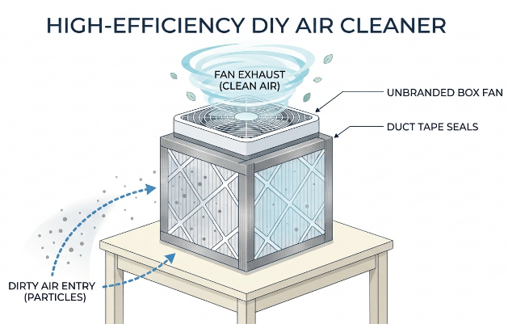
Tips, resources, and further reading
Stay indoors and reduce smoke exposure during wildfires.
Use indoor air purifiers!
  How to make your own air purifier for less than $100: https://corsirosenthalfoundation.org/instructions/
  Filter type should be MERV13 or higher
Make sure that your air conditioning (A/C) or HVAC system is not bringing smoke indoors. See slide 12.
Leave shoes outside to reduce the amount of dust and ash brought indoors.
Create a "clean air room" for vulnerable individuals, such as babies, young children, and those with health conditions. Choose an interior room away from doors or outdoor drafts, keep it sealed, and use an air purifier/filtration system to block out smoke, ash, soot, and dust.
  https://ehsc.oregonstate.edu/our-research/research-highlights/wildfire-smoke-and-infant-health or
  https://www.epa.gov/emergencies-iaq/create-clean-room-protect-indoor-air-quality-during-wildfire
Clean surfaces using wet wipes or soap and water. Avoid brooms or dusters to keep from stirring up dust. Use a HEPA-filtered vacuum. See booklet C for more post-fire cleaning tips.
When air quality returns to healthy levels, consider airing out and cleaning your home if you live near the fires.
  https://lafirehealth.org/faq/#ventilate
If you experience medical symptoms, seek medical care. Have medications on hand.
Eating a healthy diet reduces the absorption of heavy metals that can be present in smoke. Eat your fruits and vegetables!
17
Notes:
• Use this slide as a practical checklist: cleaner indoor air, reduced tracking, wet cleaning, and medical follow-up for symptoms.
• A do-it-yourself Corsi-Rosenthal box can be a lower-cost filtration option when commercial purifiers are unavailable.
• When outdoor air becomes healthy, ventilate and clean the home, especially near the fire area.

Slide 18
Key Points:
Protecting yourself from harmful fire smoke
What you need to know to protect yourself!
1. Why is wildfire smoke dangerous to our health?
Wildfires that reach urban areas can create harmful smoke that poses health risks, especially when homes, cars, and other materials burn. This smoke can be more toxic than other air pollutants.
Air quality can change quickly. Reduce your exposure while the fire is active and until smoke warnings have been lifted.
18
Notes:
• Smoke from urban fires can be more harmful than ordinary air pollution because many materials are burning together.
• Conditions can change quickly, so protection should begin while the fire is active and continue until smoke warnings are lifted.
• The safest message is simple: less smoke exposure is better.

Slide 19
Key Points:
Protecting yourself from harmful fire smoke
What you need to know to protect yourself!
2. How do I know how bad the smoke is near me?
Use smoke-related air quality information, like the EPA AirNow Fire and Smoke Map (https://fire.airnow.gov/), which provides rapid smoke information. This map provides rapid smoke readings (AQI PM2.5) that regular general weather app air quality readings don’t capture. Also note that most air quality monitors measure only some pollutants and don’t capture everything burning during a fire, so it’s best to protect yourself from smoke as much as possible due to harmful contaminants.
19
Notes:
• Use the EPA AirNow Fire and Smoke Map for rapid PM2.5 information during a fire.
• Remember that even this map cannot identify every contaminant in urban-fire smoke.
• Use the measurements to guide decisions, while still taking precautions when smoke is nearby or conditions are changing.

Slide 20
Key Points:
Protecting yourself from harmful fire smoke
What you need to know to protect yourself!
3. What can I do to protect myself and others?
During the fire: Leave the smoke area if possible to reduce your risk of harmful exposures. If you can’t leave, stay indoors, close windows and doors, use air purifiers, and reduce indoor pollution (e.g., gas appliances, cleaning products).
After the fire: When air quality improves, air out your home, avoid dry sweeping, wet-wipe surfaces, use PPE and/or professional cleaning services if ash/shoot is present.
20
Notes:
• During the fire, leave the smoke area if possible; otherwise close the home, filter the air, and reduce indoor pollution.
• After outdoor air improves, ventilate carefully and clean settled material without dry sweeping.
• If ash or soot is present, use PPE or professional cleaning services.

