Slide 1

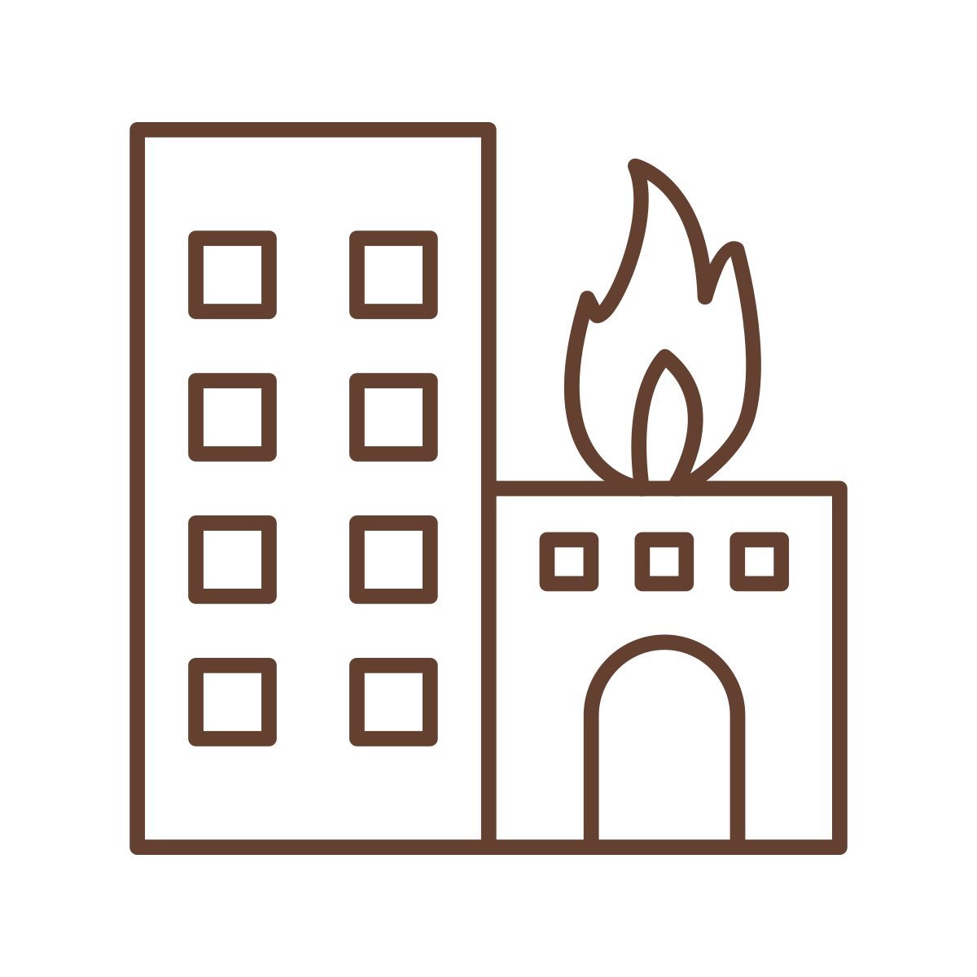
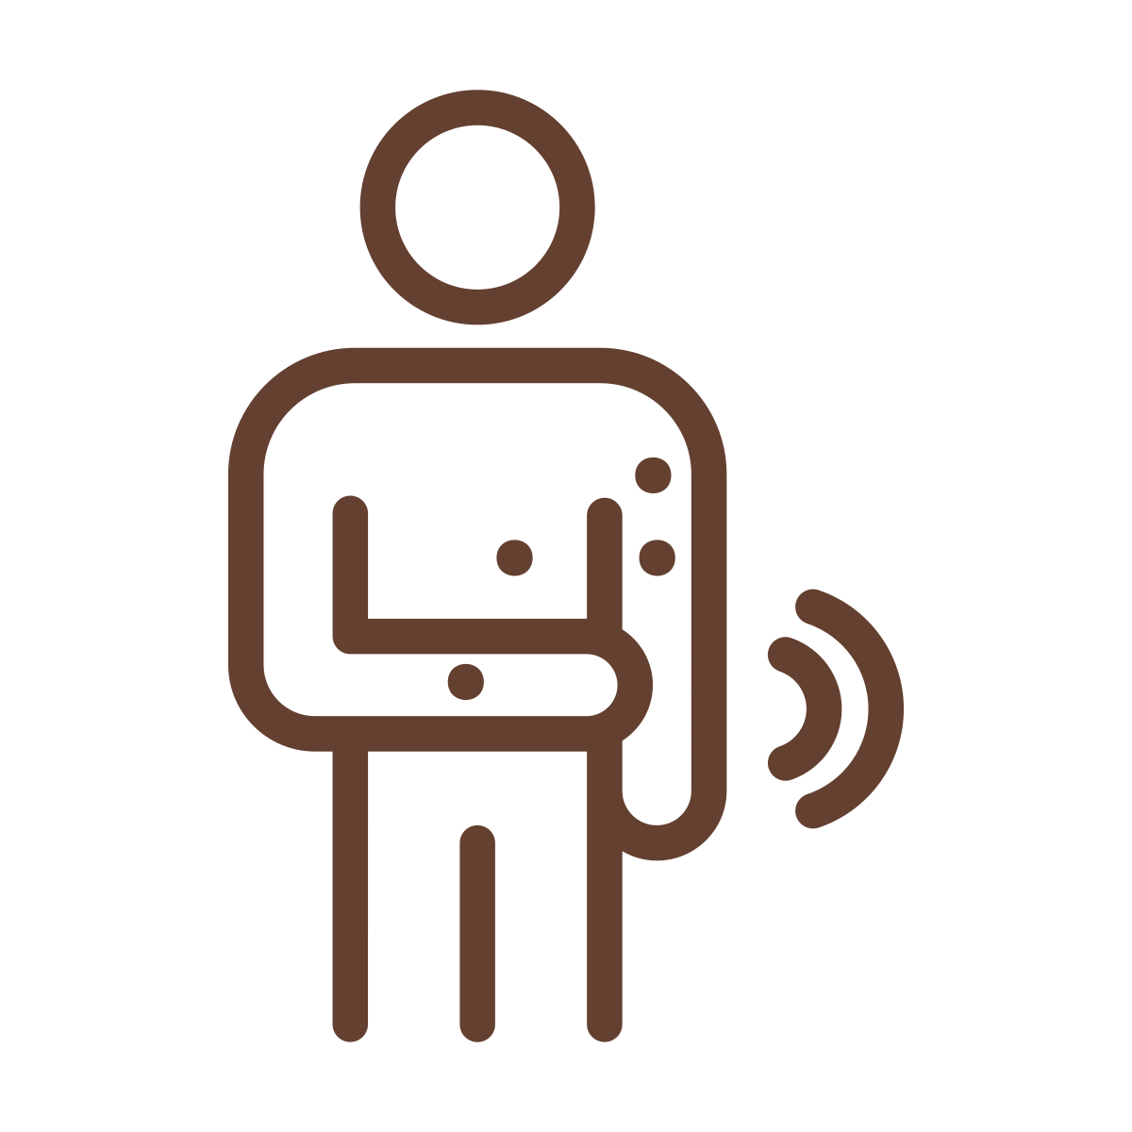



During the Fire: Smoke, Air Quality, and Protecting Yourself
Presentation A from the Understanding Health Impacts of Wildfires in Urban Areas series
Lead Authors: Savanna Carson, Katherine McNamara. For the complete list of authors, editors, and reviewers, see the website.

Slide 2

Health Impacts of Wildfires in Urban Areas
Agenda:
Wildfire smoke is unhealthy. It is even worse when fires reach urban areas!
Health effects of fire smoke and groups at higher risk
Types and routes of exposures from fire smoke, and contaminants
Understanding personal risk from fire contaminants
How to: Reducing exposure to smoke reduces your health risk
How to: Infographic/handout: Staying safe during and after fires
LEARNING ACTIVITY: Discuss how wildfire smoke exposure may affect people differently.
Review of key points
Series Note: This series addresses some of the health concerns from wildfires that reach urban areas. These fires are also called Wildland-Urban Interface (WUI) fires. Since the general public may not use the term WUI, we use “wildfires that reach urban areas” or, more briefly, “fires” to refer to large, catastrophic fires that may also burn buildings, cars, and other non-natural sources.
Key point!
Look for these “Key points” throughout this handout for the most important summaries.
Notes:
Preview of the presentation: health effects, who may face greater risk, how exposure happens, and practical ways to reduce smoke exposure.
• Let participants know the key-point boxes are the shortest path through the material.
• Invite questions, but note that later presentations go deeper into air quality, cleanup, and mental health.

Slide 3
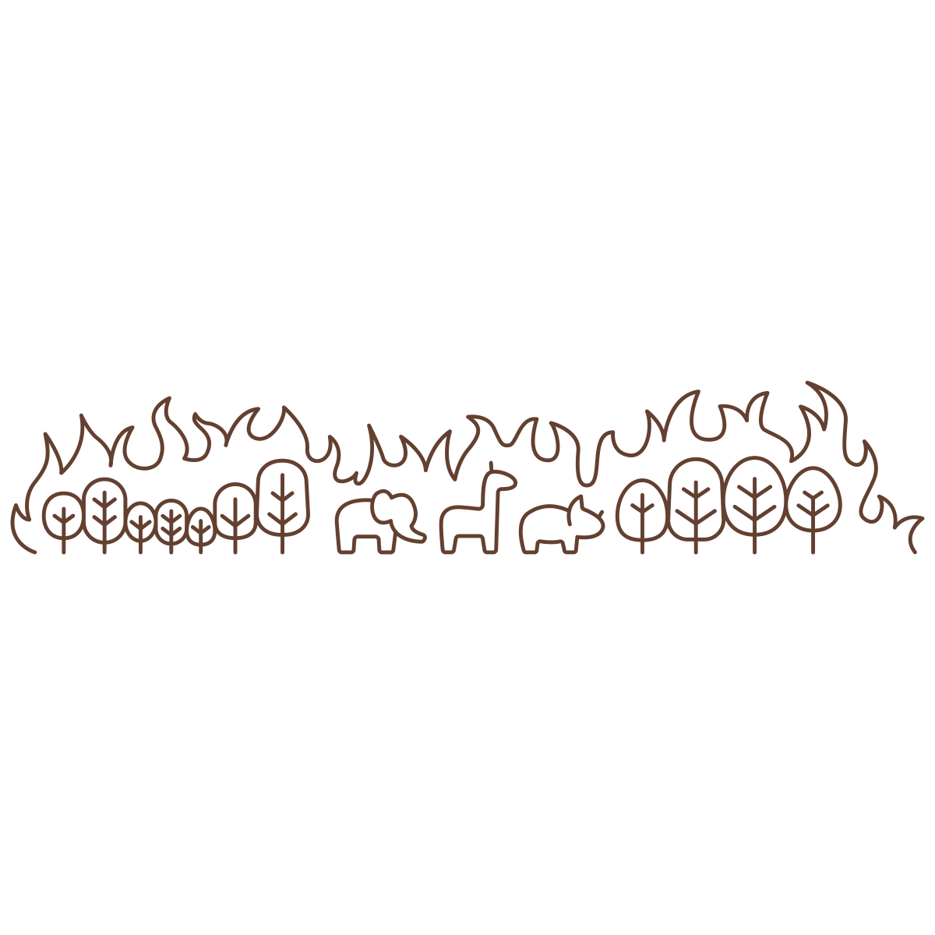
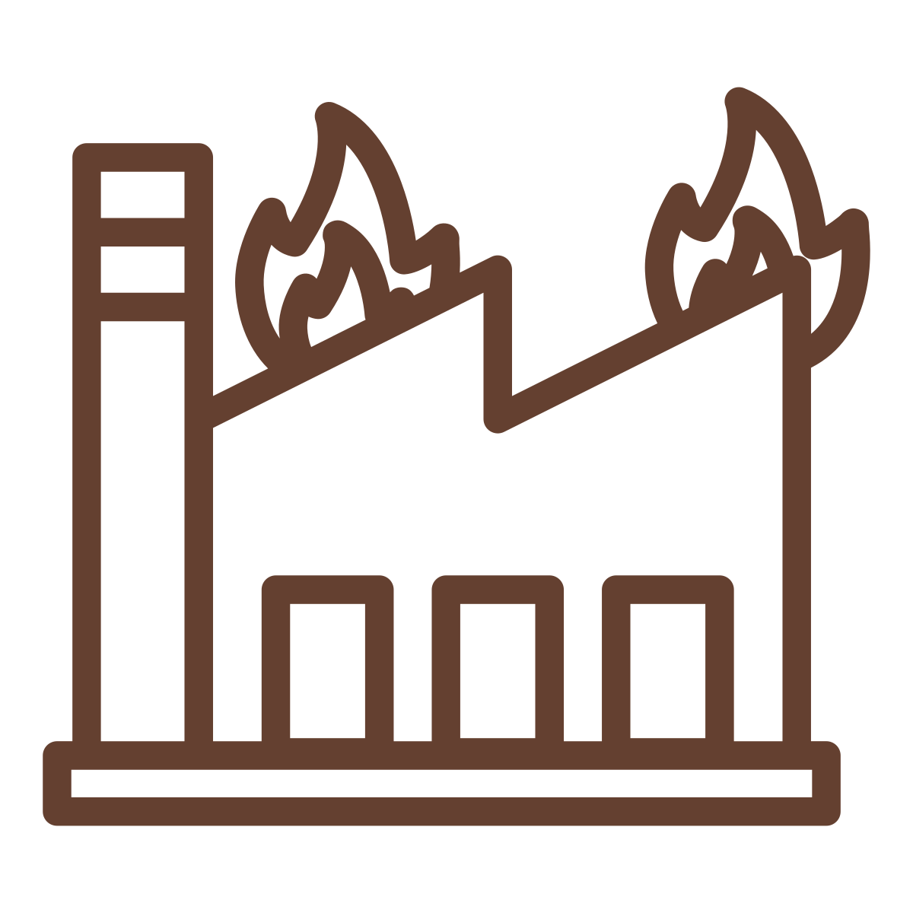
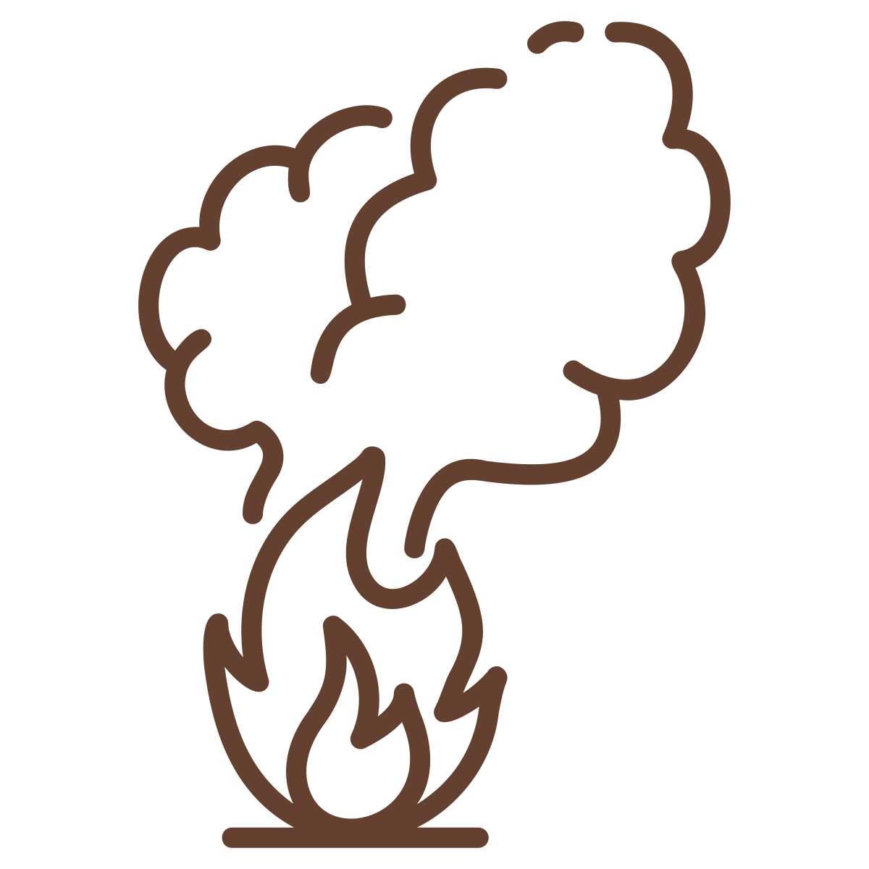
Wildfire smoke is unhealthy.
But it’s even worse when fires reach urban areas!
When wildfires reach urban areas and burn buildings, homes, cars, and chemicals, the smoke contains many more contaminants than smoke from burning forests alone. These are often called Wildland-Urban Interface (WUI) fires.
Any exposure to smoke from a fire can affect your health.
Unhealthy smoke to breathe
Even more unhealthy smoke to breathe
Wildfires that reach urban areas burn buildings, homes, appliances, cars, batteries, and the metals, paints, plastics, and chemicals inside them.
There are a large number of toxic contaminants in this smoke, making it very unhealthy to breathe.
Wildfires that burn forests, trees, plants, and other natural materials.
Even when natural materials burn, the smoke contains toxic contaminants, which are unhealthy to breathe.
Key point!
Minimize smoke exposure to protect your health during all fires, but especially during urban fires.
Notes:
• All wildfire smoke is unhealthy, but smoke becomes more complex when homes, cars, batteries, plastics, paints, and other materials burn.
• In general, it’s not always about identifying every chemical in the smoke to know if it’s bad for you. The practical response is to assume smoke is harmful and reduce exposure.
• Smoke may contain many contaminants not shown by routine air-quality readings adding to the reason you want to take precautions.

Slide 4
What are the health effects of fire smoke?
Smoke can affect many parts of the body, not just the lungs, and can worsen pre-existing conditions. These health risks can worsen during hot weather.
Respiratory impacts
Coughing, trouble breathing, wheezing, burning throat, shortness of breath, bronchitis, irritated sinuses, runny nose, and red/stinging eyes.
May lead to reduced lung function, increased asthma attacks, and worsen or increase the risk of lung diseases*
*Short-term vs. long-term health risks: Health effects with asterisks* may take longer to appear (e.g., weeks, months, or years after the fire) or may occur more often with repeated wildfire smoke exposure over time.
Mental/Brain health
Anxiety*, depression*, mental health conditions*
Headaches, dizziness
Pregnancy & Birth Outcomes
Early birth (preterm birth)*, low birth weight*
Cardiovascular risk
Heart attack, stroke, heart disease*, or increases in blood pressure, heart palpitations, or chest pain.
What can I do if I am worried about my health? Report any new, persistent, or worsening symptoms to your doctor, especially if you have other health conditions or have had severe exposures.
Direct fire damage
Burns, injuries, death
Other potential impacts (more research is needed)
Cancer*, eye disease*, diabetes*, educational delays in children*
Dermatitis/skin reactions, itching/irritation
Nausea, unusual tiredness/fatigue
Other brain impacts: dementia*, Alzheimer’s*, brain fog
Modified from: Gould CF, et al. Health effects of wildfire smoke exposure. Annual Review of Medicine. 2024 Jan 29;75(1):277-92. https://doi.org/10.1146/annurev-med-052422-020909
With data from: (1) Ma Y, et al. Long-term exposure to wildland fire smoke PM_{2.5} and mortality in the contiguous United States. Proc Natl Acad Sci U S A. 2024 (2) Lei Y, et al. Wildfire Smoke: Health Effects, Mechanisms, and Mitigation. Environmental Science & Technology. 2024 Nov 8;58(48):21097-119. (3) Ebinger et al. Emergency Encounters for Illness During and After the Los Angeles Wildfires. JACC. 2025 Dec 17. (4) Hubbard C, Abashidze N, Hennighausen H, James A. Catastrophic Wildfires & Suicide. Environmental and Resource Economics. 2026 Jul;89(7):48.
4
Notes:
• Smoke can affect more than the lungs. It affects the heart, brain, pregnancy outcomes, eyes, and mental health.
• Some effects appear quickly, while others may emerge after repeated smoke exposure or over a longer period of time.
• Encourage people to report new, persistent, or worsening symptoms to a healthcare provider, especially after heavy exposure or with existing health conditions, and particularly if any symptoms are serious.
Discussion: Have you felt any symptoms from recent wildfires or large fires?

Slide 5
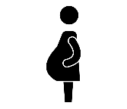
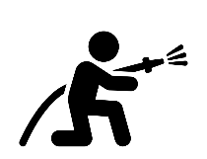
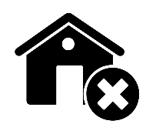
Who is most at risk for the health effects of fire smoke?
Certain groups are more likely to face health issues from smoke exposure.
Youth with developing lungs (under 25 years of age).
Pregnant People
People with Health Conditions: disabilities, chronic diseases, or weakened immunity.
Older adults
Workers: Firefighters, first responders, outdoor and clean-up workers with high exposures.
People with Limited Resources: Facing barriers related to housing, transportation, health coverage, health access, language access, or air filtration.
Racial and Ethnic Minorities: Disproportionately impacted by systemic barriers, higher exposures to air pollution, and existing health inequities.
People in several of these groups may face even greater health risks.
Discussion: Have you ever felt any health symptoms during smoke events from wildfires or fires? Who in your family or community is more vulnerable to health effects of fire smoke?
Modified from: Gould CF, et al. Health effects of wildfire smoke exposure. Annual Review of Medicine. 2024 Jan 29;75(1):277-92. https://doi.org/10.1146/annurev-med-052422-020909
With data from: (1) Ma Y, et al. Long-term exposure to wildland fire smoke PM_{2.5} and mortality in the contiguous United States. Proc Natl Acad Sci U S A. 2024 (2) Lei Y, et al. Wildfire Smoke: Health Effects, Mechanisms, and Mitigation. Environmental Science & Technology. 2024 Nov 8;58(48):21097-119. (3) Ebinger et al. Emergency Encounters for Illness During and After the Los Angeles Wildfires. JACC. 2025 Dec 17. (4) Hubbard C, Abashidze N, Hennighausen H, James A. Catastrophic Wildfires & Suicide. Environmental and Resource Economics. 2026 Jul;89(7):48.
5
Notes:
Some people have increased health risks when exposed to fire smoke, including children and young adults with developing lungs; pregnant people, older adults, and people with chronic conditions may be more sensitive.
• Workers and people with fewer resources may have higher smoke exposure and fewer options or ability to evacuate, filter indoor air, obtain masks, or access health care.
Discussion: Ask participants who in their family or community may need extra planning or support during a smoke event.

Slide 6

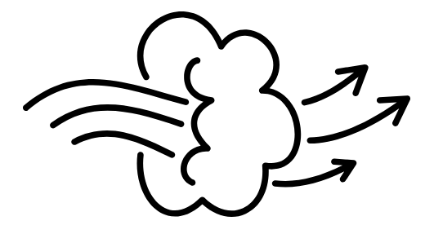
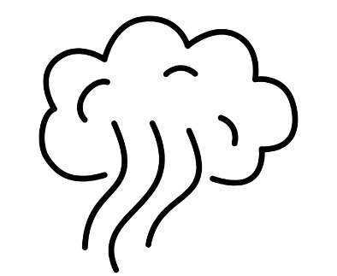
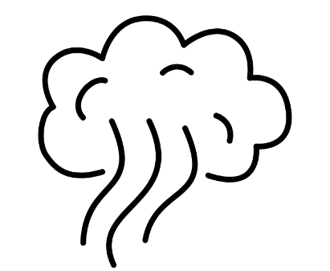
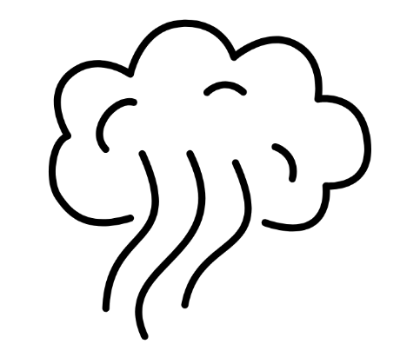

Smoke is the biggest health risk and the primary exposure for most people
Smoke can travel far from the fire, affect many communities, and expose people to harmful fire contaminants. After the smoke clears, it can also leave toxic ash and soot behind.
Breathing smoke is the easiest and most common way for these contaminants to enter your body and pose health risks.
Immediate/local 0-6 miles | Local/Regional 7-600 miles | Larger areas 600+ miles
Here are all the ways you may be exposed to fire contaminants (routes of exposure):
      Breathing in (inhalation) active smoke or disturbed dust/ash (i.e., from wind, dusting, cleaning, or construction)
      Skin or eye contact with settled dust or ash. If the water supply is affected, bathing.
      Accidentally swallowing (incidental ingestion) of settled dust or ash from food, or touching your mouth with unwashed hands after handling contaminated dust, ash, or soil. If the water supply is affected, drinking, showering, or cooking with the water.
Key point!
For most people, breathing in active fire smoke is the biggest health concern and exposure. Other types of exposure may matter more for some people with higher exposure to fire debris or dust, for example, those near burn zones, cleanup workers, firefighters, children playing directly with contaminated materials, and people with certain water sources.
Figure adapted from (1) National Academies of Sciences, Engineering, and Medicine 2022. The Chemistry of Fires at the Wildland-Urban Interface. Washington, DC: The National Academies Press, and (2) TECHNICAL BRIEF When the Dust Settles: Reducing Chemical and Particle Health Risks Following a Large-Scale Urban Fire, UL Research Institutes, 2023.
Notes:
• Active wildfire smoke is usually the biggest exposure concern because harmful smoke reaches deep into the lungs and gets in our bodies.
Smoke can also travel long distances, exposing people far beyond the fire area.
After the fire, exposure can continue through ash, soot, and dust that is disturbed and breathed in or comes into contact with the hands, skin, or eyes. However post-fire exposures are usually more localized, but may be important for people who regularly work, live, or play near burned areas. Workers near debris, children, and residents near burn zones may need additional precautions to reduce exposure to potentially harmful dust after the fire.

Slide 7
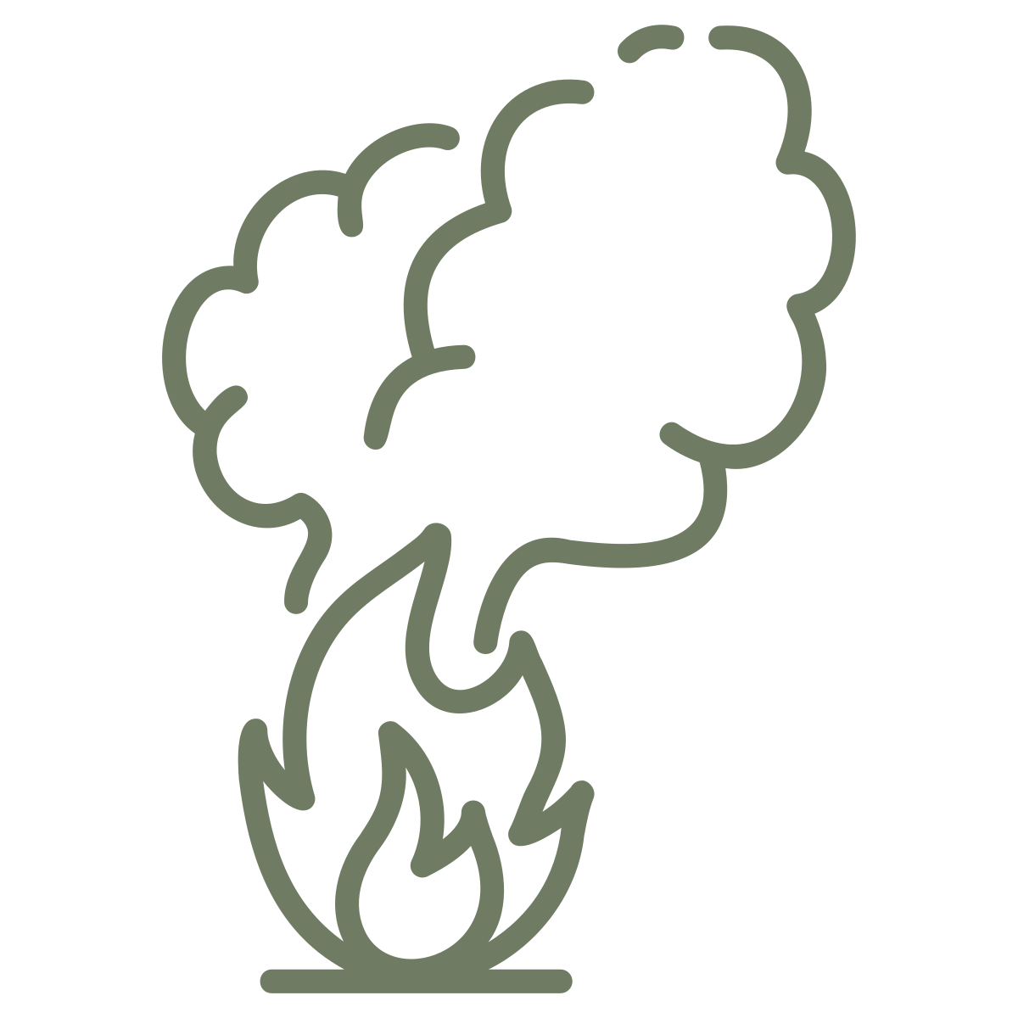


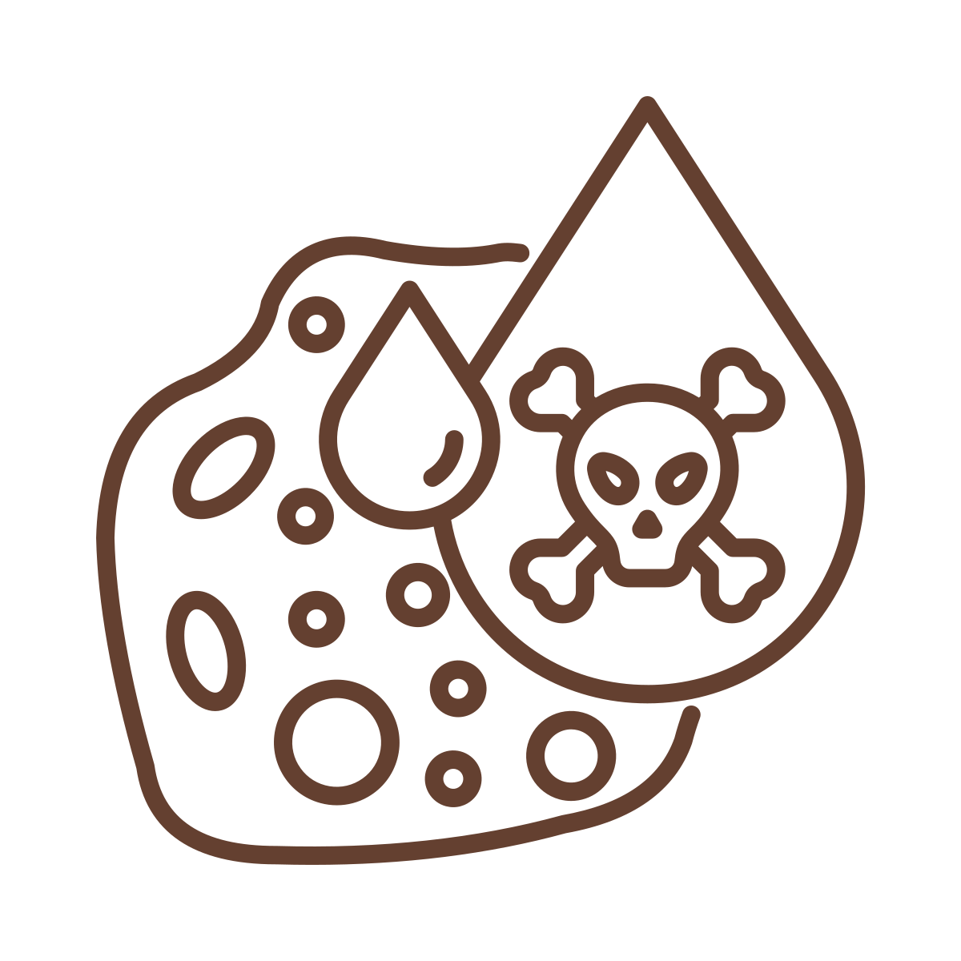
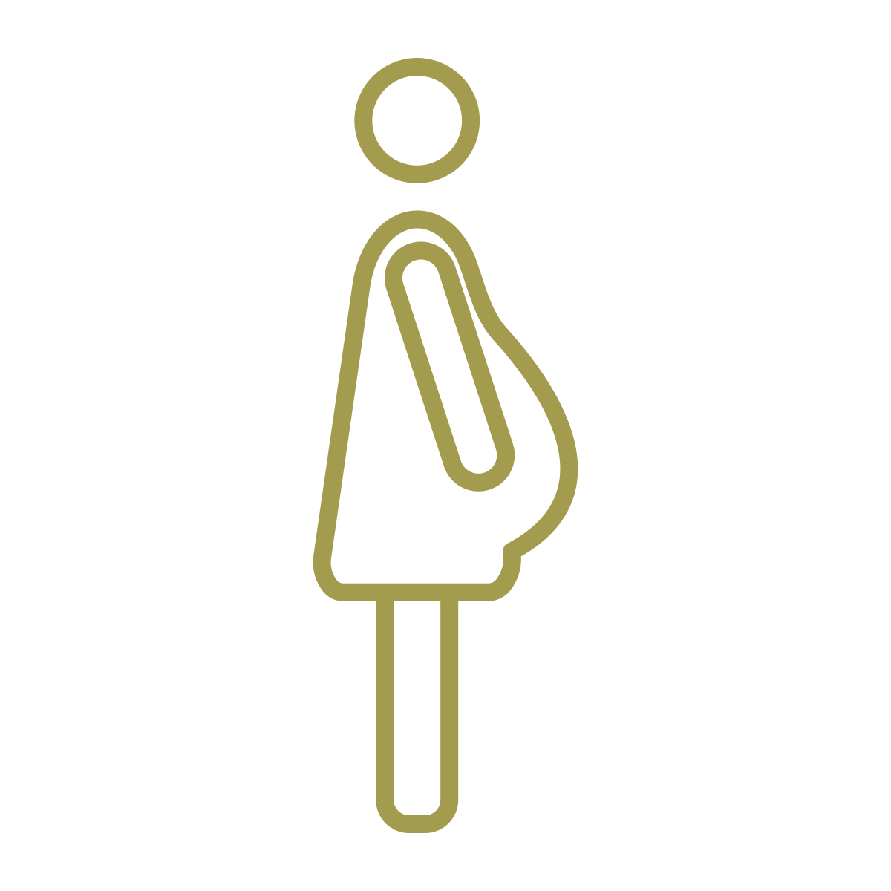
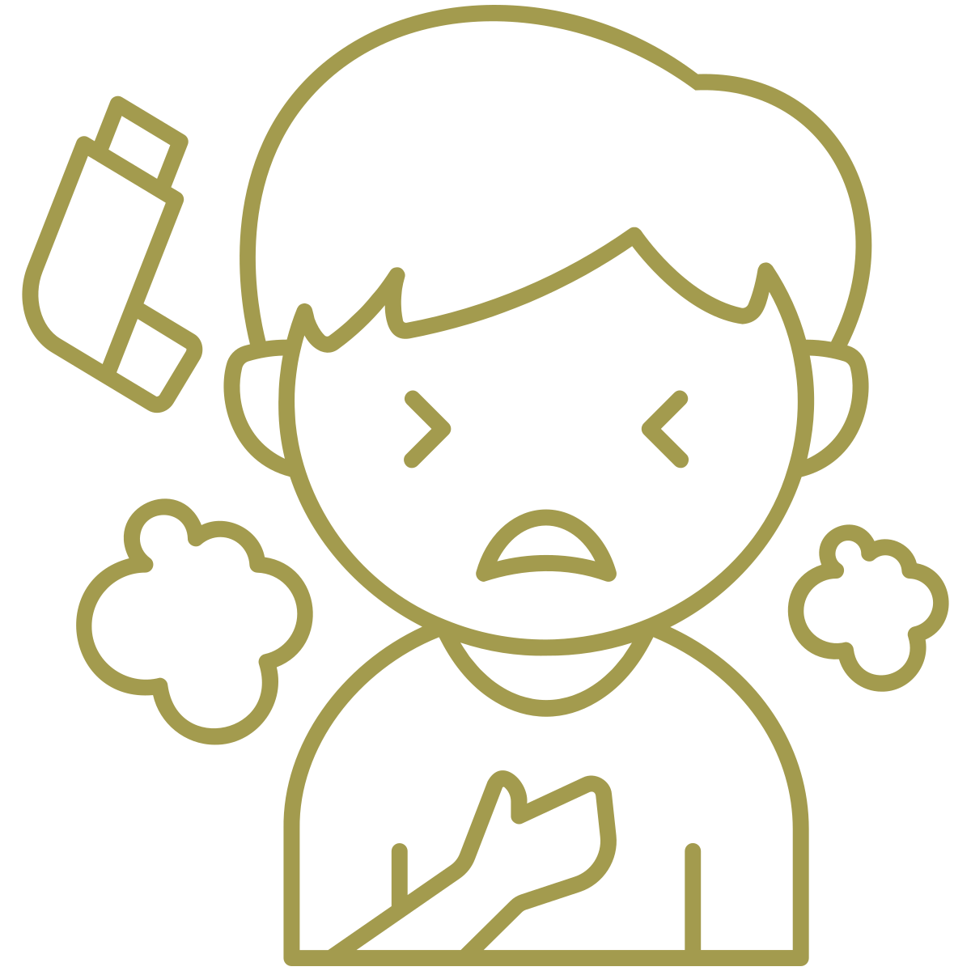
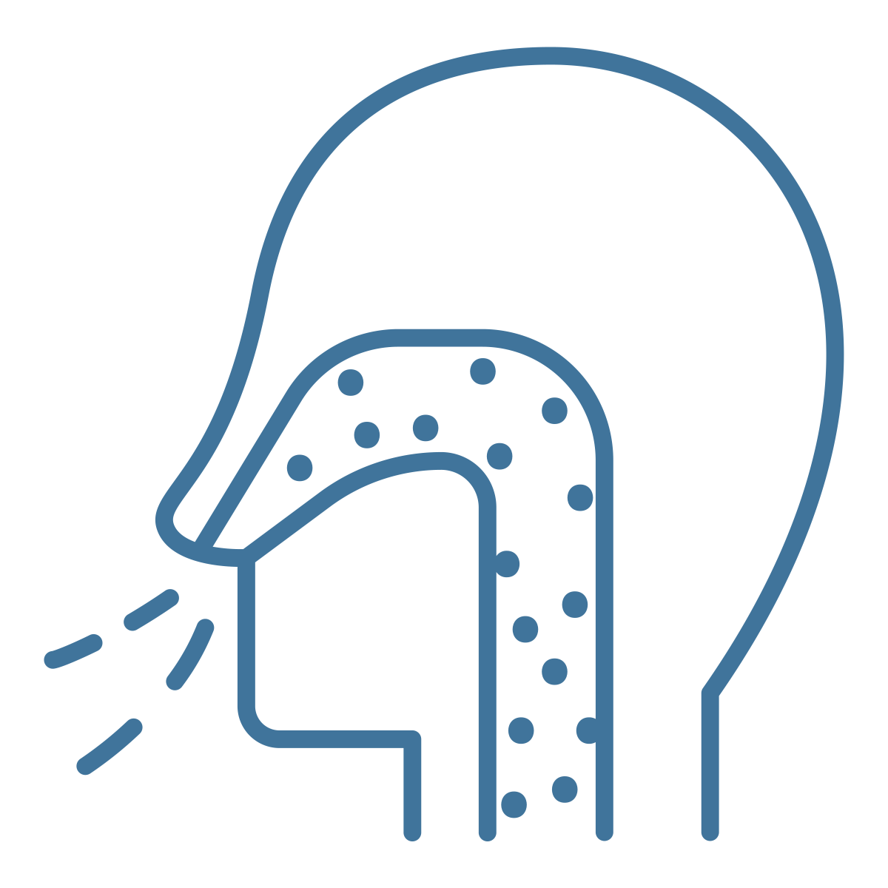
What is my health risk from fires? How do we assess contaminant exposure?
  Your total health risk from smoke and fire contaminants depends on four main factors:
  Examples of people who may have a higher risk of health impacts:
  An outdoor worker who is doing intensive physical labor near active fire smoke (high exposure), ends up breathing in heavy metals from nearby burned structures (high dose from higher breathing rate and high toxicity from the heavy metals), and who suffers from chronic coughing and bronchitis (more vulnerability).
  An older resident living directly downwind of a large fire that burned industrial warehouses (high exposure), where indoor air accumulates smoke (high toxicity), and who has a heart condition (more vulnerability).
Exposure
How much is around us
For example, how close one is to the fire and how much smoke is in the air.
Toxicity
How harmful the substance is
Vulnerability
Who is most sensitive
HEALTH
RISK
For example, lead affects brain development, and asbestos can cause lung disease, which can be released during fires.
For example, pregnant people, youth, the elderly, those with health issues, and people with limited resources.
Dose
How much gets into the body
For example, a person running in smoke will breathe faster and inhale more smoke than someone walking.
Notes:
• Health risk depends on four factors: what is present, how harmful it is, how much enters the body, and how vulnerable the person is.
• Two people in the same neighborhood can have different risks because their work, activity level, housing, health, and protective options differ.
• Use the examples to show that risk is a combination, not a single number or distance from the fire.
Discussion: What types of people in your communities may have had higher health risks due to all these factors?

Slide 8
Reducing exposure to smoke reduces your health risks
LEVELS OF PROTECTION
t
Reduce by: | Ways to reduce smoke exposure: | Advantages | Disadvantages
 | Evacuation or relocation | The best way to protect your lungs from inhaling smoke is to avoid or limit exposure. | May not be an option for those who are unable to leave for various reasons. May add costs, stress, or leave from work or school. Unknown timeframe. Smoke can still travel far.
 | Staying indoors with air purifiers | Reduces overall smoke exposure and is relatively, cost-effective. Close doors and windows and other vents or gaps that can let in smoky air. Works best with airtight homes. | Homes may not be airtight and can still let in smoke. Air conditioning or heating units can bring in smoke if not equipped with proper HEPA filters that are routinely maintained. If you don’t have filters (including most window units), turn the unit off or switch to recirculate. This can create more issues during hot weather. Air purifiers can be costly and may not remove all pollution (i.e., gases).
 | Staying indoors | Immediate, zero-cost. Close doors and windows. Blocks large ash and debris. | Homes may not be airtight and can still let in smoke. Impractical for outdoor workers or others who need to leave their homes. See air conditioning and heating unit notes above.
Varies | Going outside wearing a face mask | Convenient if you need to leave home for work, travel, or be outdoors. Effectiveness depends on an airtight face seal. Disposable N95 or P100 respirator masks are affordable and widely available. Refer to presentation B for proper mask options. | Only certain masks filter smoke (N95 or P100 respirators). Such masks: Not available for small children/babies May not be recommended for those with lung/heart disease Don’t protect against gas pollutants A false sense of security if not worn properly Can be uncomfortable to work in, especially in the heat Buying/replacing masks often is an expense. Repeated use can reduce a mask’s effectiveness. Does not work as effectively with facial hair.
Up to 100%!
~75%
(50-90%)
Discussion:
What are potential challenges with each option for you and for different people in your family or community?
Up to 50%
(30-50%)
Modified from: Xu R, et al. Wildfires, global climate change, and human health. New England Journal of Medicine. 2020 Nov 26;383(22):2173-81.
Notes:
• Present these as layers of protection, not perfect choices. Leaving the smoke area offers the most protection when it is safe and feasible.
• If leaving is not possible, staying indoors with filtration is usually the next strongest option; staying indoors without filtration still helps.
• A well-fitting respirator can help outdoors, but effectiveness drops sharply when the seal is poor, and masks do not remove gases.
Discussion: What are ways you can reduce your smoke exposure?

Slide 9
Reducing exposure to smoke reduces your health risks
LEVELS OF PROTECTION
Reduce by: | Ways to reduce smoke exposure: | Advantages | Disadvantages
 | Evacuation or relocation | The best way to protect your lungs from inhaling smoke is to avoid or limit exposure. | May not be an option for those who are unable to leave for various reasons. May add costs, stress, or leave from work or school. Unknown timeframe. Smoke can still travel far.
 | Staying indoors with air purifiers | Reduces overall smoke exposure and is relatively, cost-effective. Close doors and windows and other vents or gaps that can let in smoky air. Works best with airtight homes. | Homes may not be airtight and can still let in smoke. Air conditioning or heating units can bring in smoke if not equipped with proper HEPA filters that are routinely maintained. If you don’t have filters (including most window units), turn the unit off or switch to recirculate. This can create more issues during hot weather. Air purifiers can be costly and may not remove all pollution (i.e., gases).
 | Staying indoors | Immediate, zero-cost. Close doors and windows. Blocks large ash and debris. | Homes may not be airtight and can still let in smoke. Impractical for outdoor workers or others who need to leave their homes. See air conditioning and heating unit notes above.
Varies | Going outside wearing a face mask | Convenient if you need to leave home for work, travel, or be outdoors. Effectiveness depends on an airtight face seal. Disposable N95 or P100 respirator masks are affordable and widely available. Refer to presentation B for proper mask options. | Only certain masks filter smoke (N95 or P100 respirators). Such masks: Not available for small children/babies May not be recommended for those with lung/heart disease Don’t protect against gas pollutants A false sense of security if not worn properly Can be uncomfortable to work in, especially in the heat Buying/replacing masks often is an expense. Repeated use can reduce a mask’s effectiveness. Does not work as effectively with facial hair.
Up to 100%!
~75%
(50-90%)
Up to 50%
(30-50%)
Modified from: Xu R, et al. Wildfires, global climate change, and human health. New England Journal of Medicine. 2020 Nov 26;383(22):2173-81.
Notes:
• Reinforce that people may combine several protections, such as staying indoors, filtering the air, reducing activity, and wearing a respirator when outside.
• Acknowledge barriers such as cost, housing quality, work requirements, heat, transportation, and basic needs.
• Ask which options are realistic for the audience and what support would make the stronger options possible.
Discussion: What are ways you can reduce your smoke exposure?

Slide 10
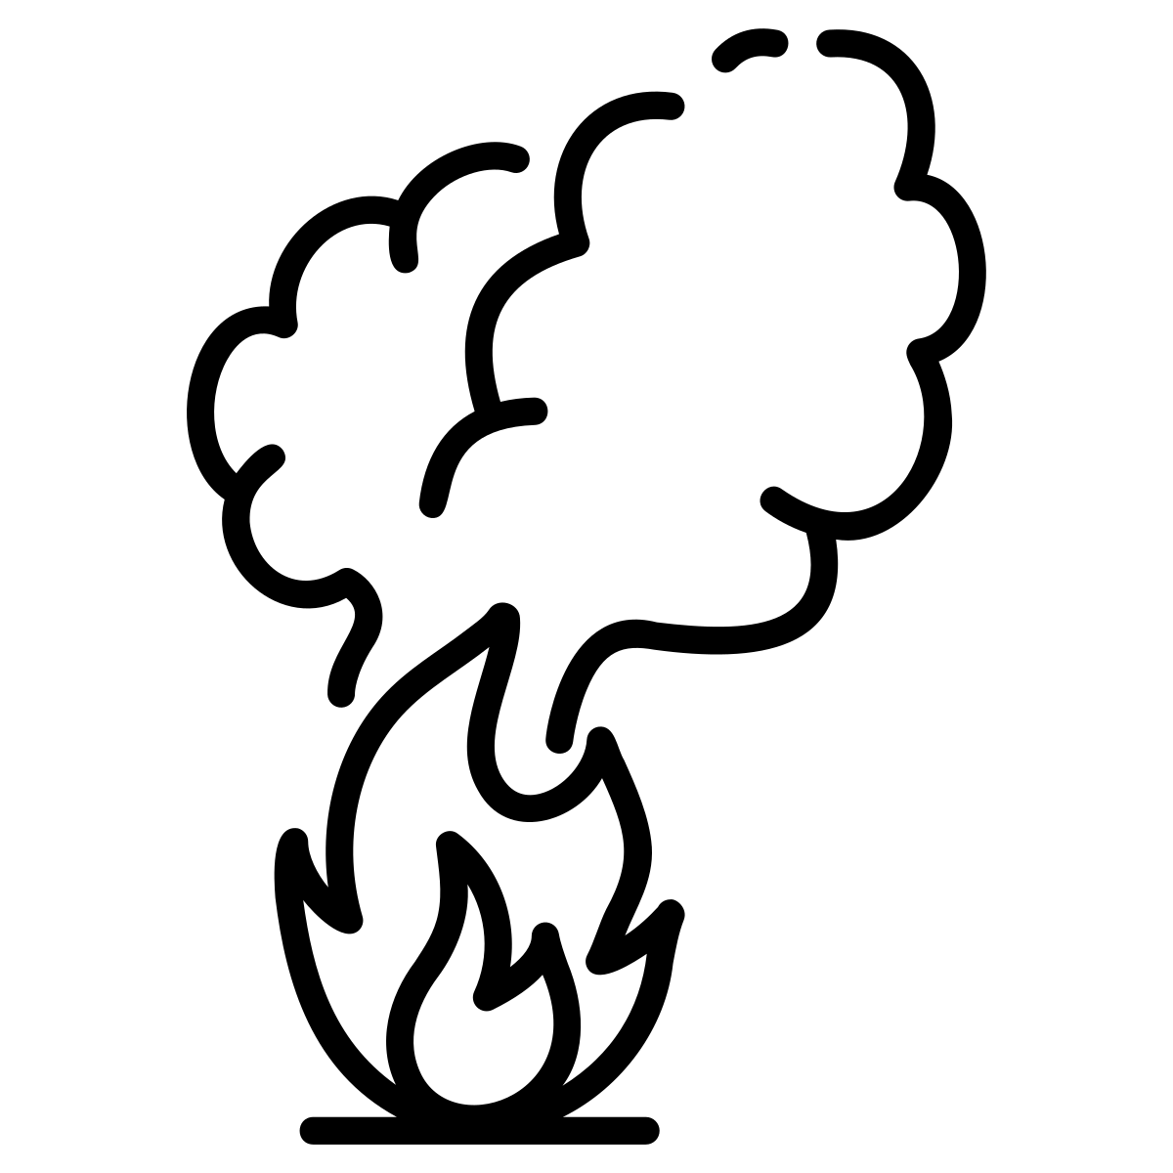






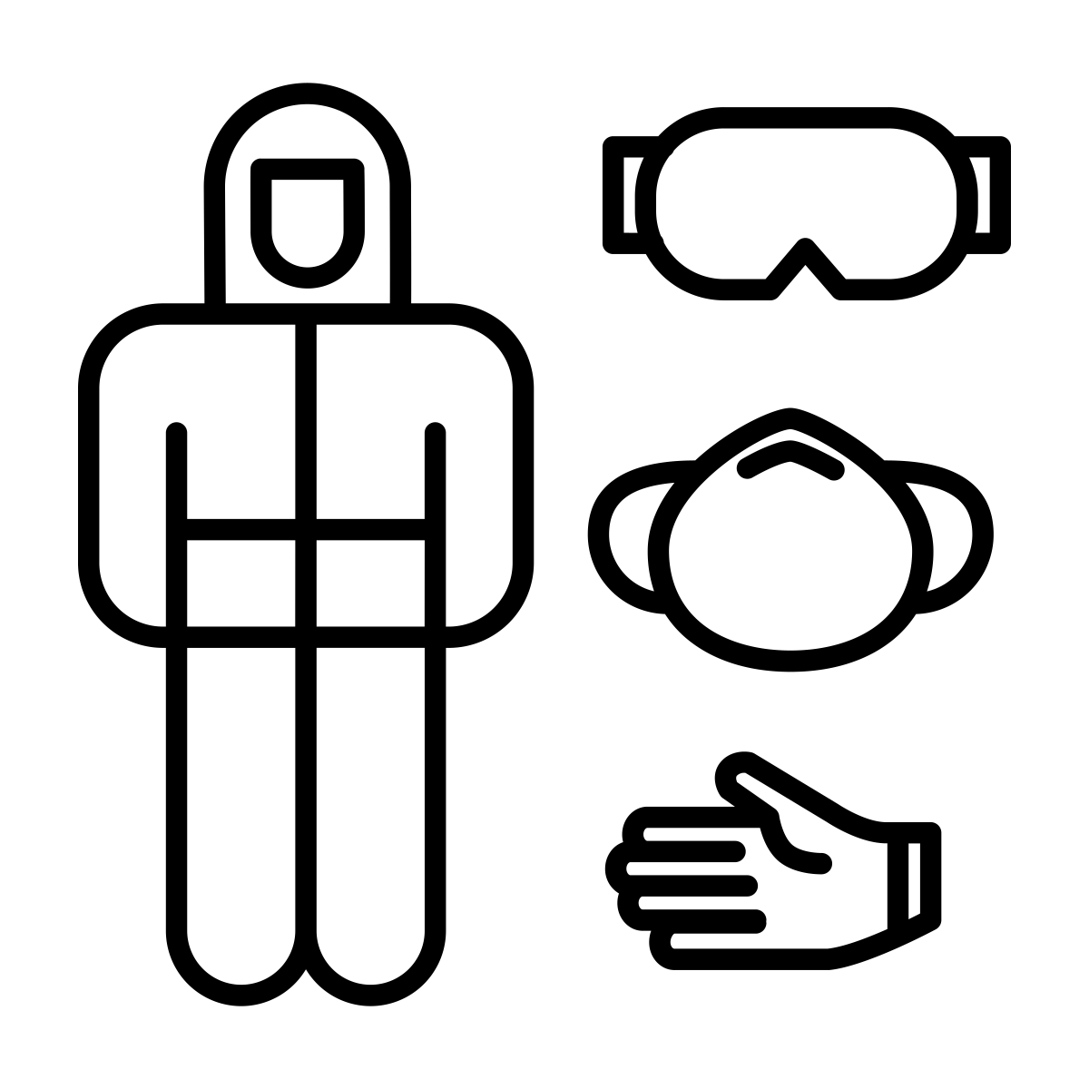



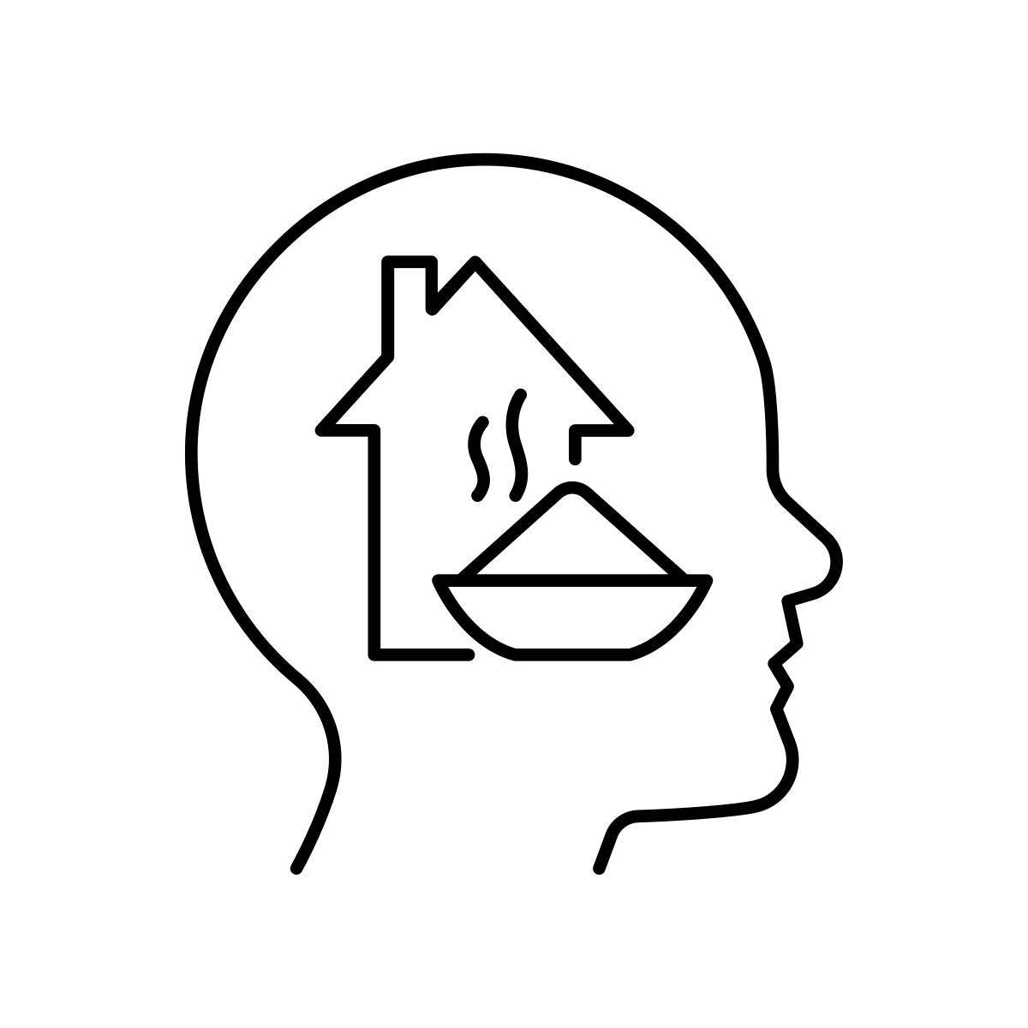

Staying safe during and after fires: Be W.A.R.E.
W Widen | Widen your distance from the smoke.
A Attention to Air quality | Attention to Air quality. Assume the smoke is dangerous. | If you can’t leave or are facing smoke: Stay indoors. Close doors and windows. Stay updated on evacuation notices. Wear masks outside (N95 or P100). Keep masks in emergency kit. Use air purifiers. Reduce indoor air pollution from gas stoves, candles, air fresheners, perfumes, and harsh cleaning solutions. Check smoke levels through the EPA AirNow Smoke and Fire Map. https://fire.airnow.gov/
R Reduce direct contact | Reduce direct contact with fire debris by wearing protective gear after the fire.
E Emphasize wellbeing | Emphasize physical and mental well-being. Check in on loved ones. Seek support when needed. | Talk with others and check in on loved ones and neighbors. Prioritize basic needs such as eating, sleeping, and housing. Outside of essential information, take breaks from media, which can increase stress.
The safest way to reduce exposure is to leave the area.
EPA
AirNow
Smoke
Map
Wear appropriate personal protective equipment (PPE) when handling fire debris, including soot, char, ash, or dust.
10
Notes:
Here’s an easy way to remember what to do during and after a large fire:
• The safest option is to reduce exposure to smoke by getting farther away from it. If people must remain nearby, close the home, filter the air, wear appropriate protection, and follow evacuation information.
• After the fire, avoid direct contact with ash and debris and remember that physical and mental well-being are both part of safety.

Slide 11
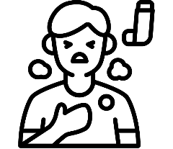
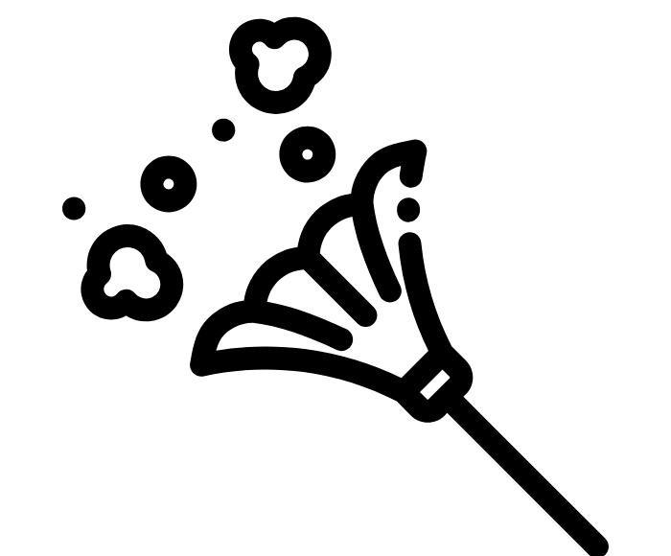
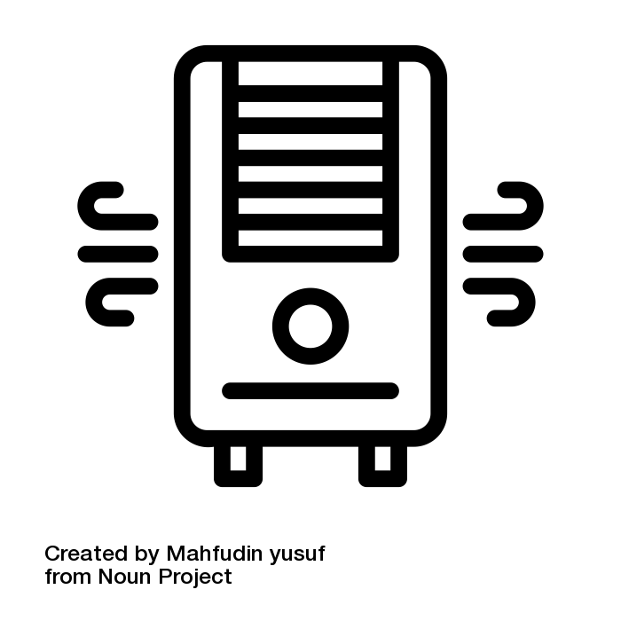
Learning Activity:
Discussion: Each scenario below takes place during and after a fire in or near the fire zone.
Consider each person below: What exposures might they have? What could help reduce their exposure?
Grace: She is 10 years old, has asthma, lives directly across from the fire zone, but her apartment is not damaged, and she walks to school.
Clara: She is 60 years old, has high blood pressure, and works in housekeeping in the fire zones. It’s hard for her to do housekeeping while wearing a mask, and she doesn’t think she needs to wear one indoors. She doesn’t want her clients to think she is sick because she is wearing a mask.
Juan: He is 35 years old, evacuated from his home during the worst smoke days, but strong winds and dust are frequent during the ongoing clean-up and rebuilding. He has been concerned about fire-related pollutants and has bought high-quality air purifiers to run daily.
Key point!
We want to protect ourselves and those we care about from toxic exposure, such as smoke and soot in dust after a fire, especially if we are at higher risk. Some people may face greater health risks, higher exposures, or fewer ways to protect themselves after a fire.
Notes:
See facilitation guide. Give groups a few minutes to identify each person’s likely exposure, vulnerability, and realistic protective options. There may be more than one good answer. Focus on practical steps and the barriers each person faces.
Answer summary:
Grace is most affected by outdoor smoke and smoke entering her apartment or school;
Clara by indoor smoke and cleanup-related exposures;
and Juan by dust and pollutants associated with rebuilding activities.
Monitoring air quality, limiting outdoor activities during periods of poor air quality, keeping indoor air clean by closing doors and windows during smoke events, using air purifiers, and wearing a well-fitting N95 respirator during higher-exposure activities can help reduce risk. Grace may also need alternative transportation to school when air quality is poor.

Slide 12
Key Points:
Health Impacts of Wildfires that Reach Urban Areas
What you need to know to protect yourself!
1. How does smoke from large fires harm health?
Wildfire smoke can cause health issues:
  Irritation in your eyes, nose, and throat
  Coughing and trouble breathing
  Harm to your lungs, heart, brain, and mental health
  Note: These health risks worsen during hot weather.
When wildfires reach urban areas and burn homes, cars, and chemicals, the smoke becomes much more toxic than smoke from burning forests alone.
Even if you're far from the flames, smoke can travel long distances and make the air unsafe to breathe.
Smoke is the biggest health risk for most people. Touching toxic ash, soot, dust, or contaminated water after the fires can also harm your health.
12
Notes:
• Summarize: wildfire smoke can irritate the eyes and airways and affect the lungs, heart, brain, pregnancy, and mental health.
• Urban fires produce a more complex mixture because buildings, vehicles, and household materials burn.
• Smoke can travel far, so distance from flames does not always mean the air is safe.

Slide 13
Key Points:
Health Impacts of Wildfires that Reach Urban Areas
What you need to know to protect yourself!
2. Who is at risk of health impacts from smoke?
Certain groups are more sensitive to health problems from smoke. These include infants and youth, pregnant people, people with disabilities or chronic health conditions, older adults, those at higher risk of exposure (like outdoor workers), populations with limited resources, and racial and ethnic minorities.
13
Notes:
• Some people are more sensitive, more exposed, or have fewer ways to protect themselves.
• Highlight youth, pregnant people, older adults, people with health conditions, workers, and people facing resource or access barriers.
• Risk can be higher when several of these factors overlap.

Slide 14
Key Points:
Health Impacts of Wildfires that Reach Urban Areas
What you need to know to protect yourself!
3. What can I do to protect myself and others?
Leaving the area temporarily is the best way to protect yourself from smoke. If traveling isn’t an option, stay inside, keep all doors and windows shut, reduce indoor sources of air pollution, and use air purifiers. Stay informed on evacuation notices. If you need to go outside, wear a tight-fitting mask and ideally a respirator (an N95 or P100). It is best to have professionals conduct post-fire cleaning, but if you must, use appropriate personal protective equipment (PPE) when cleaning up ash or moving debris after the fire.
14

Slide 15
Additional Health and Wildfires
Information

Slide 16

2025 Los Angeles fires: Health impacts
2025
LA Fires
Palisades and Eaton fires, 38,000 acres and ~16,000 structures
Note: The studies below may not represent the general population, as the data are from medical visits, including emergency room visits, which may reflect more vulnerable groups. We also don’t have general population details, including disparities in healthcare access and insurance coverage, or differences in symptoms and fire-related exposures.
Data Source | What was measured and when | Health impacts found
Los Angeles County Dept. of Public Health | ED (Emergency Department) visits across the county, compared to before and after the high smoke days¹ | During the peak of the smoke, Los Angeles County emergency room (ER) visits related to wildfires spiked, nearly doubling.
Cedars-Sinai Medical Center | ED visits up to 90 days after the fires, compared to 2018-2024, adjusting for COVID in 2020-2021² | Lung/pulmonary illness was 24% higher Heart attacks (myocardial infarction) was 46% higher Abnormal blood tests were 118% higher
Kaiser Permanente Medical Centers | Virtual/outpatient visits, 1 week after the fires, compared to the previous period³ | Respiratory visits were 34-41% higher Cardiovascular visits were 35% higher For the highly exposed groups, on the first full day of fire: Outpatient and virtual injury visits were 18% higher Neuropsychiatric visits were 18% higher
Los Angeles County Death Counts | All-cause mortality, one month after the fires, compared to 2018, 2019, and 2024 (except COVID yrs)⁴ | Deaths in LA County were ~7% higher following the fires
Kajita E. Notes from the field: emergency department use during the Los Angeles County wildfires, January 2025. MMWR. Morbidity and Mortality Weekly Report. 2025;74.
Casey JA,, et al. The 2025 Los Angeles Wildfires and Outpatient Acute Healthcare Utilization. medRxiv. 2025:2025.2003. 2013.25323617.
Ebinger JE, et alJ, Botting P, Tan ZS, Claggett BL, Kwan AC. Emergency Encounters for Illness During and After the Los Angeles Wildfires. JACC. 2025 Dec 17.
Paglino E, et al. Excess deaths attributable to the Los Angeles wildfires from January 5 to February 1, 2025. JAMA. 2025 Sep 16;334(11):1018-9.
Notes:
• These studies used different health systems, outcomes, and time windows, so they should not be treated as one combined estimate.
• Across the studies, however, the pattern was increased emergency, respiratory, cardiovascular, injury, and neuropsychiatric care around the fires, with an increase in county deaths in the following month.
• Name the limitations: medical-visit data miss people who did not seek care, and they do not fully describe differences in exposure, insurance, or access. Only adults. Not kids, not other vulnerable populations.

